Slide 1
The Assessment and Treatment of Anxiety Disorders as Crime Prevention
Kirk A B Newring, PhD
Nebraska CIP Children’s Summit
September 24, 2025

Slide 2
Introduction & Background
The initials
BS, MS, PhD, CTM, MGCP
The work & the warnings (sex, violence, generalizations)
Johnny Cash
Walla Walla, McNeil Island, Maple Lane, Green Hill School, and Echo Glen
D&E, LCC, NSP, TSCI, NCCW, NCYF, CCC-L, CCC-O, JJC, YAC, DCYC, & YRTC
Yankton, Deadwood, Rapid City, Sioux Falls, Brookings, Pierre, Harrison, Pottawattamie, Black Hawk
Federal Court, County Court, District Court, Mental Health Board, & Courts Martial
Kansas, Iowa, Texas, Washington, Nebraska, South Dakota, New Mexico
Why are we here?

Slide 3
Overview
Physiology of behavior
Dopamine
Watson, Thorndike, & Skinner
Anxiety
Trauma
Assessment & Treatment
Getting it wrong
Exploitation
Bluey

Slide 4
Physiology of behavior
Senses
Pathways
Sensory, motor
Central processing
Chemistry
Neurotransmitters
Dopamine
Glutamates
Decision-making & inhibition of behavior

Slide 5
Physiology of behavior
Brain’s self-talk is like play-by-play announcer
Like Brent Musburger calling a Husker game
Illusions
Magic
Animation
Hallucinations
Phantom Limits
Dr. Newring’s telekinesis

Slide 6
Dopamine
The cause of, and solution to, all of life’s problems
Learning and memory
Movement and goal-directed behavior (volition)
Cognitive function
Task persistence
Mood regulation
Above all: pleasure and reward

Slide 7
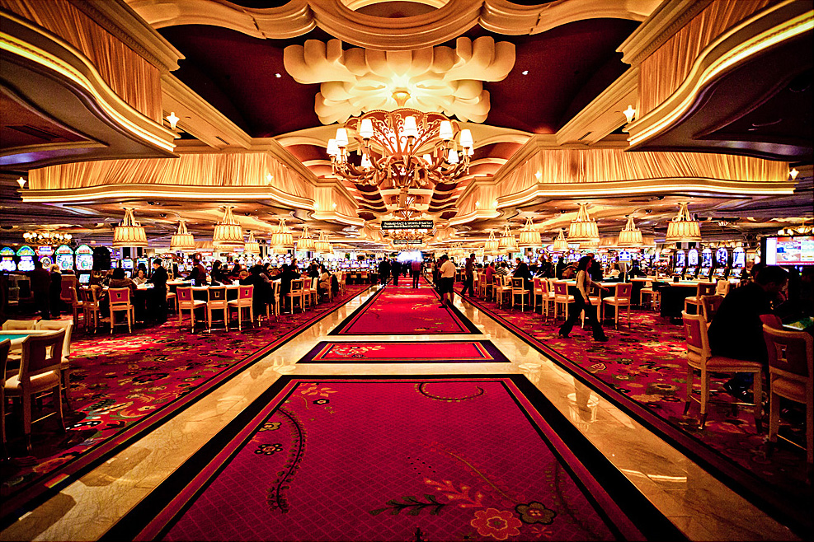
Dopamine

Slide 8

dopamine

Slide 9

dopamine

Slide 10
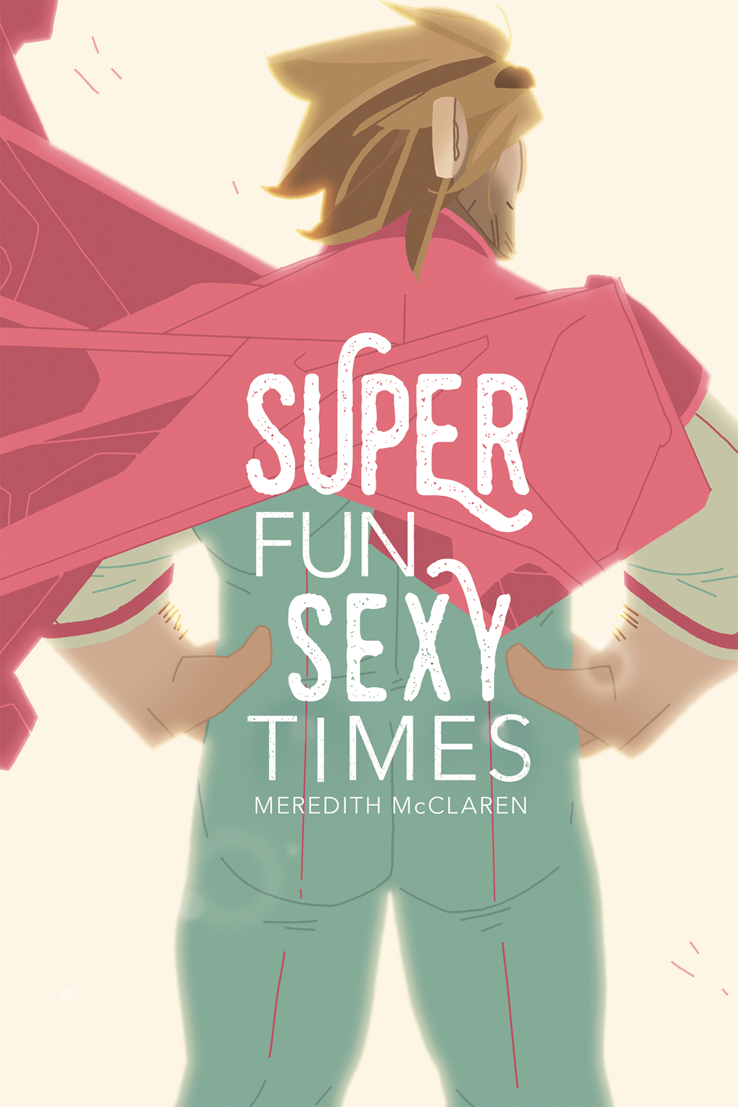
dopamine

Slide 11
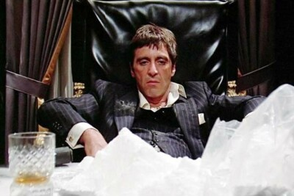
dopamine

Slide 12
Watson, Thorndike, & Skinner
Anxiety as instinct
Anxiety as a behavior
Behavior is controlled by the variables of which it is a function
Conditioning

Slide 13
Watson, Thorndike, & Skinner
Actions that lead to favorable outcomes persist
Actions that lead to unfavorable outcomes desist
Actions that used to work, but don’t now, led to variations
Work = addition of feels-good stuff
Work = removal of feels-bad stuff

Slide 14
Anxiety
Brain’s job: keep you alive
Find danger
Avoid danger
When brain gets it right, dopamine!
The avoidance trap
Bear Patrol
The Simpsons - The Bear Patrol and Lisa's Tiger-Repelling Rock

Slide 15
Anxiety: IRL
Anxiety Brain:
That didn’t work, so don’t do that anymore
Get sick after eating food
Avoid that food
Get injured
Avoid that area
Get hurt emotionally
Uhm…
Generalization
Avoid those foods and those areas

Slide 16

Anxiety

Slide 17
The Anxious generation (2024)
Social media
Peer esteem
Feedback
Negative comparison
Negative expectations
Social deprivation
Sleep deprivation
Attention fragmentation
Addiction
More harmful to girls than boys

Slide 18
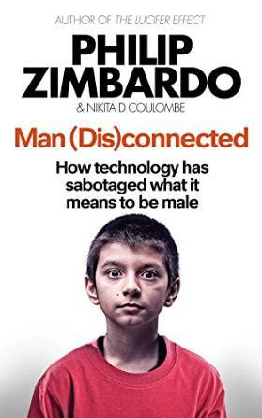
Man (Dis)Connected (2015)

Slide 19
Man (dis)Connected
Toxic masculinity
Excessive on-line gaming
Discord
On-line radicalization
The Internet is for porn
Asocialization
Over-medicalization
Arousal addiction

Slide 20
A quick tangent on language
Persistently on-line youth do not use language like lawyers do
He basically raped me last night.
What does that mean to:
A 15-year-old gamer?
A 14-year-old on TikTok?
A prosecutor?

Slide 21
Trauma
DSM-5-TR says what?
Exposure to actual or threatened death, serious injury, or sexual violence in one or more of the following ways:
Directly experiencing the traumatic event(s)
Witnessing, in person, the event(s) as it occurred to others
Learning that the traumatic event occurred to a close family member or close friend…
Experiencing repeated or extreme exposure to aversive details of the traumatic event(s)

Slide 22
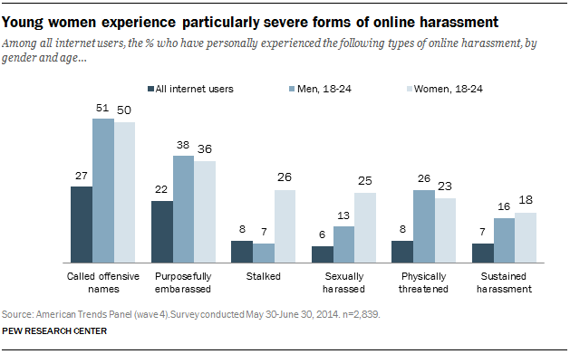
Trauma

Slide 23
Trauma
DSM-5-TR says what?
Persistent avoidance
Negative alterations in cognitions and mood associated with event(s)
Marked alterations in arousal and reactivity associated with the event(s)
Duration of disturbance
Disturbance causes distress or impairment

Slide 24
Trauma
Acute
Chronic
Observed
Second-hand
Autogenic
What would Darwin say?
How is a trauma response adaptive?
Disordered response to trauma

Slide 25
What does Anxiety look like
Inability to experience positive emotions
Distressing memories/intrusive thoughts
Physiological distress when cued
Palpitations, sweating, trembling
SOB, chest pain, choking feelings
Nausea, dizziness, hot/cold, derealization
Numb/tingling, fear of loss of control

Slide 26
What does Anxiety look like
Cognitive distress when cued (catastrophizing)
Avoidance/escape
Anticipatory distress
Restlessness
Difficulty concentrating
Irritability
Sleep disturbance
…socially anxious, seeking social approval/acceptance, & lacking the skills

Slide 27
In the classroom
Easily distracted
Intrusive thoughts
Divided focus
Restlessness
Physiological distress
Difficulty concentrating
Irritability
Sleep disturbance
Poor academic performance

Slide 28
Assessment and treatment
Clinical interview
Structured clinical interview
Self-report assessments
Dr. Google
Collateral assessments
No blood tests

Slide 29
Assessment and treatment
Generalized Anxiety Disorder
Adjustment Disorder with Anxiety
Posttraumatic Stress Disorder
Specific Learning Disorder
Attention-Deficit/Hyperactivity Disorder
Borderline Intellectual Functioning
Diagnostic Stew

Slide 30
Getting it wrong
How do we treat ADHD?
How do we treat Anxiety Spectrum Disorders
How do we treat Learning/Intellectual Disorders
Do we treat girls and boys differently?
Do we treat cultural trauma?

Slide 31
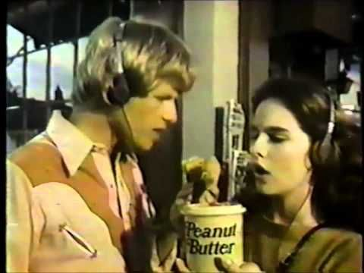
You got your chocolate in my peanut butter!

Slide 32
When these girls meet these boys

Slide 33
These girls and these boys
Social media
Peer esteem
Feedback
Negative comparison
Negative expectations
Social deprivation
Sleep deprivation
Attention fragmentation
Addiction
Toxic masculinity
Excessive on-line gaming
Discord
On-line radicalization
The Internet is for porn
Asocialization
Over-medicalization
Arousal addiction

Slide 34
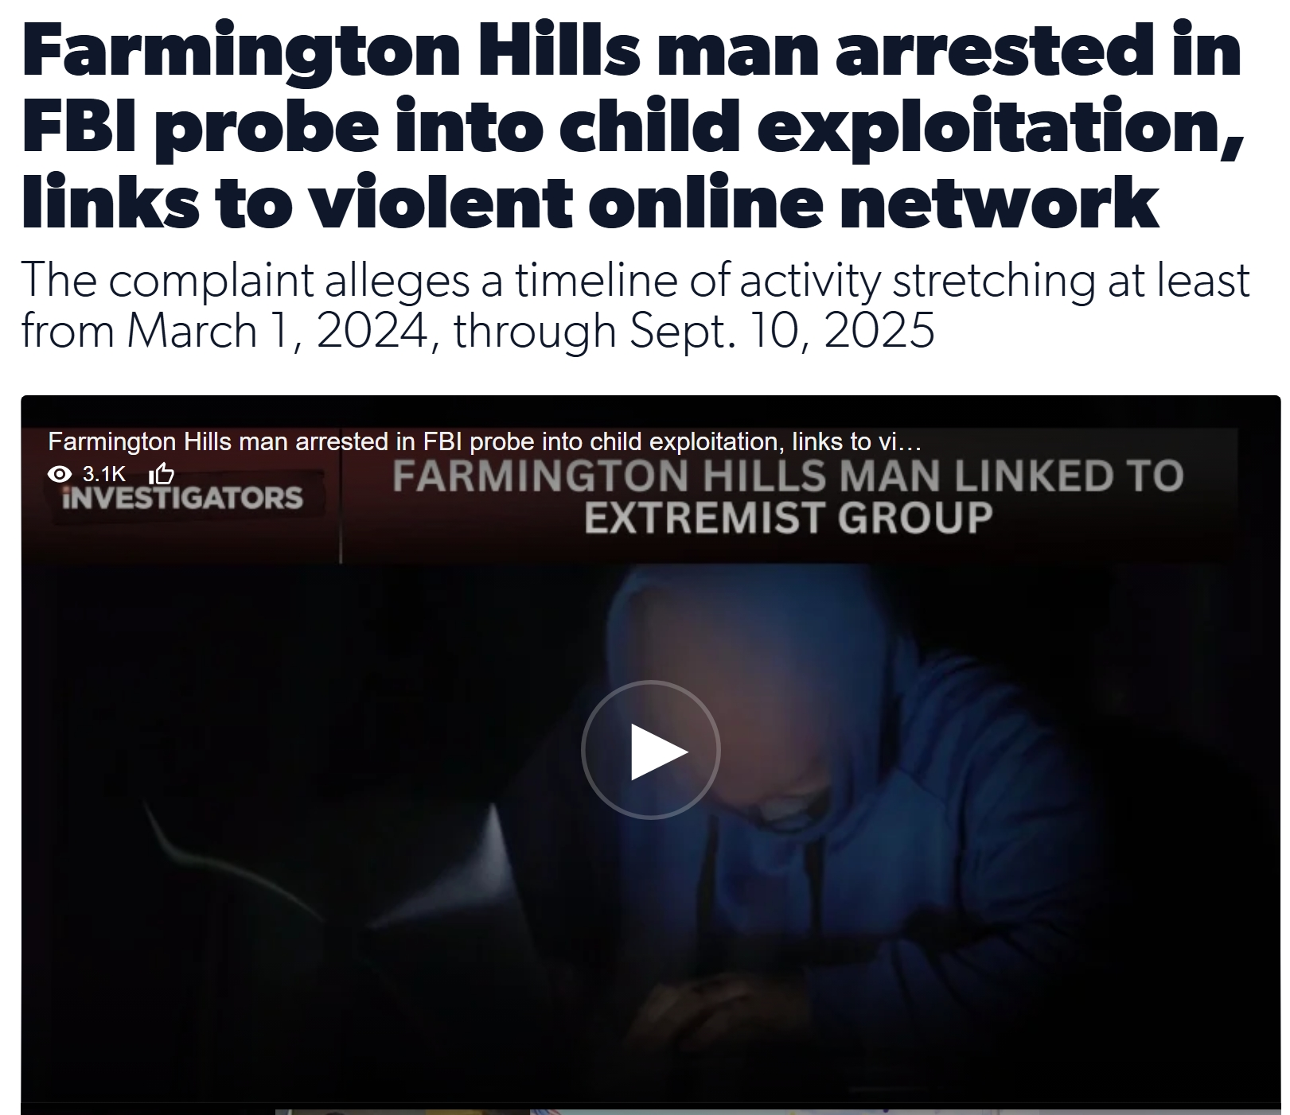
764

Slide 35
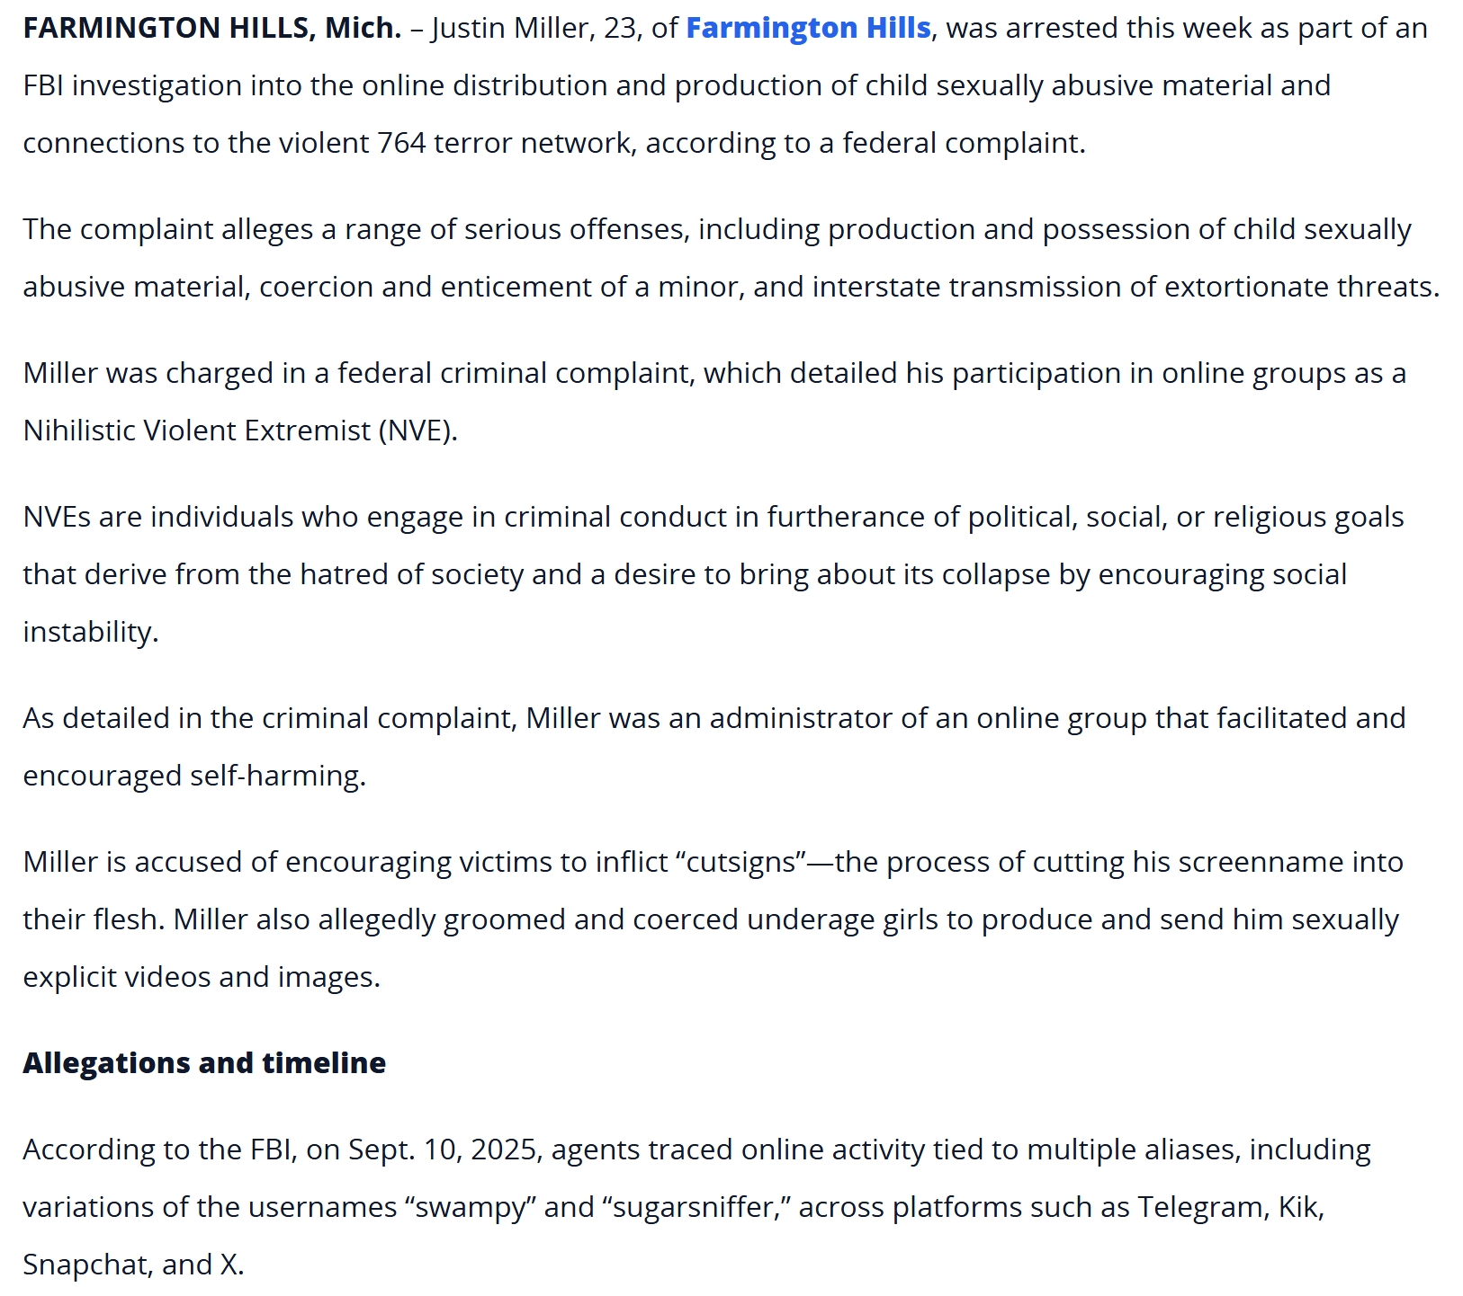
764

Slide 36
764
Farmington Hills man arrested in FBI probe into child exploitation, links to violent online network

Slide 37
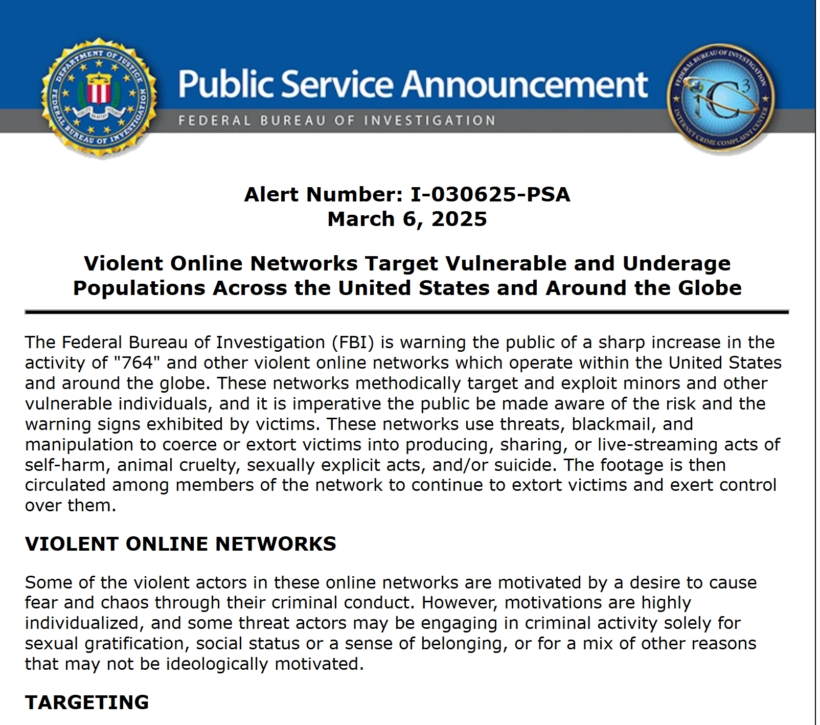
Exploitation

Slide 38
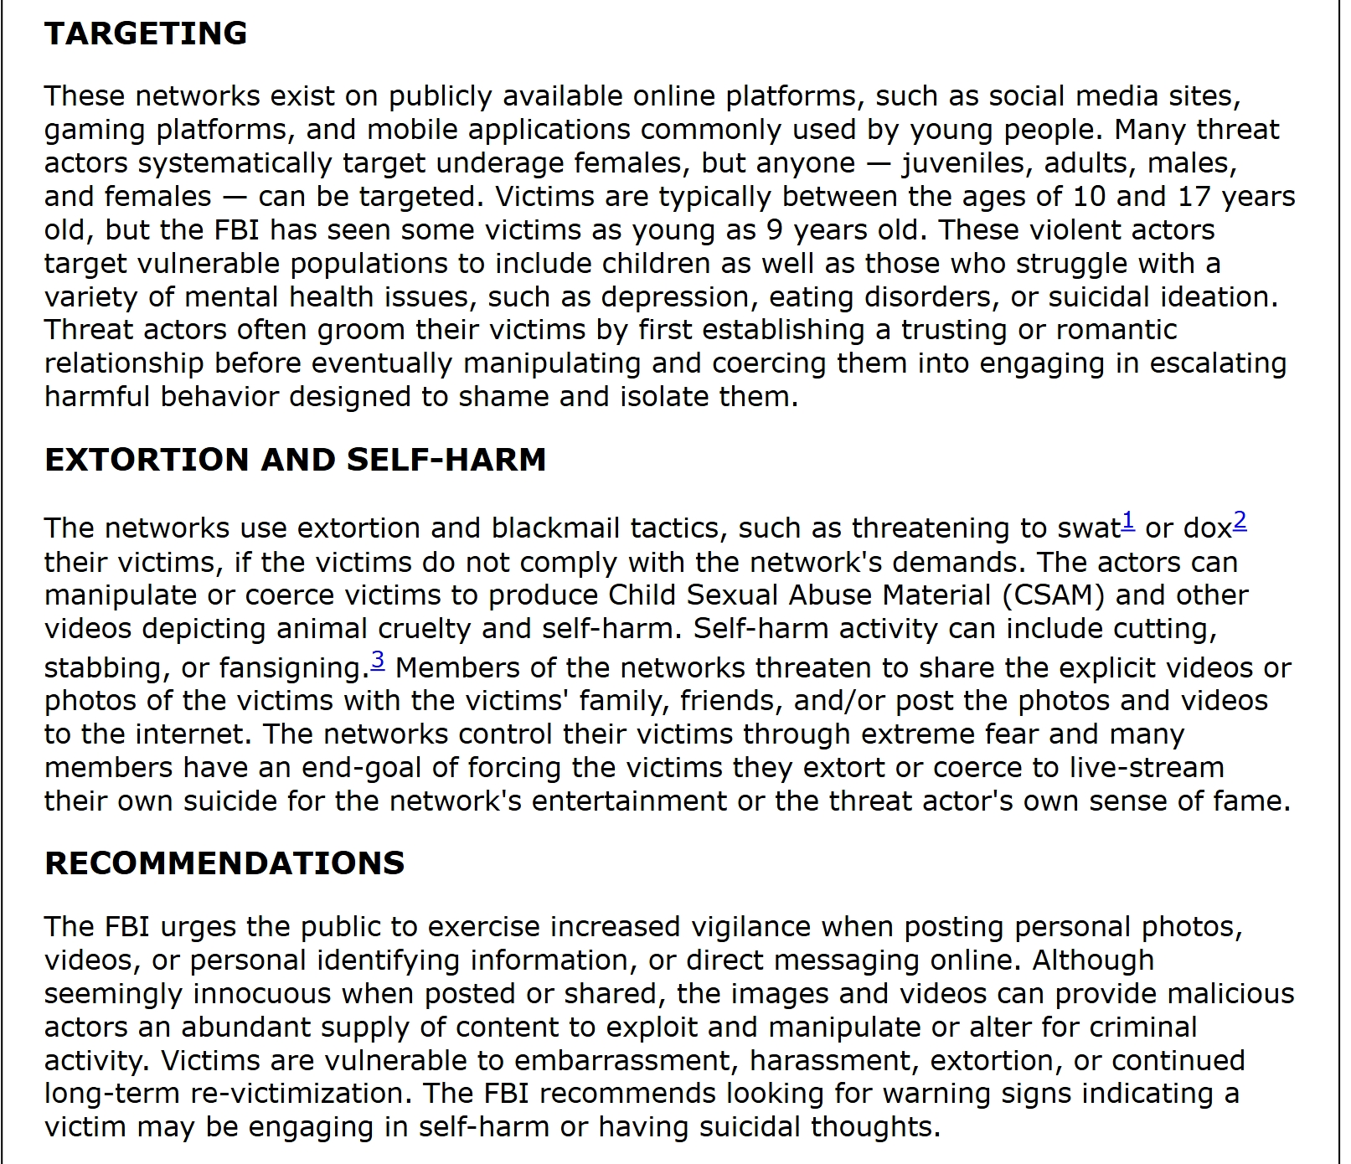
Exploitation

Slide 39
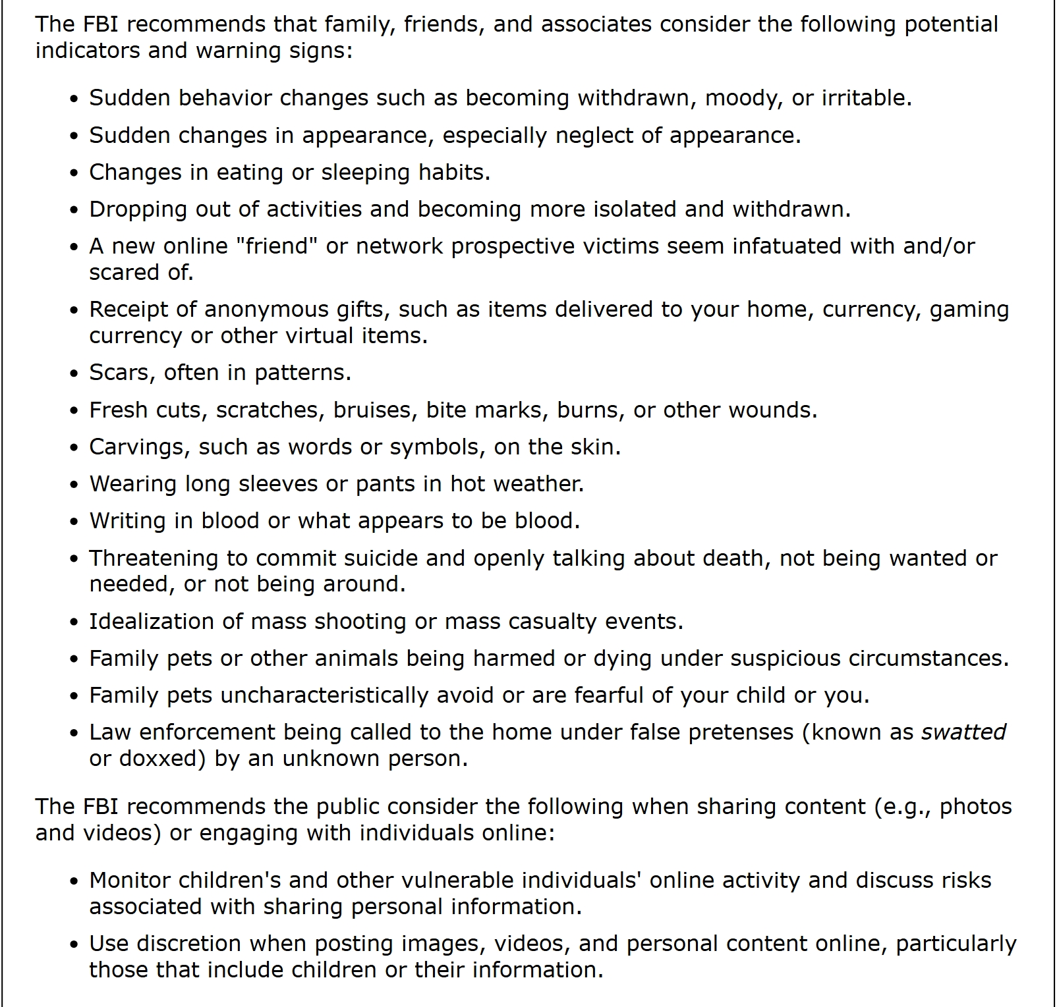
Exploitation

Slide 40
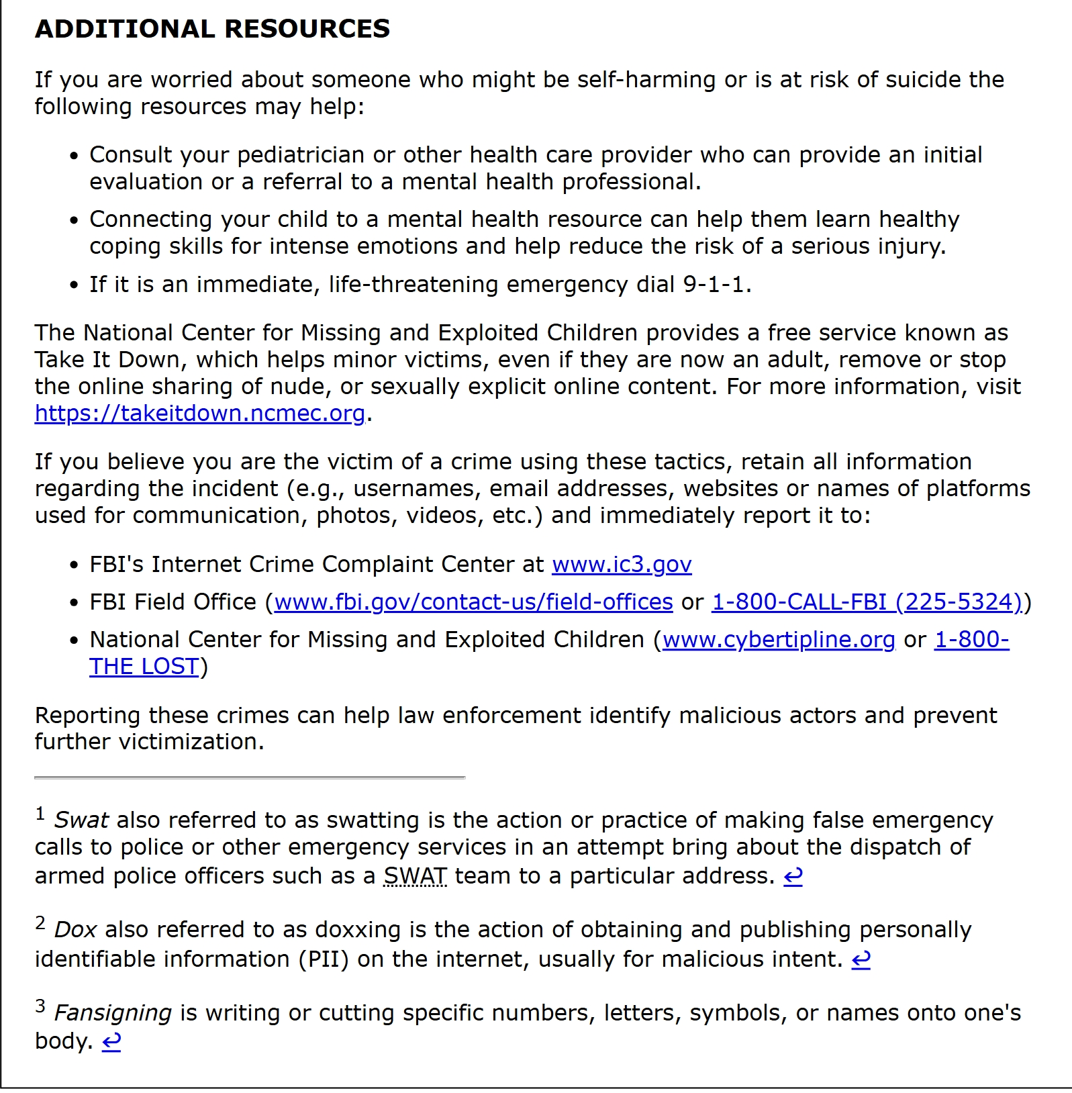
Exploitation

Slide 41
Treatment
Trauma
Sexual trauma
On-line trauma
Anxiety
ADHD
Learning Disorder
Intellectual Disability
Counseling
Medication
What happens to sex drive and preoccupation during puberty
BCBA

Slide 42
I have a dream
Our persistently on-line girls rejoin society
Reduced vulnerability
Our persistently on-line boys rejoin society
Reduced victimization
We get back to being awkward
Middle school dances
We get back to figuring out social skills overtime
We have the fortitude to keep doing the difficult work

Slide 43
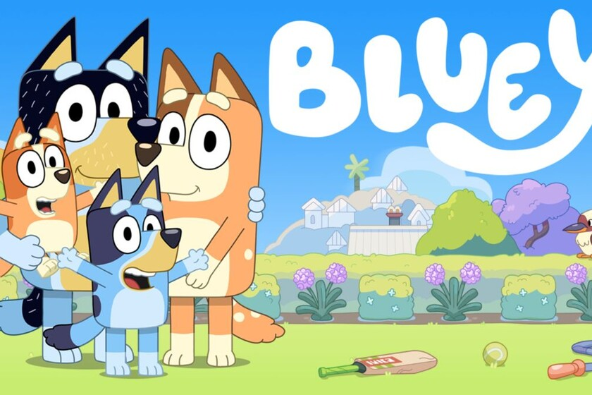
Bluey

Slide 44
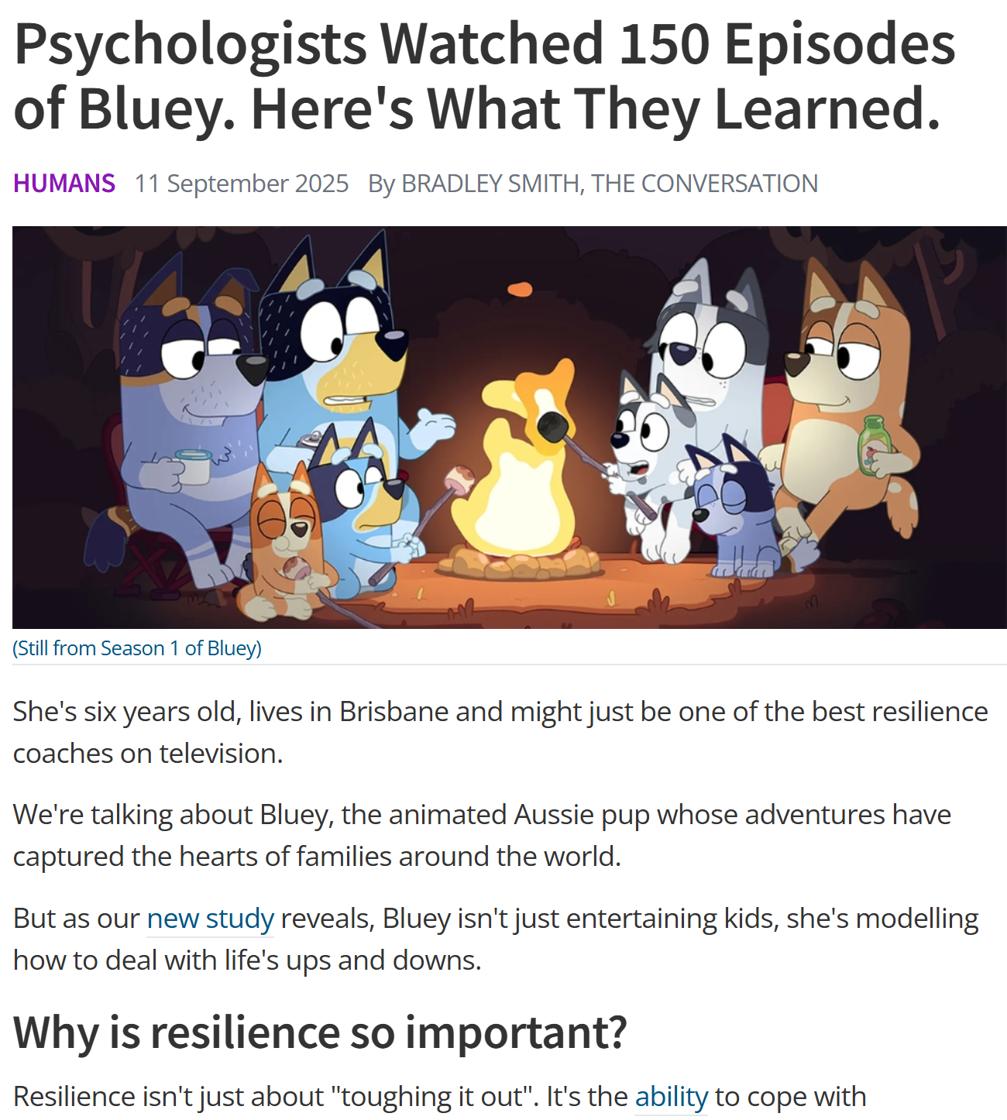
Bluey

Slide 45
The Whitney Houston question
Are children our future?
Can a child ever fail?
The sexually perseverative 13-year-old on methylphenidate
Do we have the resources to help this child?
Time
Money
Will
Health & behavioral health
Open mind
Open heart
This kid just ain’t getting it
Adult extinction bursts

Slide 46
Do the difficult work
Assessment takes time
Treatment takes time
There may not be a medication for that
The medication might make it worse
The medication might make more problems
Pain is a part of life
Suffering is an active and ongoing choice
Resiliency is a skill

Slide 47
TED
Thank you for coming to my TED Talk
Discussion time
Kirk A B Newring, PhD
Forensic Behavioral Health
1410 E Gold Coast Road, Suite 300
Papillion NE 68046
402-557-6027
Newring@fbhnebraska.com
manager@fbhnebraska.com

