Slide 1

Nebraska Goes Upstream
2025 CIP Children’s Summit
September 24, 2025
Judge Linda Bauer
County Court Judge – Jefferson, Saline, and Thayer Counties
Judge Anne Paine
County Court Judge – Red Willow County
Judge Randy Roland
County Court Judge – Cheyenne County
Teri Deal, Ph.D.
National Center for State Courts
Court Consulting Services

Slide 2
Upstream Overview
Judicially-led, community-based framework
Identifies resources, services, and supports that exist in a community and opportunities to improve communication, collaboration, and coordination
Discuss how and why children and families enter the juvenile justice and child welfare system
Collectively agree on community priorities and develop action plans

Slide 3
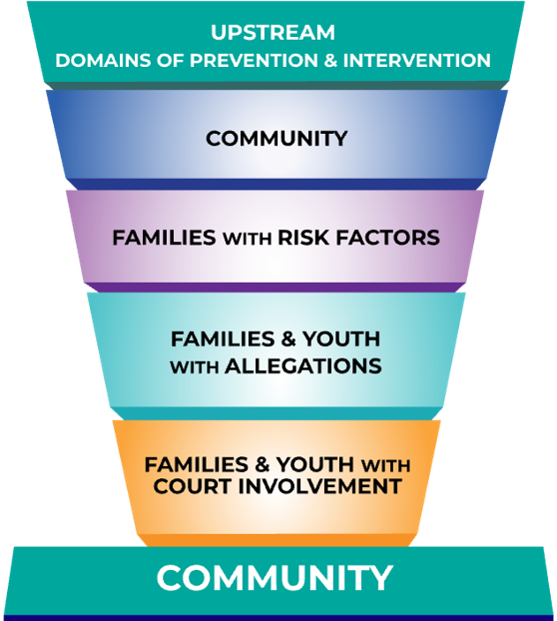

Slide 4
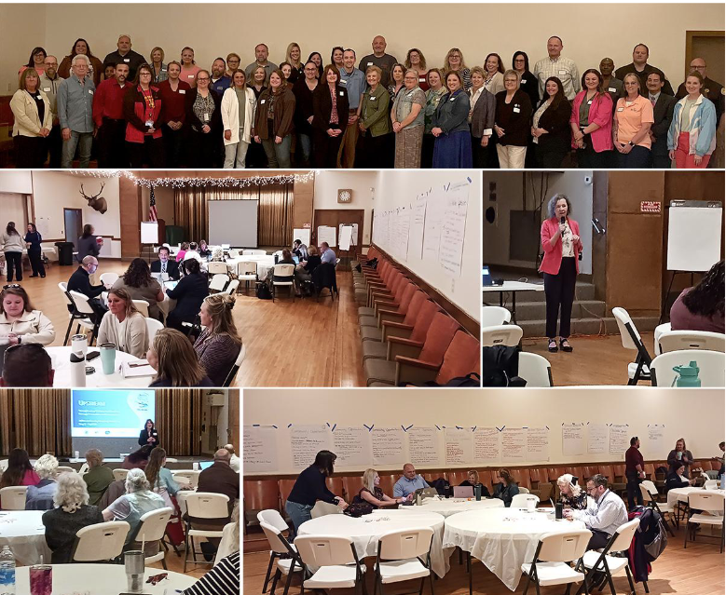
Jefferson County Upstream

Slide 5
Post Mapping Survey Highlights
Upstream Mappings Achieved Its Goals:
Identified opportunities to enhance practices, protocols, and programming
Created a shared vision among attendees on priority areas
Participant Experience:
92% strongly agreed it was a good use of their time
92% strongly agreed that the event was useful to their work

Slide 6
What aspects of the mapping session were particularly positive?
“ so many people offering resources and ideas!”
“meeting members of the community and figuring out what each of us had to offer.”
“liked the well-rounded team that was represented in the room and enjoyed the time to brainstorm together!”

Slide 7
Thank You
Contact:
Teri Deal
tdeal@ncsc.org
ncsc.org

