Slide 1

Bridge to Independence Program
Presented by DHHS – Children and Family Services, and the Administrative Office of the Courts and Probation
September 2025
Notes:
CIP team do intro and overview/etc.

Slide 2

Topics to Cover
b2i Background and History
Program Overview & Eligibility
Expansion to Juv. Justice Youth
Things to consider and challenges
Evaluation
Discussion & Questions
Notes:
Camas / Deanna

Slide 3
Background & History
National data shows generally poor outcomes for many young people who age out of foster care.
Less than 2% finished college
Over 50% experienced homelessness
Many others struggled with employment, healthcare access, and poverty
In response, Congress passed the Fostering Connections to Success and Increasing Adoptions Act in 2008, which allowed states to extend foster care services up to age 21.
45 states extend foster care over age 18
Notes:
Sarah

Slide 4
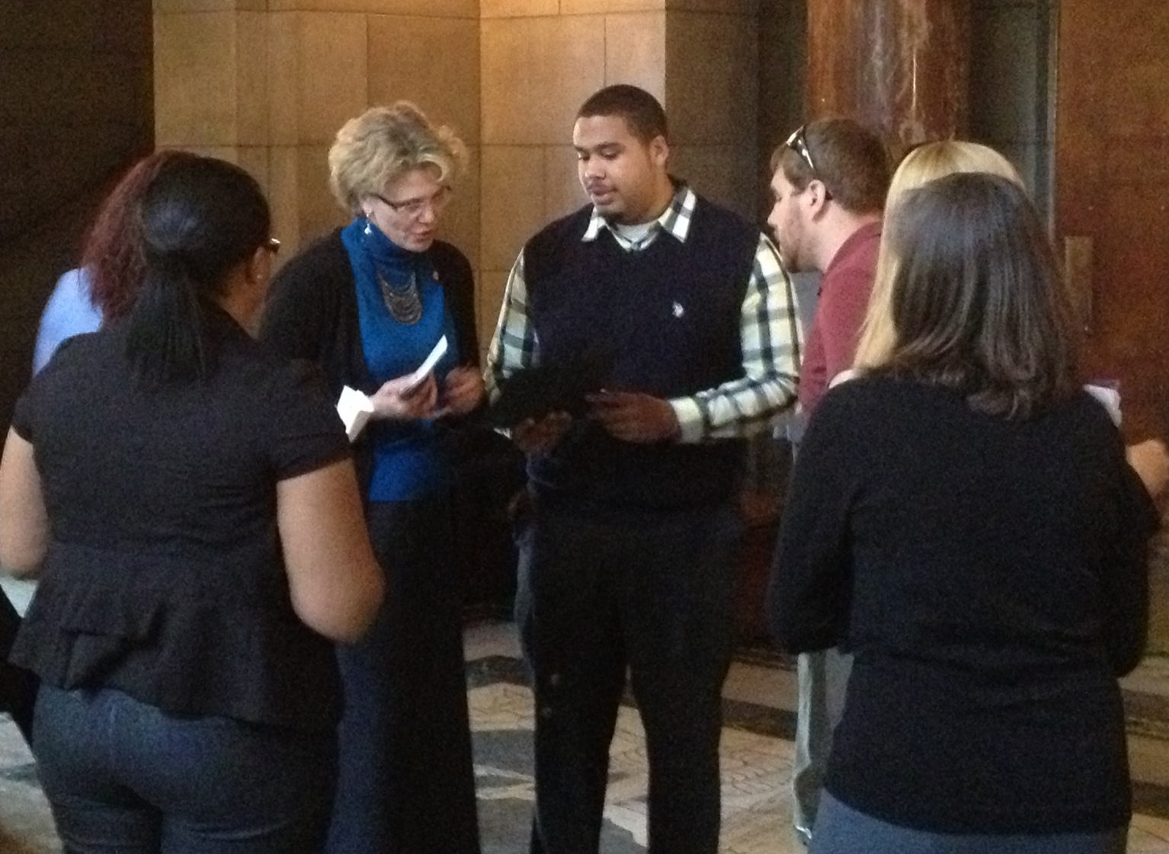
Nebraska Legislation
NE process: stakeholder group, fiscal analysis, NDHHS data, surveys of over 250 stakeholders, and surveys and focus groups with 100 youth
Youth-driven process, with Project Everlast
LB 216 (Sen. McGill, 2013)
Passed by the NE Leg (44-2-3) on May 29, 2013,
signed into law by Gov. Heineman on June 5, 2013
Codified at Neb. Rev. Stat. § 43-4501 et seq.
State Plan Amendment
Program began Oct. 1, 2014
NDHHS regs (395 NAC 10)
Advisory Committee - recommendations
Notes:
Sarah

Slide 5
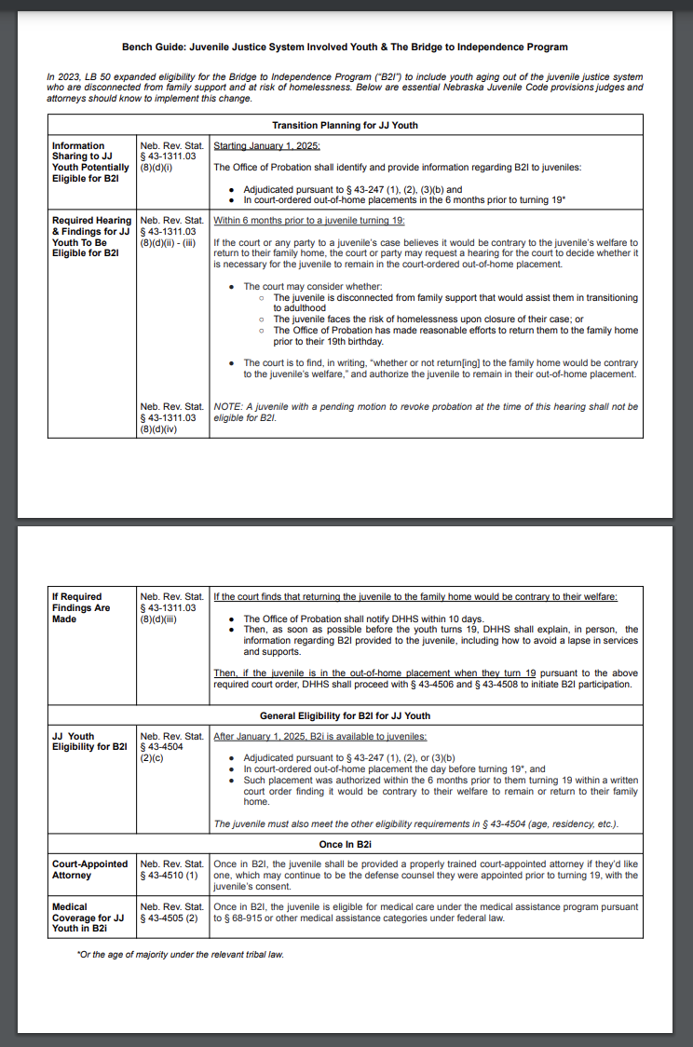
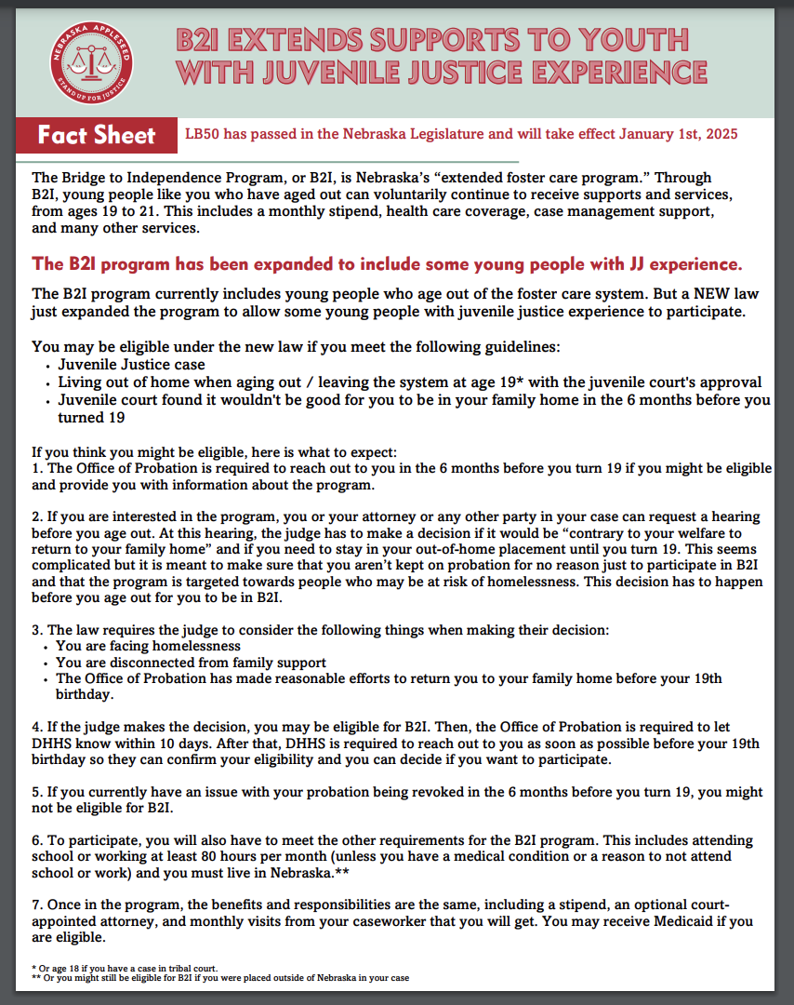
Resources
Professionals:
Plain language: https://neappleseed.org/download/45126/ Statutory language: https://neappleseed.org/download/45128/
Young People:
https://neappleseed.org/download/45130/
Notes:
Sarah

Slide 6

Program Overview and Eligibility

Slide 7
The Bridge to Independence Program (“b2i”)
b2i is voluntary
Young people are legally adults - can choose to join and leave at any time
“b2i shall at all times recognize and respect the autonomy of the young adult.”
BUT b2i is foster care
Under the care of DHHS
Under the jurisdiction of the juvenile court
Under the authority of the Foster Care Review Office
In “foster care” for the purposes of Medicaid eligibility
Notes:
Sarah

Slide 8
Where We Are Today…
As of June 2025, 275 Young Adults are actively participating in b2i.
189 aged out of foster care (from the data above).
11 entered from tribal courts (from the data above).
68 entered from Guardianship or Adoptions (from the data above).
7 entered from the Office of Probation (with anticipation of 3 more entering before the end of 9/30/25).
Since the inception of b2i, 1,630 young adults have chosen to participate in b2i.
Notes:
Camas
As of March 31, 2024, 230 young adults are in the program. Since its inception in 2014, 1,453 young people have taken advantage of b2i.

Slide 9
Where We Are Today...
2024 is the second highest year of b2i entry by young adults in the last ten years.
So far in 2025, out of 53 youth who entered a guardianship or adoption, only 7 have not taken advantage of b2i.
86% are not pregnant or parenting
Employment tends to be the highest program category youth are engaged in.
2024 is the second-highest year of b2i entry by young adults in the last ten years.
So far in 2025, out of 53 youth who entered a guardianship or adoption, only 7 have not taken advantage of b2i.
86% are not pregnant or parenting.
Employment tends to be the highest program category youth are engaged in.
Notes:
Camas
As of March 31, 2024, 230 young adults are in the program. Since its inception in 2014, 1,453 young people have taken advantage of b2i.

Slide 10
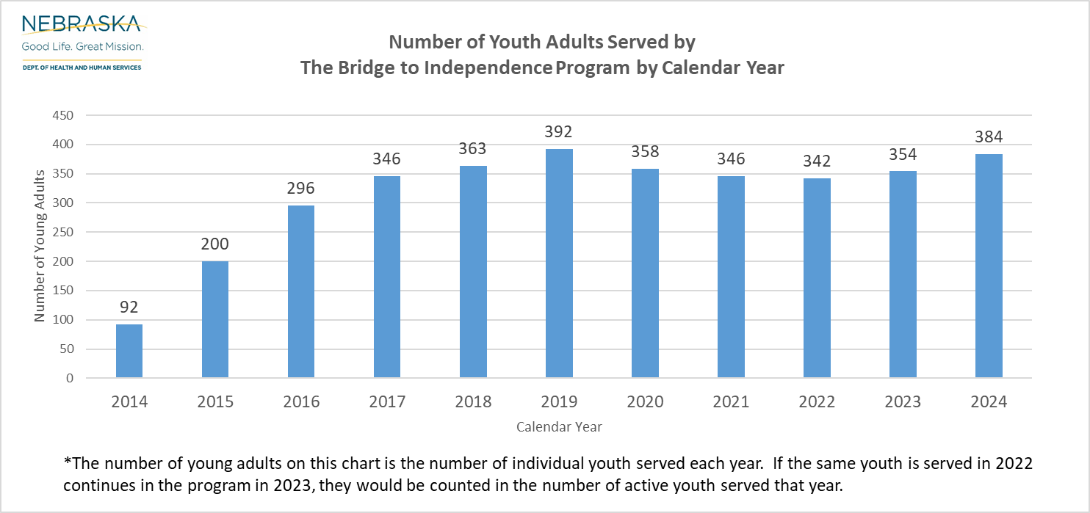
b2i Participation By Year
Notes:
Camas

Slide 11

b2i Staffing
b2i staff are located across the state.
15 Independence Coordinators
2 b2i Supervisors
Notes:
Terrence
The assigned case managers for the b2i program are known as Independence Coordinators. Independence Coordinators are placed strategically across the state and are responsible for traveling to meet with young adults in the program. Currently, there are 12 specialized Independence Coordinators who primarily work with young adults in the b2i program. The two b2i Supervisors are located in Omaha and Lincoln.
With more youth entering the program, CFS plans to hire four additional staff members. However, the locations of those additional staff members have yet to be determined.

Slide 12
Services Provided to Young Adult
Medical Coverage based on Medicaid eligibility.
Case Management- Services to help prepare for the transition
Monthly meetings with the Independence Coordinator
Vital Document Access
Community Resources & Public Benefit Navigation.
Much more- Young Adult Driven
Monthly Maintenance Payment to provide housing support.
A Young adult must sign a Voluntary Services and Support Agreement to enter the program.
Unlike traditional foster care, we do not pay for services- we must be creative with community services.
Notes:
Terrence
b2i is a program that aims to support young adults in their transition to adulthood, helping them become self-sufficient and establish permanent relationships. The program offers three main types of services: medical care, case management, and a monthly financial stipend to assist with expenses. Qualifying young adults in b2i may be eligible for Medicaid if federal regulations are met and the young adult meets IV-E eligibility. Most young adults in b2i will apply for Medicaid as income-eligible single adults. Medical coverage must be discussed during transitional meetings to determine if a Medicaid application is necessary.
Young adults must meet with their Independence Coordinator at least once a month. Depending on their needs, the location of these monthly visits may vary from the young adult's home to community settings. If additional support is required, the visit frequency can also vary.
b2i provides a monthly foster care maintenance stipend of $991.89 to young adults, which is the only payment or funding they will receive. The program does not cover costs for services, programs, college tuition, or fees. However, young adults will be referred to adult or community services for additional support, such as drivers ed, educational support, employment/skill building, mental health, substance abuse, and housing assistance.

Slide 13
Current Eligibility
Age:
Aged 19 up to 21st birthday—unless a Tribal Young adult whose jurisdiction ends at age 18 according to their tribal code
Adjudication:
Juvenile Court adjudication in an abuse/neglect case under Nebraska Statute 43-247 3(a) or equivalent with Tribal Law
Juvenile Court adjudication in Sub-Division (8) of section 43-247 or the equivalent under tribal law
Youth who were in DHHS custody and entered into a Kinship or State state-funded guardianship Assistance Agreement at age 16 or older.
Youth aging out of Office of Probation (cover later in presentation)
Placement:
In an out-of-home placement upon turning 19 years old OR discharged to Independent Living before age 19
Notes:
Terrence
Since the inception of b2i, eligibility for the program has been modified and enhanced several times. The current eligibility includes young adults from the age of 19 until their 21st birthday. With the exception of tribal young adults who can enter at age 18 if their Tribal codes close jurisdiction at age 18. If this is the case, they can receive support through the b2i program for three years instead of the standard two years.
Youth must have been adjudicated as 43-247 3 (a) which is an abuse or neglect filing, or Sub-Division (8) which is a disrupted guardianship or for youth who were adopted or entered a guardianship at age 16 or older with a subsidized adoption of guardianship agreement.
On the youth’s 19th birthday, they must be in out-of-home care, or the youth's court case was closed due to the youth achieving Independent Living prior to their 19th birthday.

Slide 14
Eligibility Continued
Must be a Nebraska resident
Citizenship/lawful presence in the United States
“Does not meet the level of care for a nursing facility, skilled nursing facility, or for an intermediate care facility for persons with developmental disabilities.”
Probation Youth cannot have a pending motion for Revocation at the time of the Contrary to Best Interest Court Order.
Notes:
Terrence

Slide 15
Participation Eligibility
Work & Education Requirements
Neb. Rev. Stat. § 43-4504(3) + 395 NAC 10-003.03 say must be:
In school part-time (six credits hours)
Working part-time (80 hours a month)
In a job skills program (40 hours a month) OR
Incapable of the above due to a medical condition
Temporary lapses are typically okay if less than 30 days
Have to prove initially, every 6 months, and when asked, using written documentation agreed upon by the young person and DHHS
Notes:
Terrence

Slide 16
Housing Requirements
Approved Living Arrangements
Must reside in a housing or living arrangement approved by DHHS and in a category:
Group home; or
Supervised independent living setting (apartment, house, dorm, shelter, parental home, etc.) or Military Housing
Young Adult must report changes within 10 business days
Notes:
Terrence

Slide 17
b2i Case Oversight
A Petition must be filed to the Juvenile Court.
The Court needs to determine a “Best Interest” finding within 180 days.
The court shall determine whether the Bridge To Independence Program is providing the appropriate services and support.
If the court believes that the young adult requires additional services and support to achieve their goals, the Court may make appropriate findings or order DHHS to take action to ensure that the Young Adult receives the identified services and support.
Permanency Hearing must occur at least once a year.
Young Adult can request more hearings if they choose.
Foster Care Review Office oversees the progress and will make recommendations to the court.
Notes:
Terrence
Young Adults will be involved in a court case. A petition will be initiated with the court within 10 to 15 days of the VSSA's signature. The Court will determine the young adult's best interest and whether additional support is needed.
Permanency hearings will be scheduled once a year, and the young adult can request additional hearings. Young adults will have a say in when these hearings are scheduled.
The court can be where the young adult lives which will ease the access to court hearings.

Slide 18
Termination of Services
Reasons for Termination
The Young Adult:
Fails to meet any of the eligibility requirements.
Is incarcerated, committed, or placed in a residential facility by a court.
Fails to meet with the Independence Coordinator for at least 30 days.
Cannot be located for at least 30 days.
Moves outside of Nebraska and does not meet the residency definition.
The Young Adult can appeal a Termination.
Notes:
Terrence
A Young Adult can voluntarily leave the program if they determine the program is not what they want to be involved in or can be terminated by DHHS for not following Programming requirements.
A young adult can be terminated from b2i if they fail to meet any of the eligibility requirements, such as not allowing the Independence Coordinator to observe their housing, not meeting the Nebraska Residency definition, lack of participation program requirements, or failing to provide documentation of employment, education, or participation in activities to eliminate the barriers to employment.
If the young adult is incarcerated for more than 30 days or if they were committed through a Mental Health Board.
The young adult does not respond or can be located for at least 30 days.
Even if a young adult receives a 30-day termination letter, the young adult can correct the issues causing the termination notice within the time frame identified, the termination will be stopped.
If the young adult volunteers to leave the program or are terminated, they can re-enter (there is no limit on re-entries) before they turn 21.
The young adult can appeal a termination and will be advised on how to do that.

Slide 19

Probation’s Role in Bridge to Independence (b2i)
Notes:
Probation

Slide 20
b2i Eligibility for Probation Youth
Adjudication:
The youth must be adjudicated to be a juvenile as described in subdivision (1), (2), or (3)(b) of section 43-247 and who is in a court-ordered out-of-home placement in the six months prior to attaining nineteen years of age.
(A) Whether the juvenile is disconnected from family support that would assist the juvenile in transitioning to adulthood;
(B) Whether the juvenile faces the risk of homelessness upon closure of the juvenile court case; or
(C) Whether the Office of Probation Administration has made reasonable efforts to return the juvenile to the family home prior to the juvenile's nineteenth birthday.
Exception:
A juvenile with a current pending motion to revoke probation before the court at the time of the hearing shall not be eligible for the Young Adult Bridge to Independence Act.
Notes:
Probation

Slide 21
Role of Probation for b2i youth
Identify youth aged 18 ½ years old in a court-ordered out-of-home placement.
Provide information fact sheet about b2i to all youth age 18 ½ in a court-ordered out-of-home placement.
Communicate with legal parties and/or the court regarding a hearing finding return to the family home would be contrary to the juvenile’s welfare.
Upon the court’s finding order, the Juvenile Probation Services Division will notify the Department of Health and Human Services within ten days, providing a referral to DHHS for eligibility determination.
Ongoing case collaboration with DHHS to ensure a smooth transition to b2i upon completion of probation at the 19th birthday.
Notes:
Probation

Slide 22

Challenges
The Office of Probation is not a guardian, so limited in what it can do.
Limitations on sharing of information.
Youth may not have their personal documents.
Affordable and available housing.
Timing of Contrary to Welfare Court order and the youth’s 19th birthday.
Limits on transitional services and supports before age 19.

Slide 23
Things to Consider for Probation Expansion
The time frames for the transfer process may vary depending on when the court enters the Contrary of Welfare finding.
b2i and the Juvenile Probation Services Division will have to work closely for a successful transition.
Where the youth is placed vs. where they want to reside may affect b2i assignments. Proactive planning for future housing will help eliminate the change in Independence Coordinator assignments.
b2i program is voluntary; however, a Young Adult on Probation can not be found eligible if they do not have a court order with the “Contrary to Welfare” finding.
Notes:
Camas / Deanna
As we move forward, it's important to consider the following: The law allows a court to make a "Contrary to Welfare" finding within six months of a youth's 19th birthday. Depending on when the court makes this finding, the timelines outlined may need to be adjusted to ensure a successful entry into b2i. DHHS and the Office of Probation Administration will have to work closely together and have continued collaboration as we navigate through the process. With limited b2i staff scattered across the state, we want to eliminate the change in Independence Coordinators as much as possible by being proactive in identifying where the youth may want to live at age 19 for the purpose of consistency with IC assignment for the youth. Keep in mind that the only way a young adult can be involved in b2i is to have contrary to the welfare finding. If this is not secured prior to age 19, the young adult will not be eligible.

Slide 24
Things to Consider- Benefits
Youth who enter b2i from Probation are considered a part of the “foster care” program and will receive the same benefits as those youth who age out of foster care.
Foster Youth towards Independence Housing Vouchers (FYI Vouchers)
Chafee funding
Access to Connected Youth Initiatives such as Driver’s Education, Coaching, Supportive Funds, Central Navigation, and Leadership opportunities.
Education and Training Program
Former Foster Care Medicaid, if they meet eligibility and age out of b2i at age 21.
Notes:
Camas / Deanna
As we move forward, it's important to consider the following: The law allows a court to make a "Contrary to Welfare" finding within six months of a youth's 19th birthday. Depending on when the court makes this finding, the timelines outlined may need to be adjusted to ensure a successful entry into b2i. DHHS and the Office of Probation Administration will have to work closely together and have continued collaboration as we navigate through the process. With limited b2i staff scattered across the state, we want to eliminate the change in Independence Coordinators as much as possible by being proactive in identifying where the youth may want to live at age 19 for the purpose of consistency with IC assignment for the youth. Keep in mind that the only way a young adult can be involved in b2i is to have contrary to the welfare finding. If this is not secured prior to age 19, the young adult will not be eligible.

Slide 25

Are we moving in the right direction?

Slide 26

2019 Child Trends Evaluation of b2i
Involvement in b2i reduced the negative outcomes that youth who age out of care are more likely to experience.
b2i participants were more likely than their non-b2i foster youth peers to:
Have post-secondary education
Have safe, stable, affordable housing
Be able to cover monthly expenses
Have adults to turn to in a crisis or for a loan
Have some savings
All reported high-quality, positive relationships with IC, progress towards their goals, and that the stipend helped them feel more financially secure & focus their energy elsewhere.
Said Nebraska can do a better job of telling youth about b2i.
https://www.childtrends.org/publications/Nebraska-bridge-to-independence-extendedfoster-care-evaluation
Notes:
Camas

Slide 27
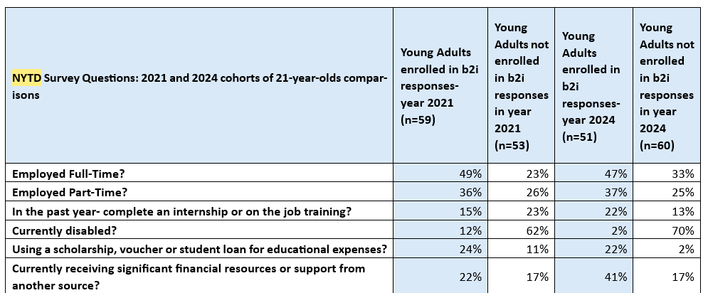
National Youth in Transition Data

Slide 28
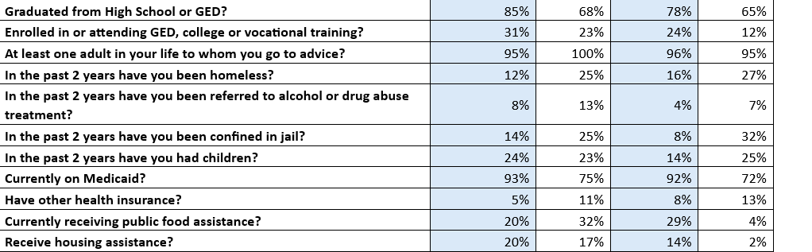
National Youth in Transition Data

Slide 29
B2i Young Adult Responses who entered from the Office of Probation
How did you find out about b2i?
Probation Officer
Cedars
PALS Worker
After participating in b2i, do you feel that you had a clear understanding of the program before you decided to enter the program?
Unanimously said “yes”.
Had a meeting with b2i, and it was explained in detail, which helped to understand the program.

Slide 30
B2i Young Adult Responses who entered from the Office of Probation
What suggestions would you have to assist with the transition into b2i from Probation?
Have a phone
Have personal documents
Discuss the monthly stipend and know how that can help you get set up for adulthood
Don’t be nervous, b2i Court is totally different than probation court and the fear of getting “locked up”
Ability to focus on yourself and your own dreams
Just communicate with your IC and what you need to do.
Save the money and invest

Slide 31
B2i Young Adult Responses who entered from the Office of Probation
How do you feel b2i has helped you focus on long term goals, enhancing self-sufficiency?
My hygiene has improved
Reluctantly went back to school and discussing employment- things I don’t want to do but know it is “adulting”
Accountability and focusing on my own goals
Reminder for the need to save money
I have saved over $3,000 already!
Investing and planning to get nice things
The IC has been great in answering my questions, locating services and supports and being there why I am navigating adulthood.

Slide 32
B2i Young Adult Responses who entered from the Office of Probation
Is there anything you found challenging with the transition into b2i?
Nope!
The transition was easy.
Entering b2i without my personal documents.
No phone to communicate with.
A lot of telephone conversations, having to repeat myself on where I am going to live, my plans, etc.
Length of time it took to get a Reli-card for my monthly stipend.
No, it’s all been chill.

Slide 33
B2i Young Adult Responses who entered from the Office of Probation
What advice would give to youth who are considering entering b2i?
Ask questions, use b2i as a reference, aging out is overwhelming, but b2i can help.
Helped me get back on my feet.
b2i does not hold your hand but is there to guide and encourage you.
The money and the ability to save so you have a financial foundation when you are done with the program.
Make sure you are serious about wanting to get something from the program, so you are not wasting their time.
Make sure you have your documents.
Take the opportunity- it helps!

Slide 34
B2i Young Adult Responses who entered from the Office of Probation
What do you want people to know about you now that you have been in b2i?
I am saving money to start my own business.
Proving to my haters I can make something of myself.
I got on SSI, so I will be okay after b2i.
I have matured and I am proud of who I am becoming.
I am saving money for my future!
Working full-time.
I have not returned to my old behaviors.

Slide 35

Office of Probation Administration Contact
Brooke Fuhr
Juvenile Justice Projects Specialist
Brooke.fuhr@nejudicial.gov
Notes:
Camas / Deanna

Slide 36
Bridge To Independence Program Contacts
WEBSITE: www.b2i.ne.gov
DHHS Prevention Administrator: Camas.Holder@nebraska.gov
b2i Program Specialist: Deanna.Brakhage@nebraska.gov
b2i Supervisors:
Terrence.Williams@nebraska.gov
Angela.Morehead@nebraska.gov
Notes:
Camas / Deanna

Slide 37
Discussion & Questions?
Notes:
All

