Slide 1

¡Bienvenidos!
Por favor asegúrense de tomar un equipo de interpretación para esta sesión que será bilingüe en inglés y español.
Welcome!
Please ensure you use the interpretation equipment provided for this bilingual session, which will be conducted in both English and Spanish..
Notes:
Mariana starting in both, then changing into Spanish and Felipe will speak through interpretation equipment

Slide 2



Language of the Heart:
Exploring the Impact of Leadership Opportunities on Young Adults
Lincoln Arneal
Felipe Longoria-Shinn
Mariana Schell
Notes:
15 mins between First two slides and giving/showing how to use equipment
Mariana starting in both, then changing into Spanish and Felipe will speak through interpretation equipment

Slide 3
Presentation at a Glance:
Introductions
Why leadership matters to youth
Youth Perspective #1
Reflection Prompts
Who is missing from leadership opportunities?
Purpose of Youth Leadership
Youth Perspective #2 – Q&A
NCFF's Youth Leadership Approach
Connection to Postsecondary Pathways
Closure and Questions
Notes:
2 - minutes

Slide 4
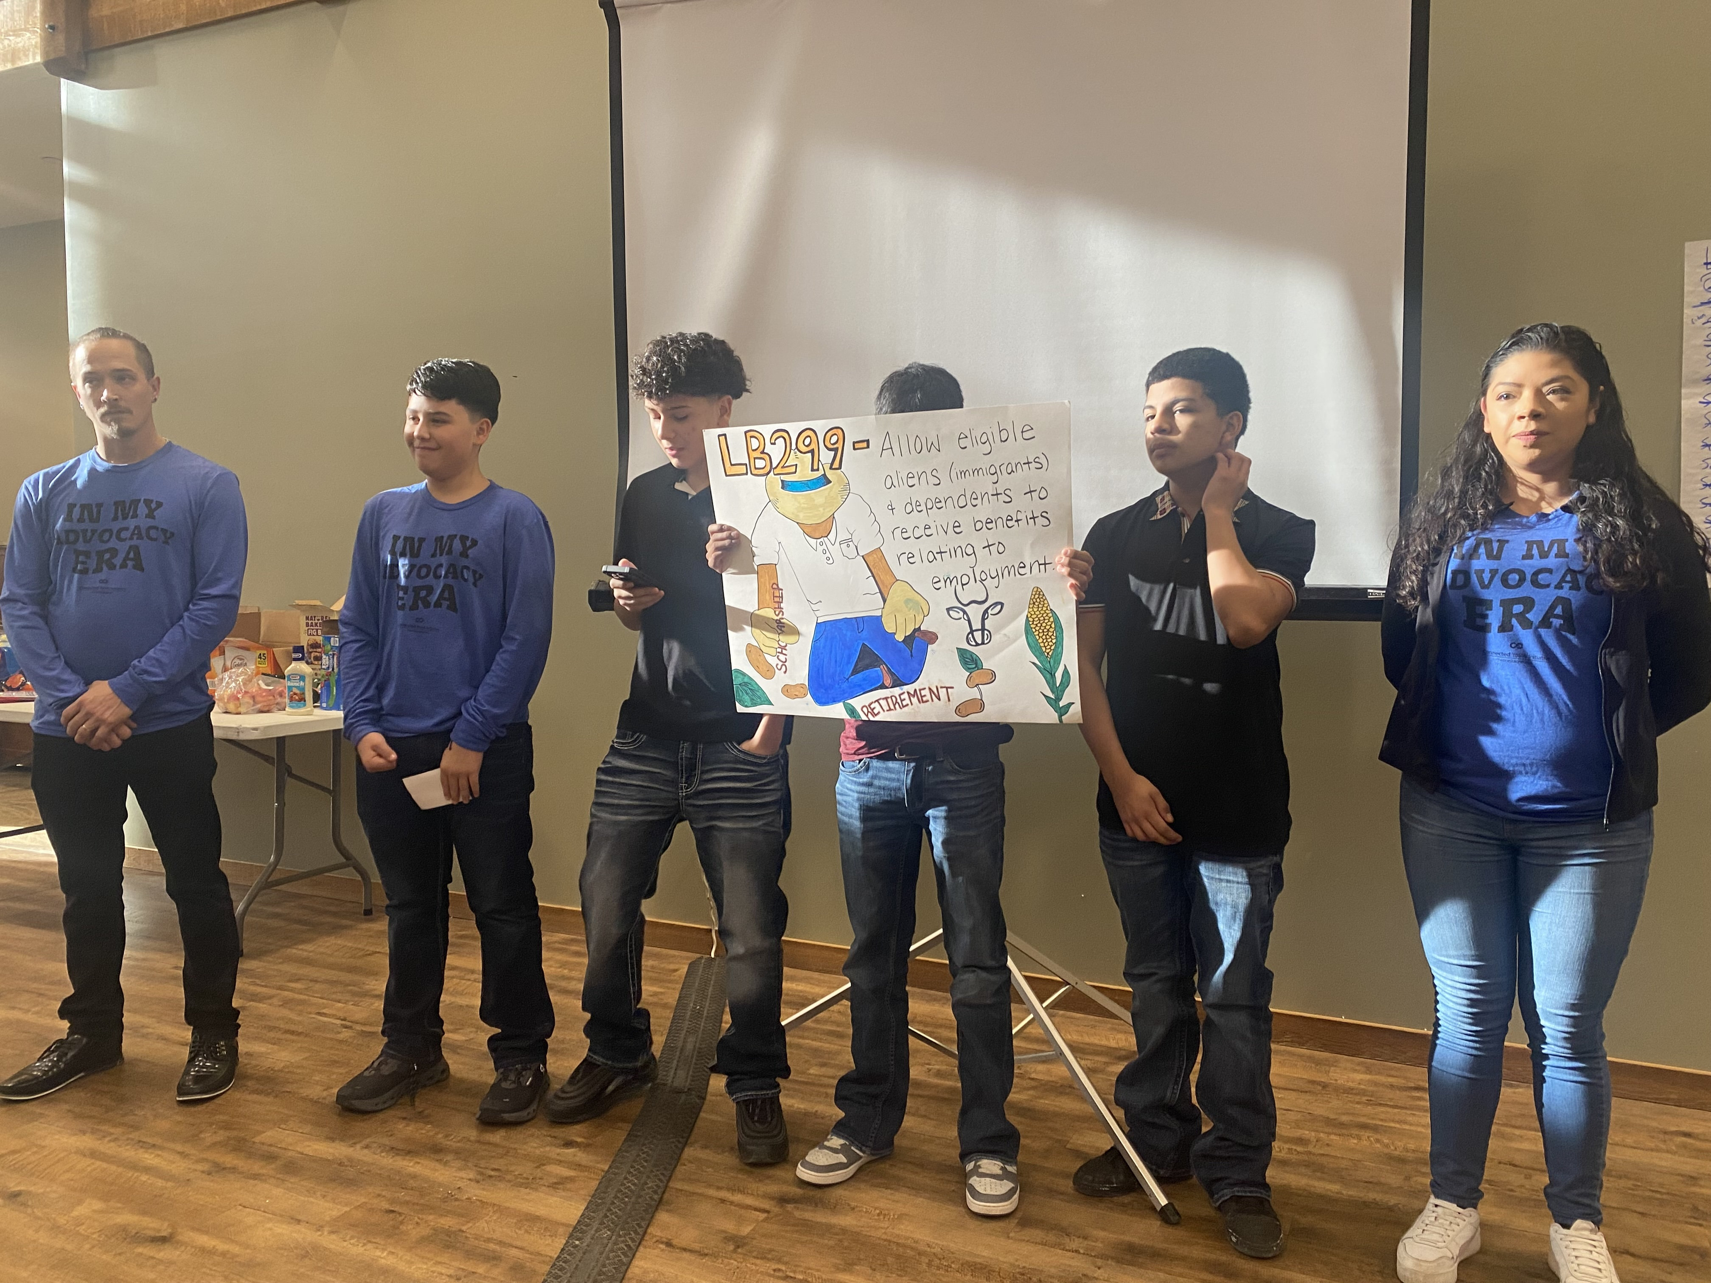
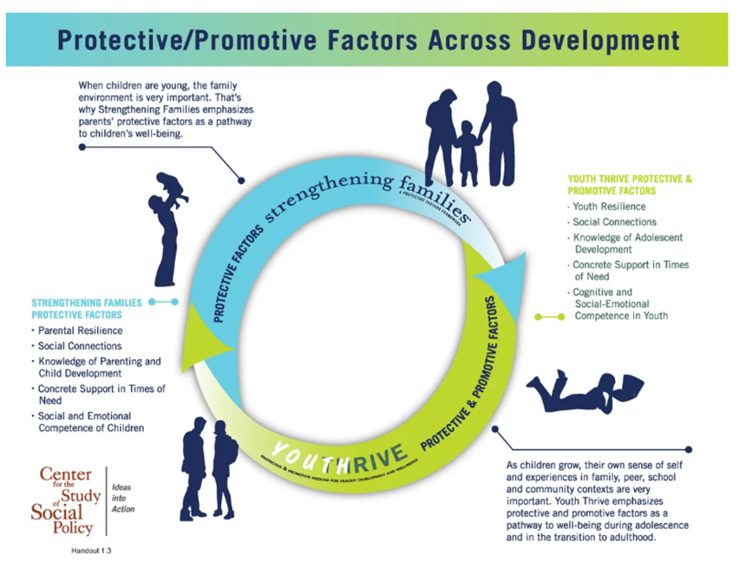
Why Giving Young and Young Adults Leadership Opportunities Matters
Notes:
Lincoln - 7 min

Slide 5
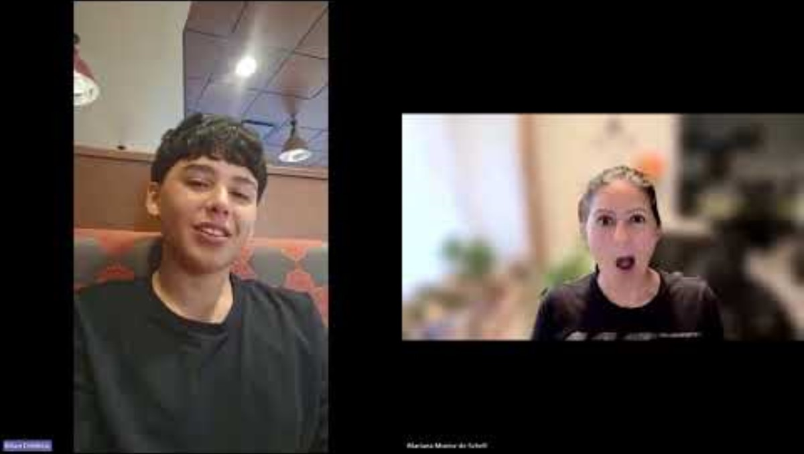
Notes:
Lincoln - 7 mins - Video in Spanish, with English subtitles

Slide 6

Reflection Prompts for Youth Leadership
What opportunities do you have for your local youth?
Is it really open to anybody?
How do you think these youth, who presented in their perferred langauge during Legislative Days, felt?
Notes:
Felipe - 5 mins
We can have more questions here.
-Additional questions:

Slide 7

Reflection Prompts on Language
How did you feel about the pieces of this presentation being in a different language?
Did you feel welcome?
Did you feel uncomfortable?
Was it challening to concentrate?
Notes:
5 mins – Mariana

Slide 8

Purpose of Leadership
Notes:
5 mins – Lincoln
What is being done
Why does it matter
Connection to future growth

Slide 9
Young Adult Perspective
Q&A with Bailey Herman
Notes:
5 – 7 mins
Felipe and XX

Slide 10

Why NCFF values youth leadership?
Individual level
Youth are often not included
They are directly impacted
Notes:
Lincoln – 4 mins
Why NCFF values youth leadership; what it can do for the individual, how these youth are often left out and why it matters to include them.
youth voice is important, especially for systems-involved or vulnerable populations, such as those who are non-English speaking youth (youth with English as a Second-Language)

Slide 11

Connection to Post Secondary Pathways
Youth Voice Builds Confidence
Confidence uplifts strengths
Strengths with the support of caring and knowledgable adults can be connected with career interests
Career interests are best accessed through postsecondary credentials
Inclusion must exten to non-English speakers
Notes:
Felipe – 7 mintues

Slide 12

Takeaways/Questions/Comments
Notes:
Team closes
If nothing else, here are our takeaways –
People communicate most comfortably in their maternal language—create space for this.
Provide welcoming spaces that encourage participation and authentic youth voice.
Consider who might be unitentionally excluded from opportunities.
Meet youth where they are, recognizing their unique contexts and experiences.
Invite and actively involve youth in decision-making teams.
Expand leadership opportunities to ensure representation of all youth.
Leadership and youth voice opportunities influence future trajectories, including postsecondary and career pathways.

Slide 13

Contact Us:
Lincoln Arneal
larneal@nebraskachildren.org
Felipe Longoria - Shinn
flongoria-shinn@nebraskachildren.org
Mariana Schell
mmunozdeschell@nebraskachildren.org
Notes:
5 mins – Mariana

Slide 14


