Slide 1



9/24/25

Slide 2



History of Bridges Out of Poverty - 1990’s
RUBY PAYNE
PHIL DEVOL
PHD in Education Leadership
20 plus years working in addictive counseling

Slide 3





Bridges Out of Poverty Background

Slide 4
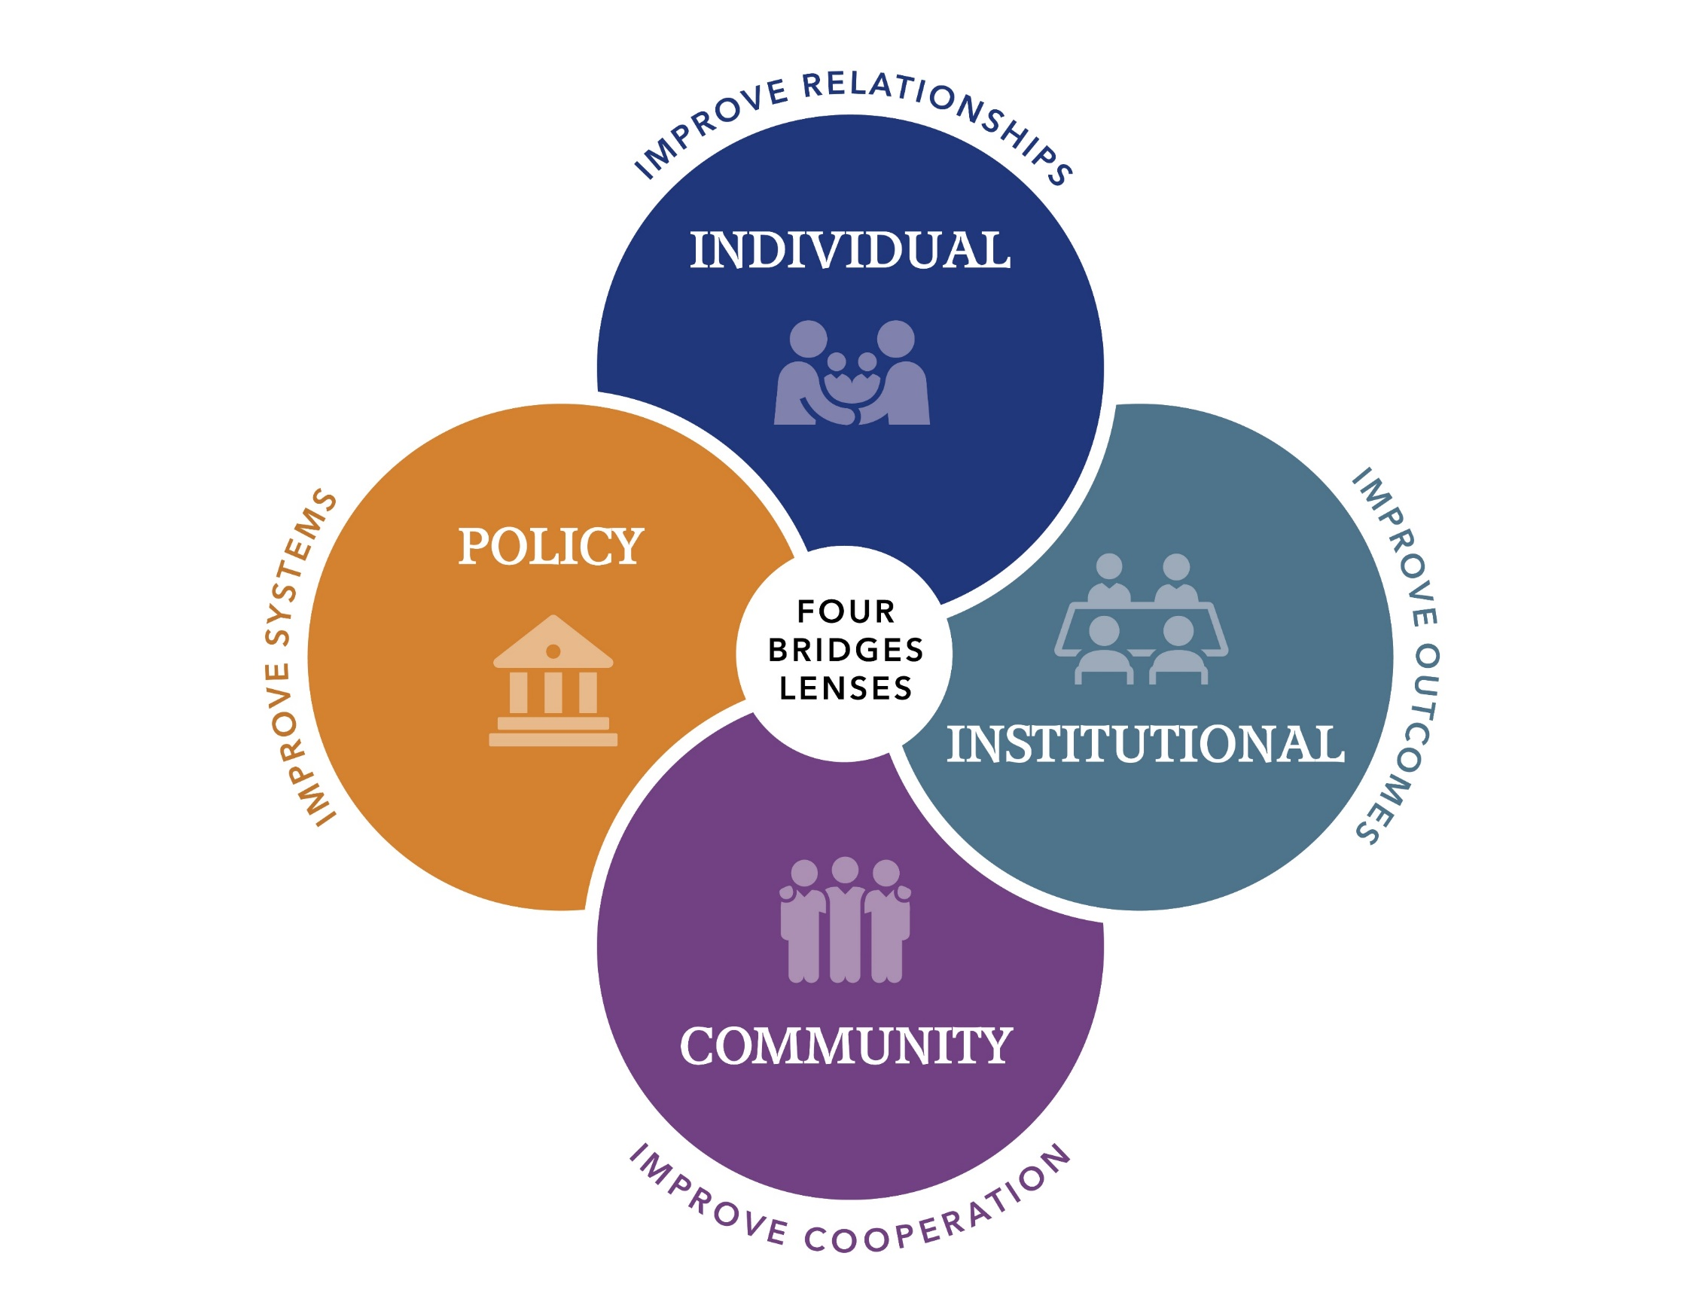
Bridges Lenses

Slide 5
Definition of Poverty by aha! Process Inc. – Bridges Out of Poverty
“the extent to which an individual does without resources.” This perspective emphasizes that poverty is not solely about economic status but also considers material, cultural, and social resources.”
11 resources …..

Slide 6

11 Resources
PHYSICAL
INTEGRITY
EMOTIONAL
MENTAL
SPIRITUAL
SOCIAL CAPITAL
FINANCIAL
LANGUAGE
PERSISTANCE
RELATIONSHIPS
KNOWLEDGE

Slide 7


Who is Omaha Bridges?
More Effective Communication
Cost / Leadership
Long-term Management
Motivated Team Members
We currently have not received state, federal or city tax dollars.
All programming is free to the participants.
Funding comes from grants, agencies, churches & individuals.
We do not require any
documents/paperwork
or any income.
We require most
participants to be 19 years of age or older.
Free unlimited life
coaching is offered for
all grads.
We are the local Omaha initiative that is non-profit.
There are over 225 Bridges initiatives across the world.
We started in 2016.
Wide Knowledge
Classes cover people, life & financial skills
We also offer workshops and poverty simulations.
Our mission is to help
end poverty and bring stability to people.
We have over 2,000 graduates from our program.

Slide 8
Tools used in class
MY LIFE NOW
LANGUAGE
THEORY OF CHANGE
CAUSES OF POVERTY
HIDDEN RULES
COMMUNITY ASSESSMENT
BUILDING RESOURCES
PERSONAL AND COMMUNITY PLANS
11 RESOURCES
ASSESSMENTS

Slide 9


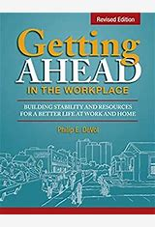

Curriculum Class Types
Getting Ahead in a Just-Getting’-By-World (General - 32 hours/ 19 years & up)
2) Getting Ahead While Getting Out (Correctional facility – 52 hours/ 19 years & up)
3) Getting Ahead in the Workplace (Work setting – 32 hours / 19 years & up)
4) R Rules (Highschool content – 32 hours / 16-19 years)

Slide 10
Class Testimonies
Getting Ahead in a Just-Getting’-By-World
Getting Ahead While Getting Out
3) Getting Ahead in the Workplace
4) R Rules

Slide 11

(531) 772-0724
R Rules-
Blackburn High School class success

Slide 12

(531) 772-0724
Gettin - By -
Miller Park school class success

Slide 13
Getting Out -
OCC class success
Graduation video from first cohort at Omaha Correctional Center -
20250531_144258000_iOS.MOV
Graduation testimony video from Omaha Correctional Center Graduation -
IMG_1145.MOV

Slide 14
Workplace -
Hospital success story
A local employee worked long shifts at a metro hospital while raising three young children. No matter how hard she tried, making ends meet always felt just out of reach.
Everything changed for her when she took the Getting Ahead in the Workplace class. With the support of her life coach, she started to feel valued and gained the confidence she had been missing. She asked her supervisor for a raise. After completing a market analysis, her supervisor decided to give her a $10 per hour increase.
What once felt impossible became reality—because she found her voice and had the courage to use it.

Slide 15






















Partners

Slide 16

Class Graduation Requirements
DEBT-TO-INCOME RATIO​
STABILITY SCALE​
REMOTE INTAKE​
SELF-ASSESSMENT
​
SMART GOAL ​
EXIT EVALUATION
COMPLETE THE ATTENDANCE REQUIREMENT

Slide 17
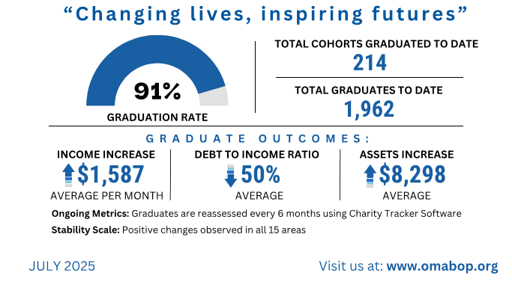
Stats about Omaha Bridges
​

Slide 18
Workshops offerings
General Workshops
Customizable to fit your specific needs
Duration: 30 minutes to 7 hours
Explores the Bridges Out of Poverty framework
Focuses on professional and economic perspectives to support community development
Poverty Simulation Workshops
Hands-on, interactive experience
Provides a deeper understanding of life in poverty
Not a game — an immersive educational tool
Builds empathy and sparks meaningful dialogue
2, 4 or 6 hours

Slide 19

Connect with Omaha Bridges
​

Slide 20

Any Questions

Slide 21



Contact Information
Main office for Bridges 402-884-9665
Greg Smith – 531-466-3946
LaShantra Waits – 531-772-0742
https://omabop.org
info@omabop.org
Greg’s – gsmith@omabop.org LaShantra’s – lshantra@omabop.org

