Slide 1



MDT COLLABORATION:
EFFECTIVELY USING MULTI-DISCIPLINARY TEAMS IN CHILD WELFARE CASES
Elizabeth Alt, MA, MPhil
Forensic Interview, Medical, and
MDT Engagement Coordinator

Slide 2
Objectives
Explore the statutory requirements for Multi-Disciplinary Teams (MDT)
Recognize the significance that MDTs can have on case review, investigations, and treatment planning
Discover the important role that you could play as an MDT member.
Discover how MDTs can be incorporated into your cases.

Slide 3

WHAT IS AN MDT?

Slide 4
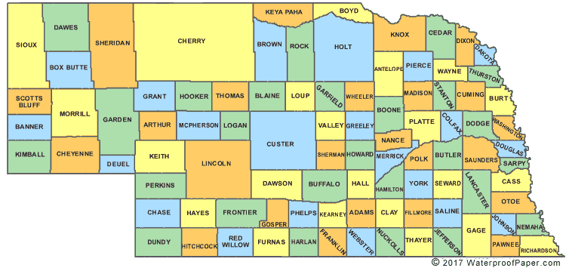
Nebraska Revised Statue 28-728
“It is the intent of the Legislature to create a child abuse and neglect investigation team in each county or contiguous group of counties and to create a child abuse and neglect treatment team in each county or contiguous group of counties.”

Slide 5

MDTs
Multi-Disciplinary Teams are systematic reviews of child abuse and neglect cases by professionals within the community that make recommendations for how to move the case forward.

Slide 6





MDT Statutory Requirements: Nebraska Revised Statute 28-728-729
County Attorney
“responsible for convening the child abuse and neglect investigation team and ensuring that protocols are established and implemented.”
Treatment and Investigative Teams
Investigative team: DHHS, Law enforcement, CAC, and other agencies determined by the team
Treatment team: DHHS, probation, mental health professional, medical, school district, CAC, and other agencies determined by the team
CAC Facilitator
“A representative of the child advocacy center assigned to the team shall assist the county attorney in facilitating case review, developing and updating protocols, and arranging training opportunities for the team.”

Slide 7

Case Review
Interview outcomes
Progress of the investigation/case updates
Medical evaluations
Child protection/safety issues
Input for prosecution and sentencing decisions
Emotional support/treatment needs and strategies for meeting those needs
Family’s reactions to the child’s disclosure and involvement in CPS
Review of criminal and civil case updates and ongoing involved of child and family
Court support/education
Ensure that all children and families are afforded the legal rights and comprehensive services
CAC/MDT intervention is impacting child and family
Child well-being and outcomes

Slide 8

WHY ARE MDTS IMPORTANT?

Slide 9

What cases can be staffed?
Hotline Intakes
Non-Court Cases
Court involved Cases
Cases in Investigative stage
Non DHHS involved cases
Community Referrals

Slide 10

Investigation MDTs
-Next steps for investigations
-Recantation has occurred
-Should FIs be conducted?
-Information sharing
-Should charges be filed?
-Should a petition be filed?

Slide 11

Treatment MDTs
-Truancy
-Addressing basic needs
-Placement concerns
-Type of treatment and evaluations
-School placement
-Information sharing
-Engaging parents
-Visitation

Slide 12

WHAT ROLE CAN YOU PLAY ON MDTS?

Slide 13
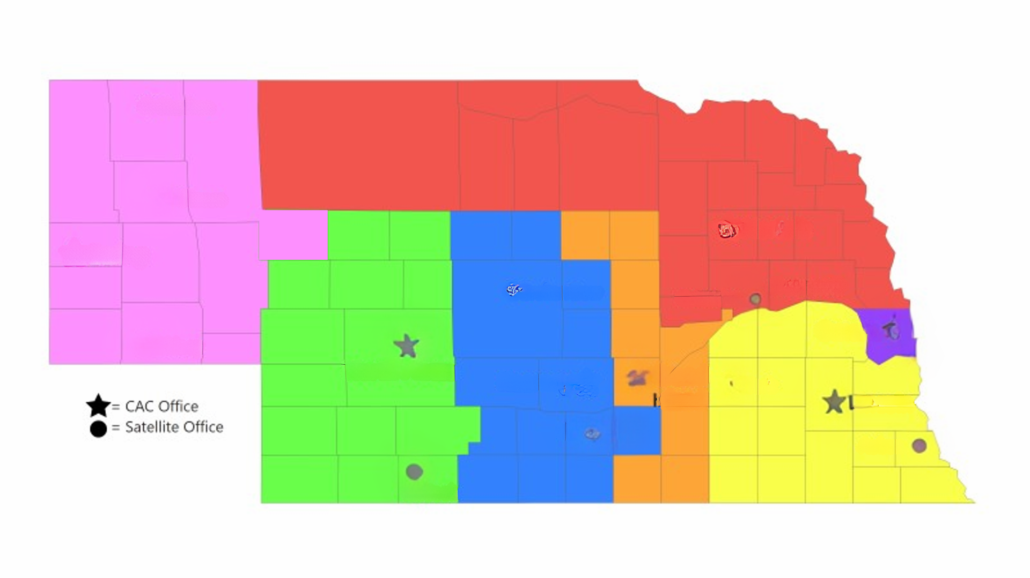

Child Advocacy Center Coverage
Chadron
Alliance
Norfolk
Gering
Broken
Bow
Columbus
Omaha
Sidney
Grand
Island
North
Platte
Kearney
= CAC Office
York
Lincoln
= Satallite
Hastings
McCook
Beatrice

Slide 14

MDT Member Role
-Participate in Case Review
-Collaboration
-Information Sharing
-Referring Cases to MDTs
-Utilizing MDTs in Difficult Cases
-Making recommendations and
next steps

Slide 15

USING MDTS TO ASSIST THE FAMILIES THAT YOU WORK WITH

Slide 16



Considerations for Incorporating MDTs into your Cases
What are the barriers and challenges in the case?
How can you encourage the use of MDTs in your field?
How can you use the recommendations from the MDT in your field?

Slide 17
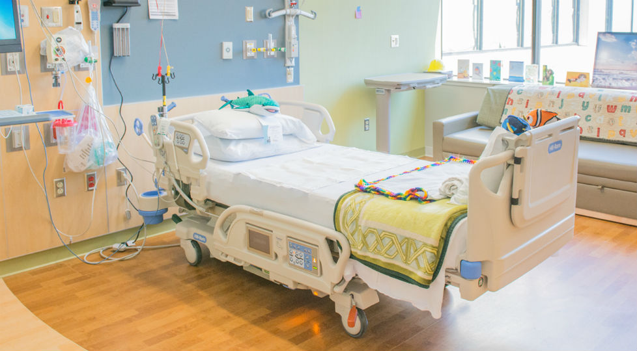


Case Study 1
Lack of Progress in Juvenile Court Case
Case Background
MDT Discussion
Recommendations
-Young boy admitted to hospital with unexplained injuries
-Concerned that mother caused the injuries
-Tension between the mother and all case professionals
-Generational Trauma
-The team relooked at the case with a new perspective
-Teach mom about her own attachment and her attachment to her children
-Develop a plan where mom consults social workers regarding children’s care
-DV services and interventions

Slide 18


Case Study 2
Roadbump in Investigation
Case Background
MDT Discussion
Recommendations
-Father produces CSAM that includes children
-Children disclosed at school
-CSAM was not found during initial investigation, but some supporting evidence was found
-Children were terrified to testify
-What was disclosed during the FI?
-The father had older children out of state that could be contacted
-Could technology be seized and searched?
-Locate older children and see if they had information about their past or what was currently happening to younger siblings
-See if older children would testify
-Get a search warrant for electronics
-Monitor calls to make sure mother and father were not communicating

Slide 19


Case Study 3
Concerns for Truancy
Case Background
MDT Discussion
Recommendations
-Family has 3 children that are frequently missing school
-Grandmother attendance vs Mother attendance
-Concerns for hygiene
-What are the barriers to coming to school?
-What are the school procedures for calling the hotline
-What information does the hotline need for an intact
-Brainstorm with Mother her transportation options
-Compile all the information from school professionals regarding family for 1 hotline call

Slide 20

HOW WILL YOU USE YOUR LOCAL MDT?

Slide 21


Contact Information
For more information about MDTs, visit our website: https://www.nebraskacacs.com/mdt-enhancement/
Elizabeth Alt, MA, MPhil
Forensic Interview, Medical, and MDT Engagement Coordinator
ealt@nebraskacacs.com

