Slide 1
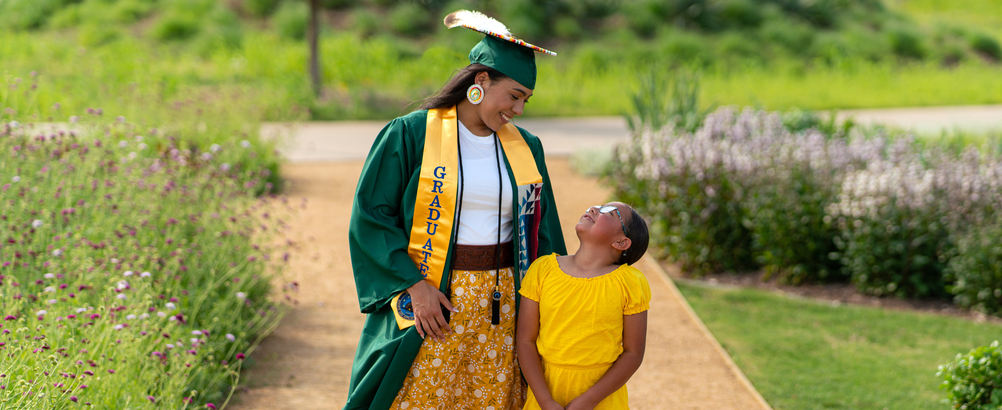
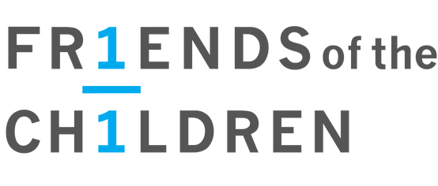

Friends of the Children
Mentoring and Kinship for Indigenous Youth and Families

Slide 2
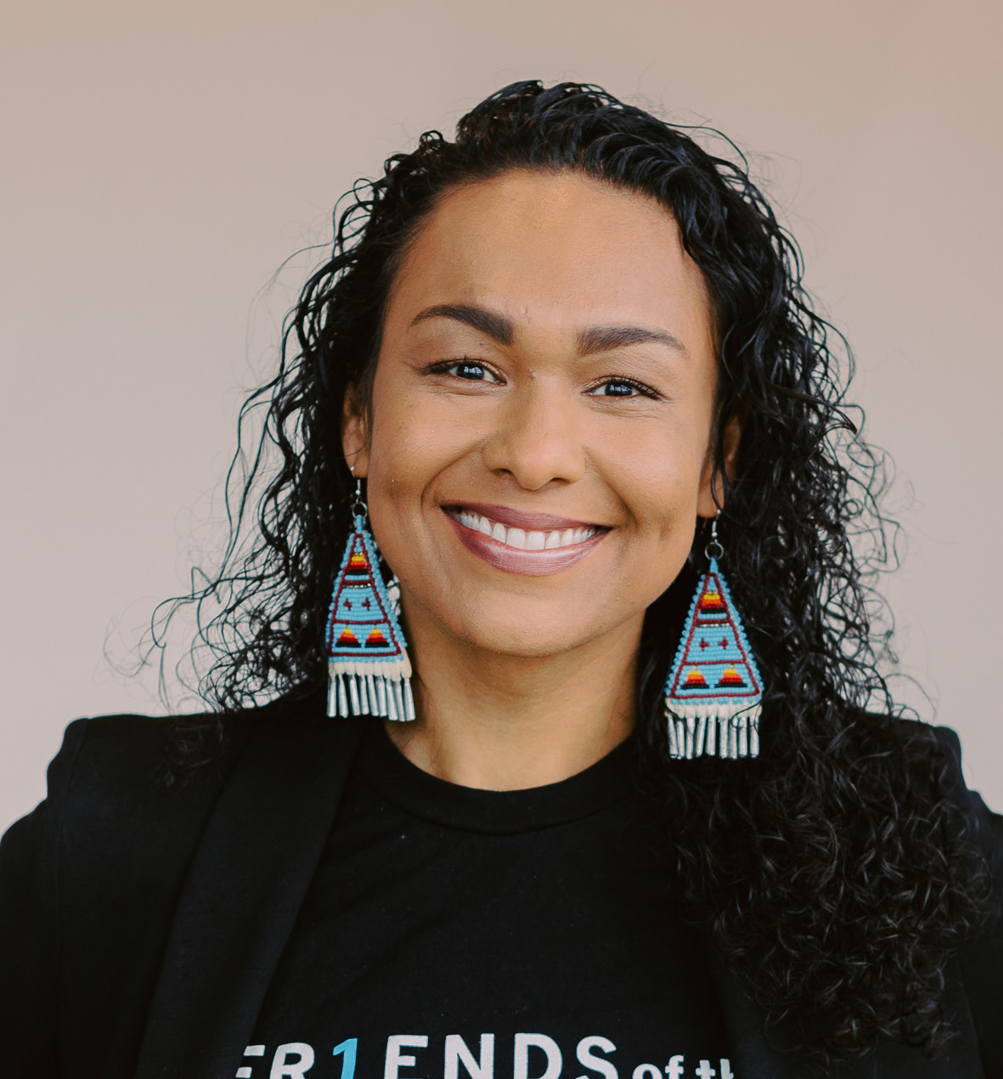
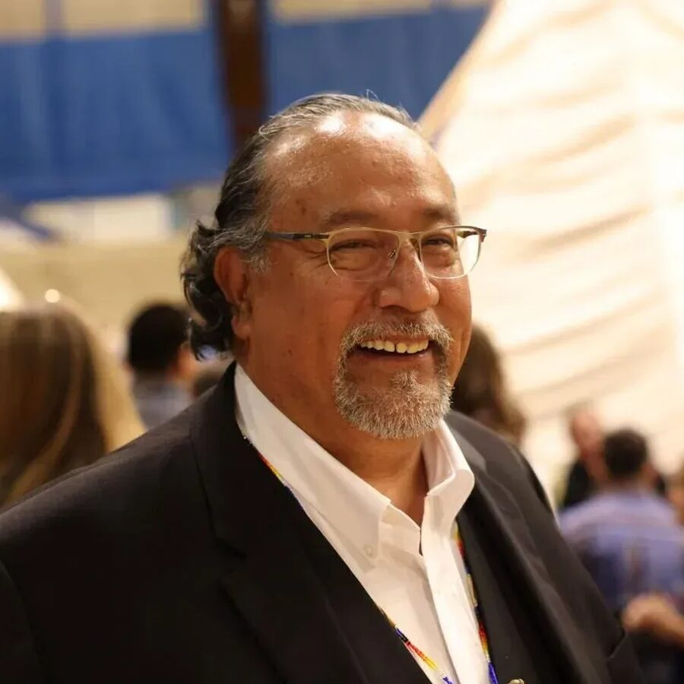
Presenters
Tasha R. Mousseau JD
Pejuta Cangleska Win
Sacred Medicine Circle Woman
Wichita, Kiowa, Caddo, Hunka Oglala Lakota
Chief Officer of Advancement and Tribal Relations
Friends of the Children – National
Walt Swan Jr
Cheyenne River Sioux
Executive Director
Friends of the Children – He Sapa

Slide 3
OPENING IN A
GOOD WAY

Slide 4
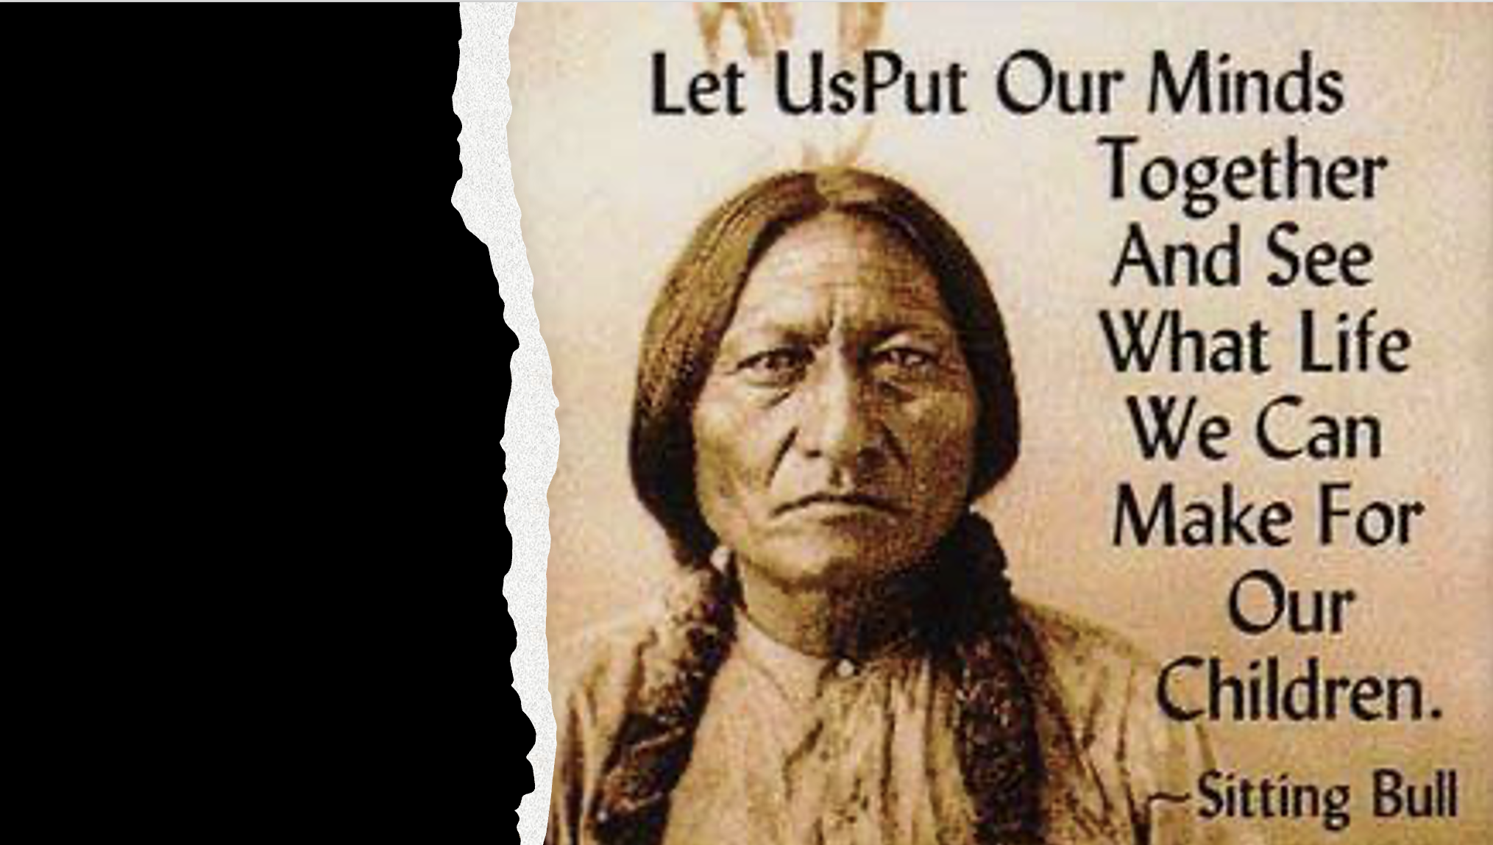

Slide 5
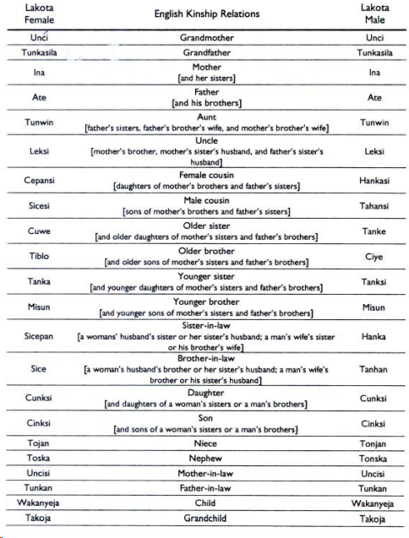
Lakota Kinship Exercise

Slide 6
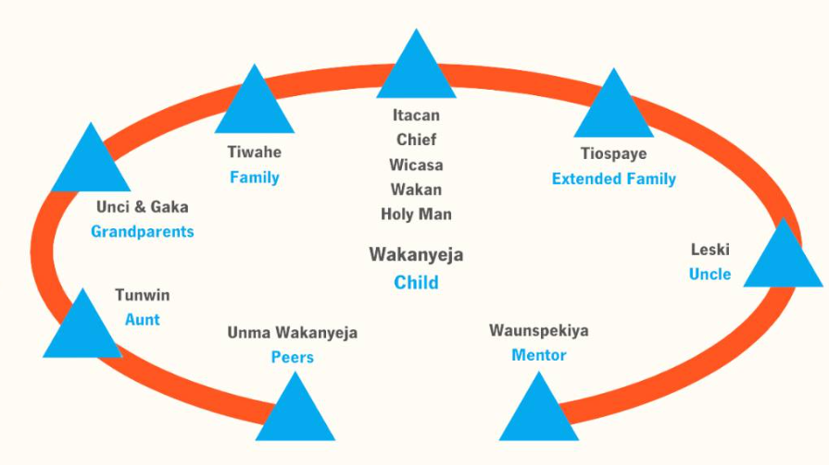
This representation of the extended kinship model is based on the work of Richard Two Dogs and is shared with is permission.

Slide 7
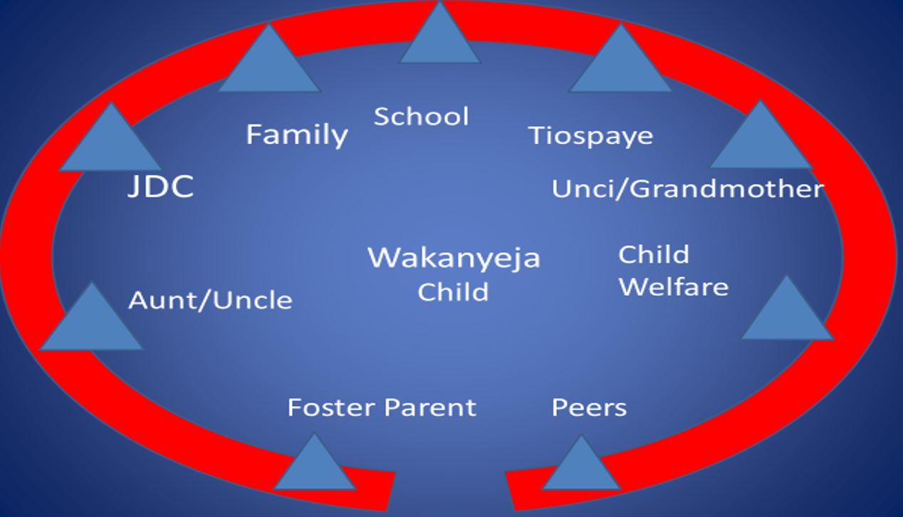

Slide 8
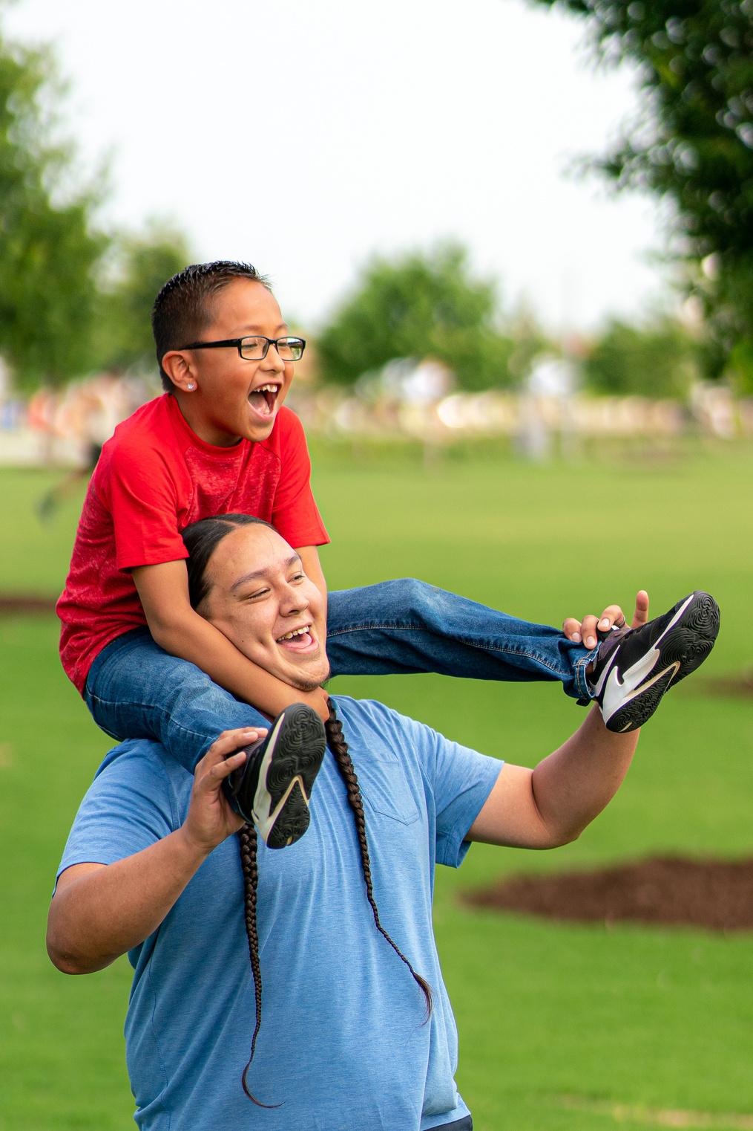
Model
12 years+ No Matter What
Paid Professional Mentor
Youth ages 4-6 with greatest risk factors & lowest protective factors
Consistent Presence
2 Gen Approach

Slide 9
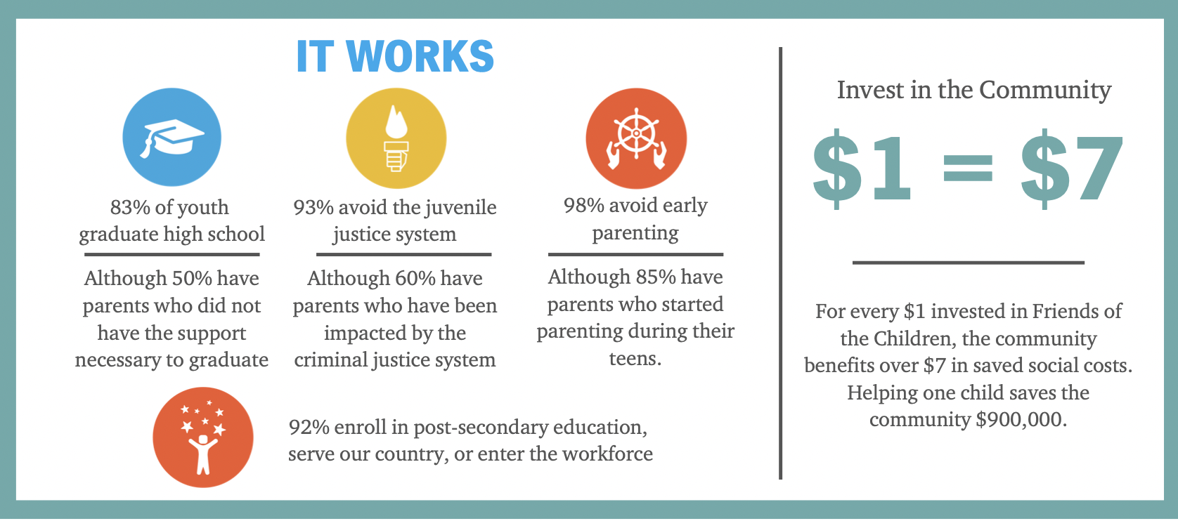
Impact

Slide 10
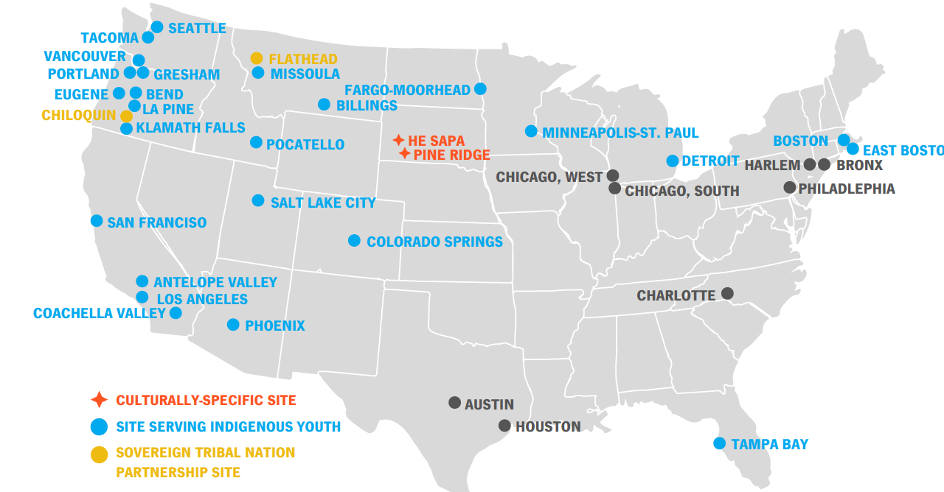
Where We Work

Slide 11
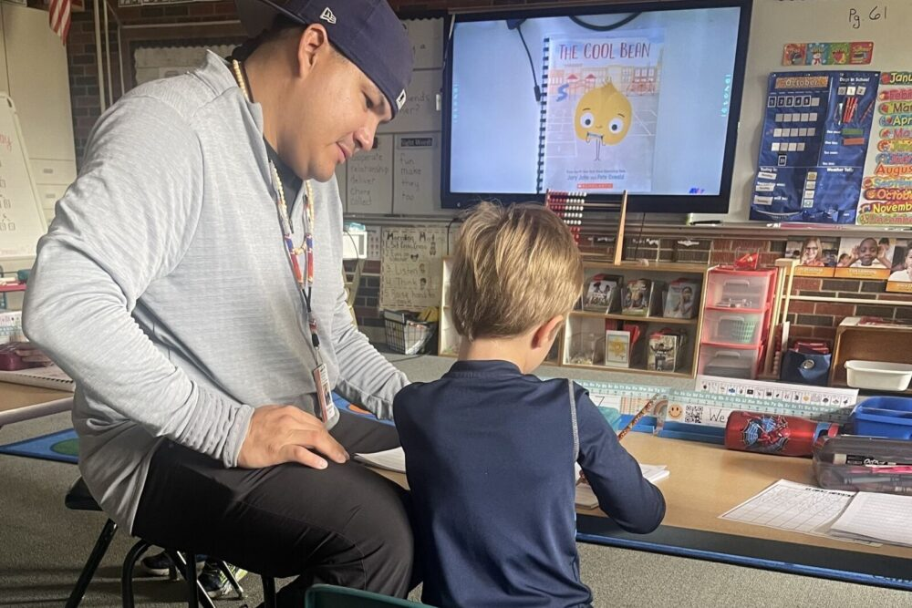
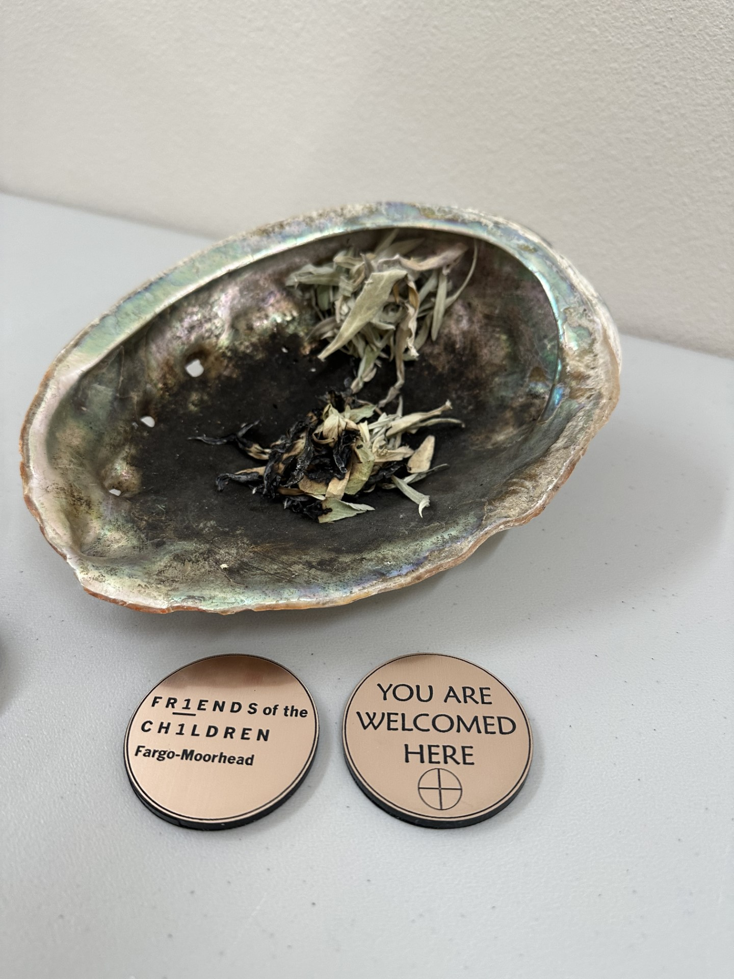
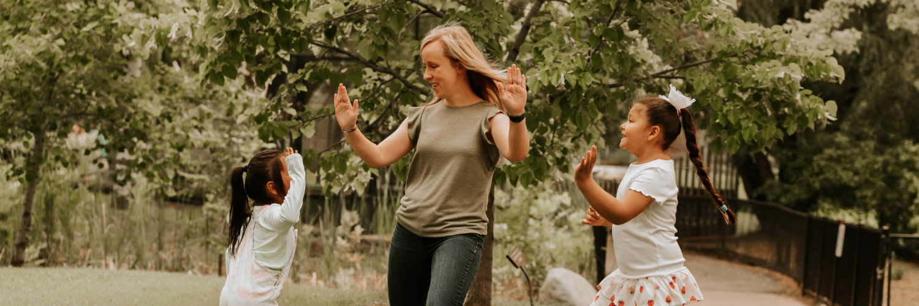
Chapter Diversity: Tribal, Urban, Rural
Klamath Falls/Chiloquin
Western Montana/Flathead Reservation
He Sapa/Rapid City/Pine Ridge Reservation
Eastern Montana
Twin Cities
Fargo-Moorhead
Eastern Idaho
Eastern Washington

Slide 12
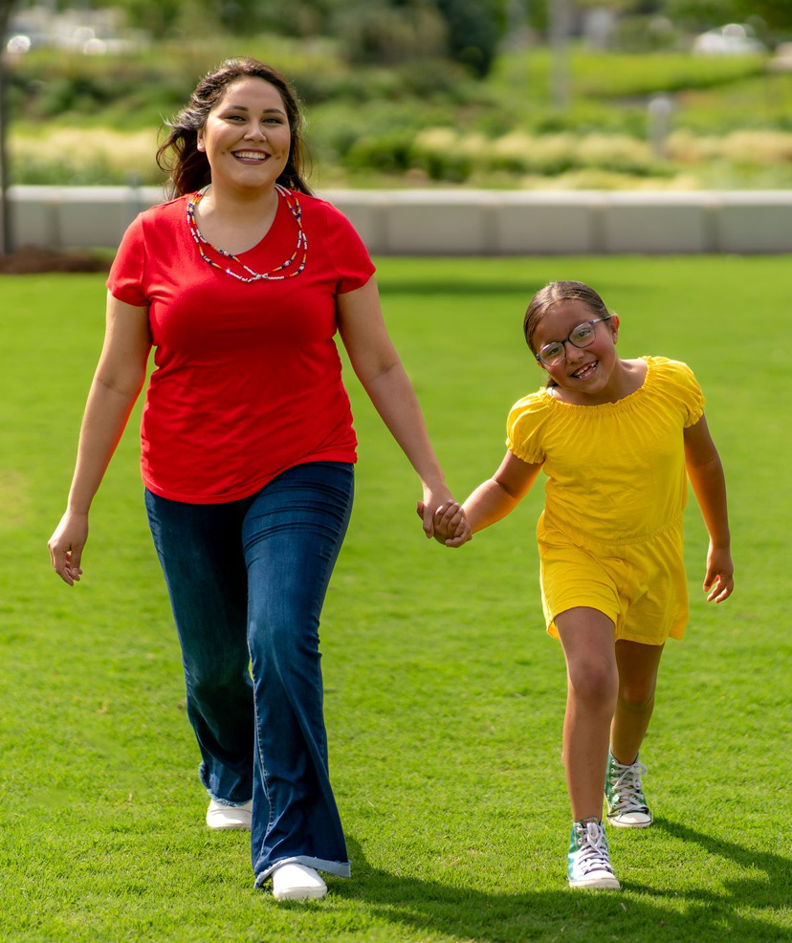
Growth in Indian Country
Acknowledgment of and Respect for Tribal Sovereignty
Acknowledgement and respect for inter-tribal communities
Alignment of Values
Shared Goals
Culturally Grounded vs. Culturally Adapted
Culturally Responsive
Reflective of Community Specific Culture

Slide 13



Partnering with Tribal Communities

Slide 14
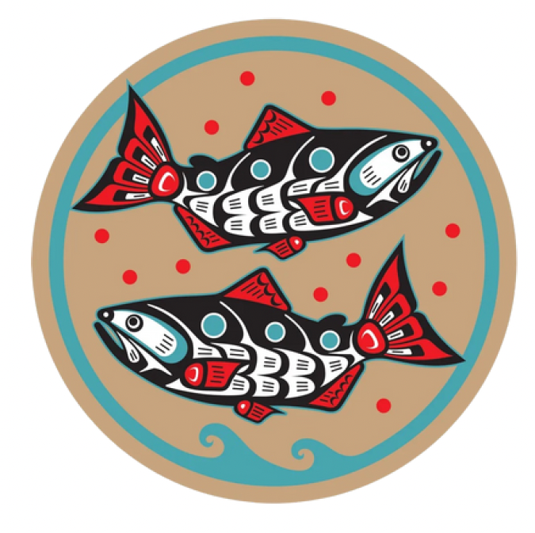
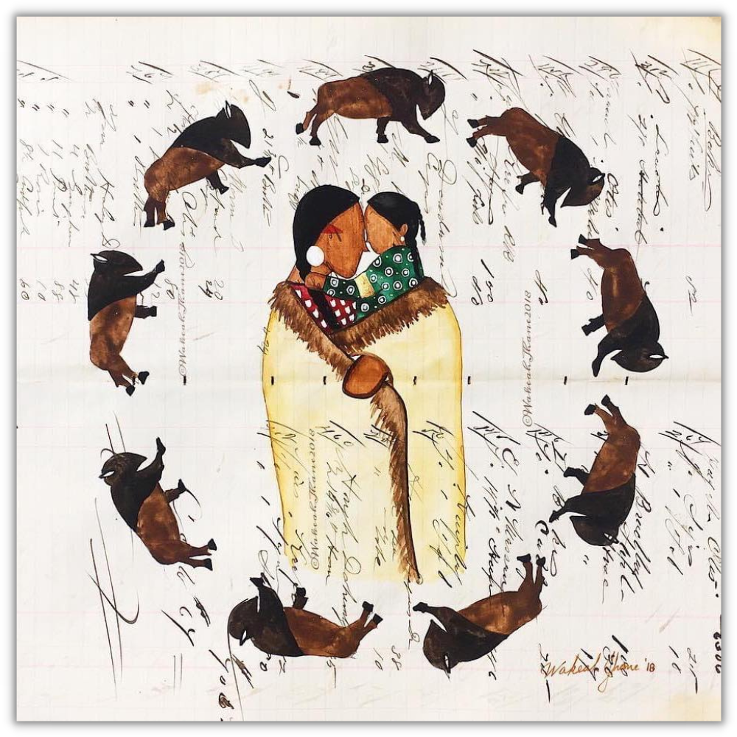
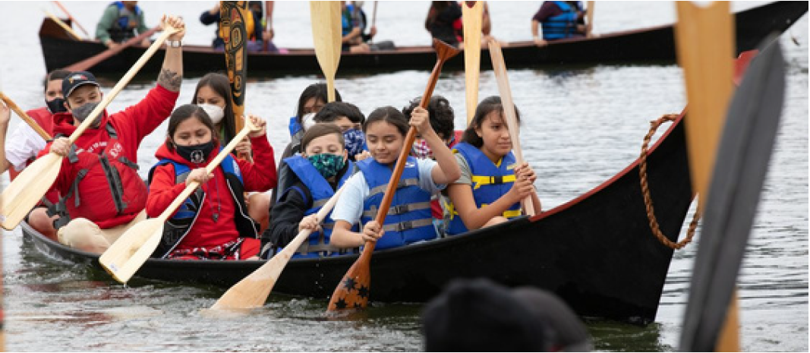
Approach

Slide 15
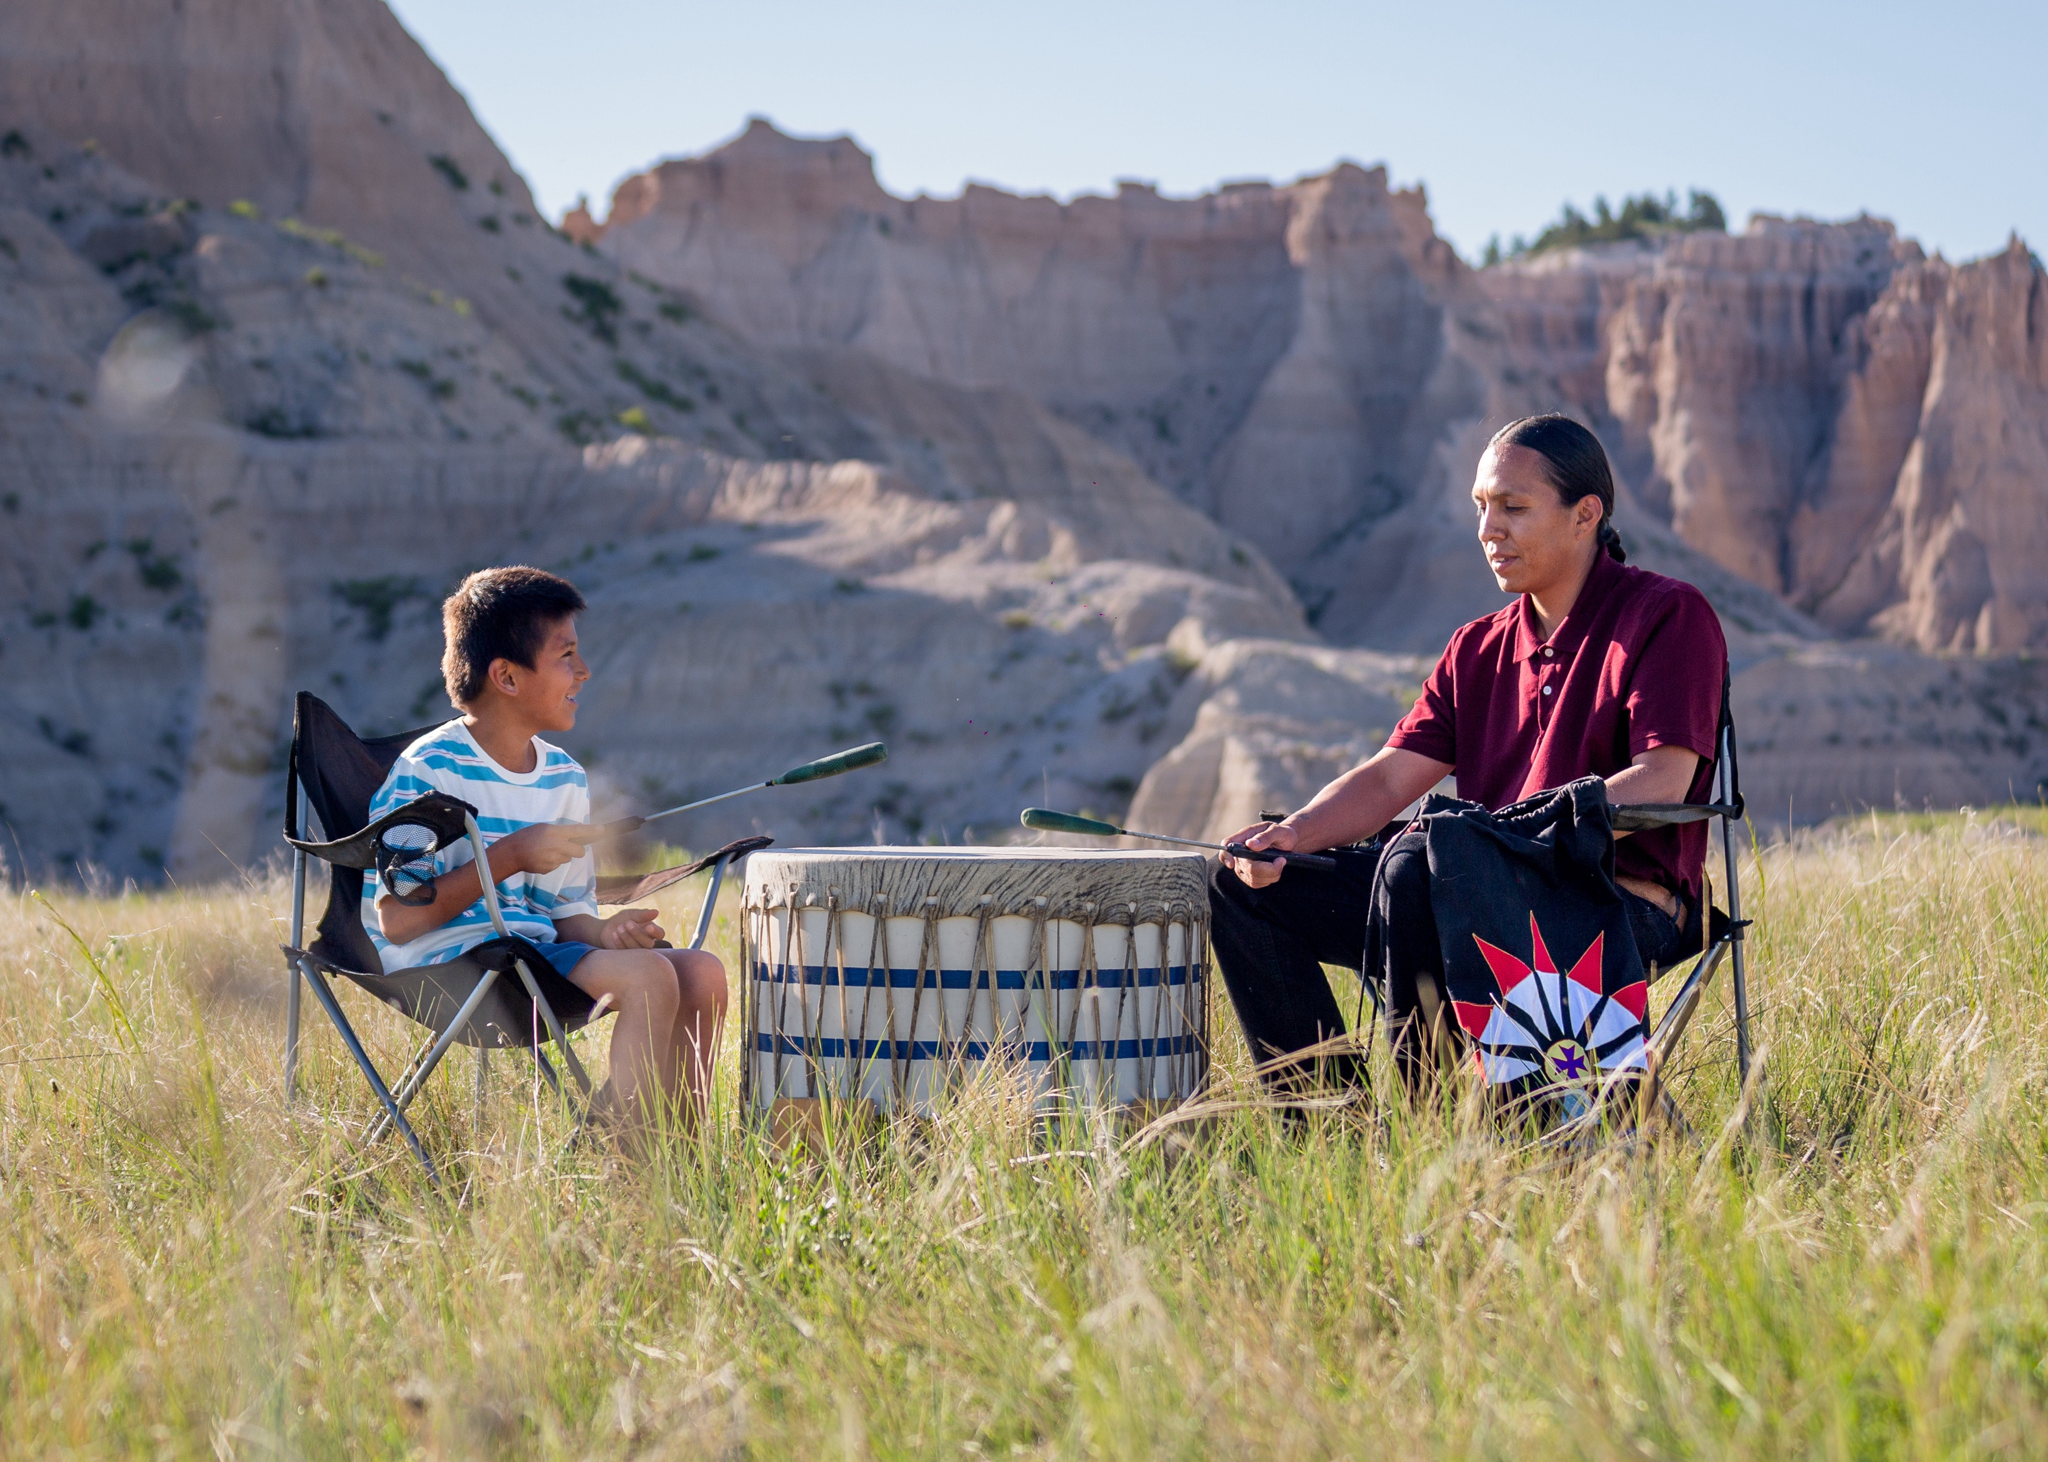
Friends of the Children He Sapa
Established 2022
62 Lakota youth in 2 separate areas of South Dakota, Pennington County (Rapid City Area) and a 30-mile radius of Wounded Knee District School
28 Youth-Rapid City Site
34 Youth-Oglala Lakota Nation sites
164 caregivers
8 Relatives (Profess
25 of 62 youth in foster care (state/tribal/kinship)
10 of 164 caregivers who are incarcerated
Using our Family/Kinship approach, we help or affect close to 300 youth. More if you include classroom affect.

Slide 16
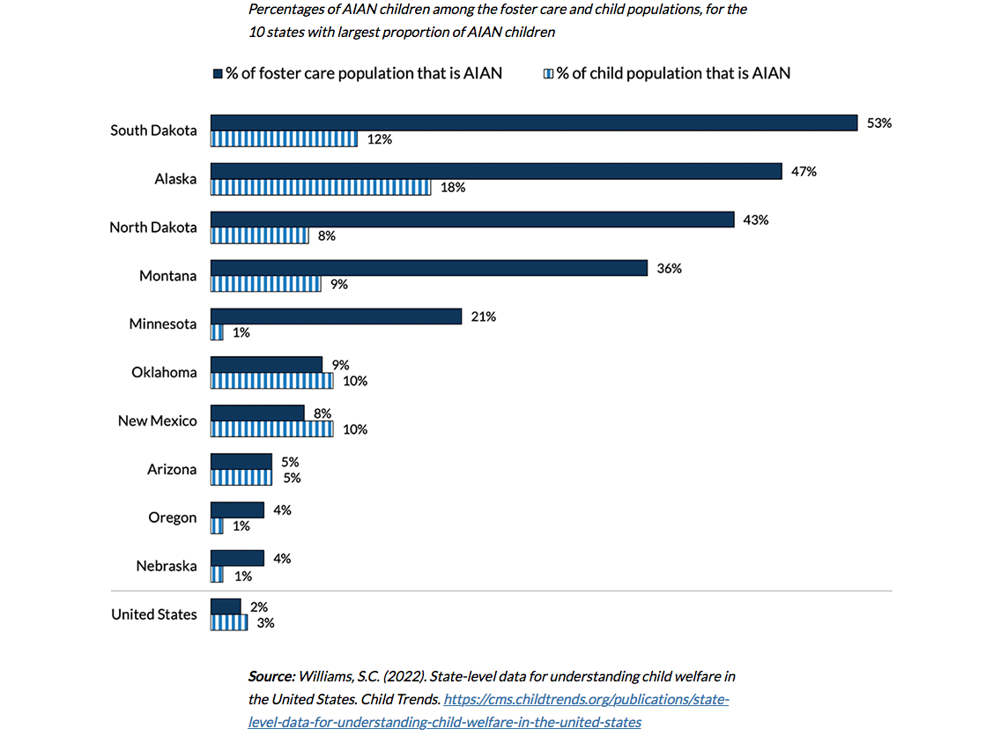
South Dakota Foster Care

Slide 17
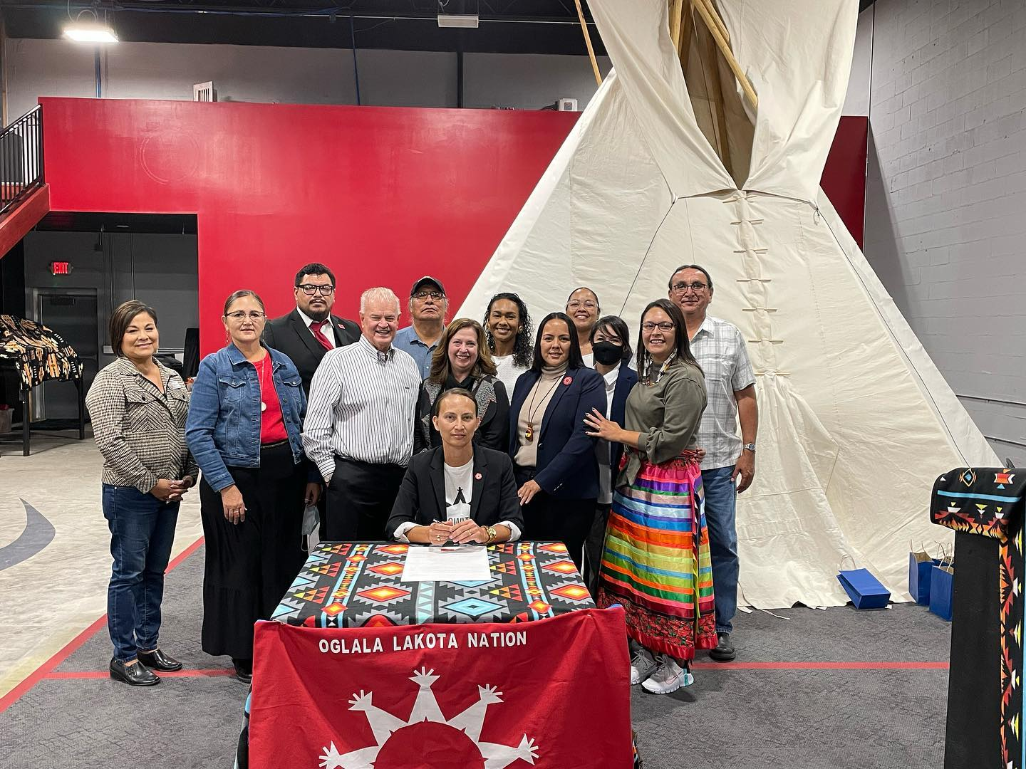
Oglala Sioux Tribe
Community Advisory Board
Board of Directors Representation
Job Creation
School Partnerships
ICWA/CPS State of Emergency Declaration
ICWA Taskforce
Introduction of State ICWA Legislation

Slide 18
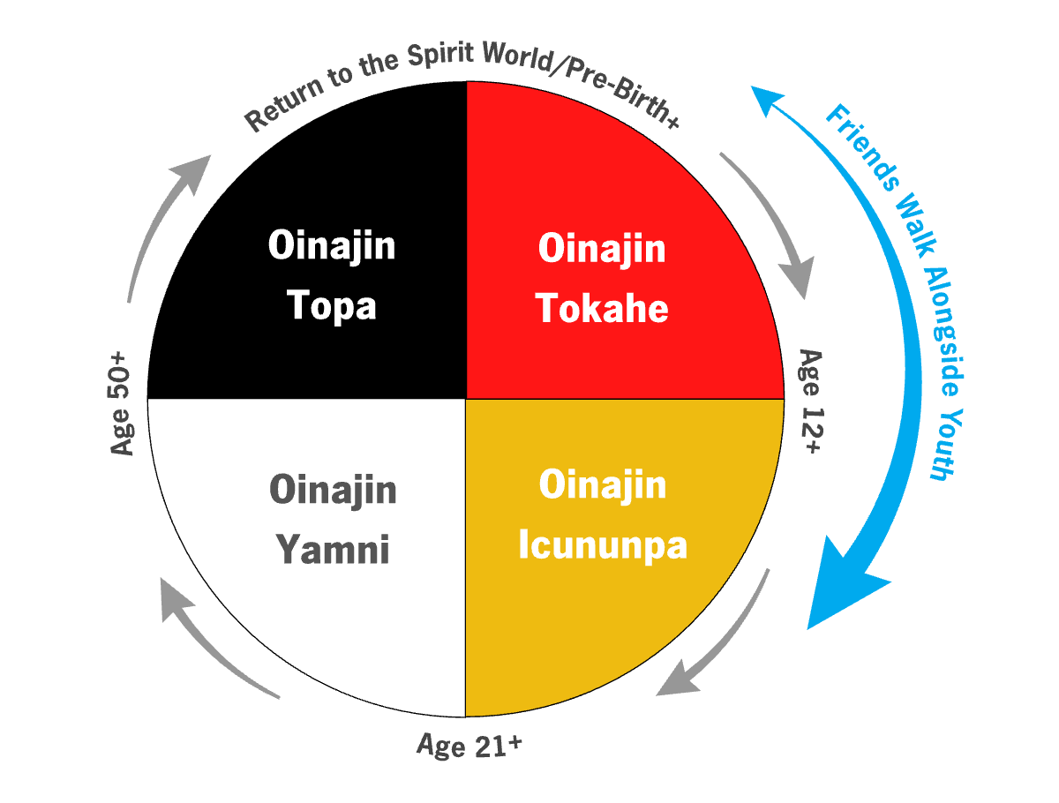
Friends of the Children – He Sapa
Combining Evidence-Based Research with Practice-Based Indigenous Ways of Knowing and Being
Wakanyeja ta Wolakota
Walking alongside youth nearly half of the Oinajin Topa (four stages of Lakota life)
Grounded in Lakota values and philosophy
Naming ceremonies, making of relatives, coming of age ceremonies, healing camps
Friends walk alongside youth
Incorporating family and strengthening family kinships
Integrating culture and language
Culture and language serve as protective factors for Indigenous youth.

Slide 19
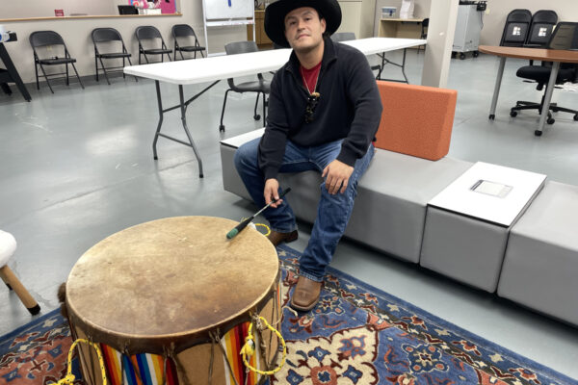
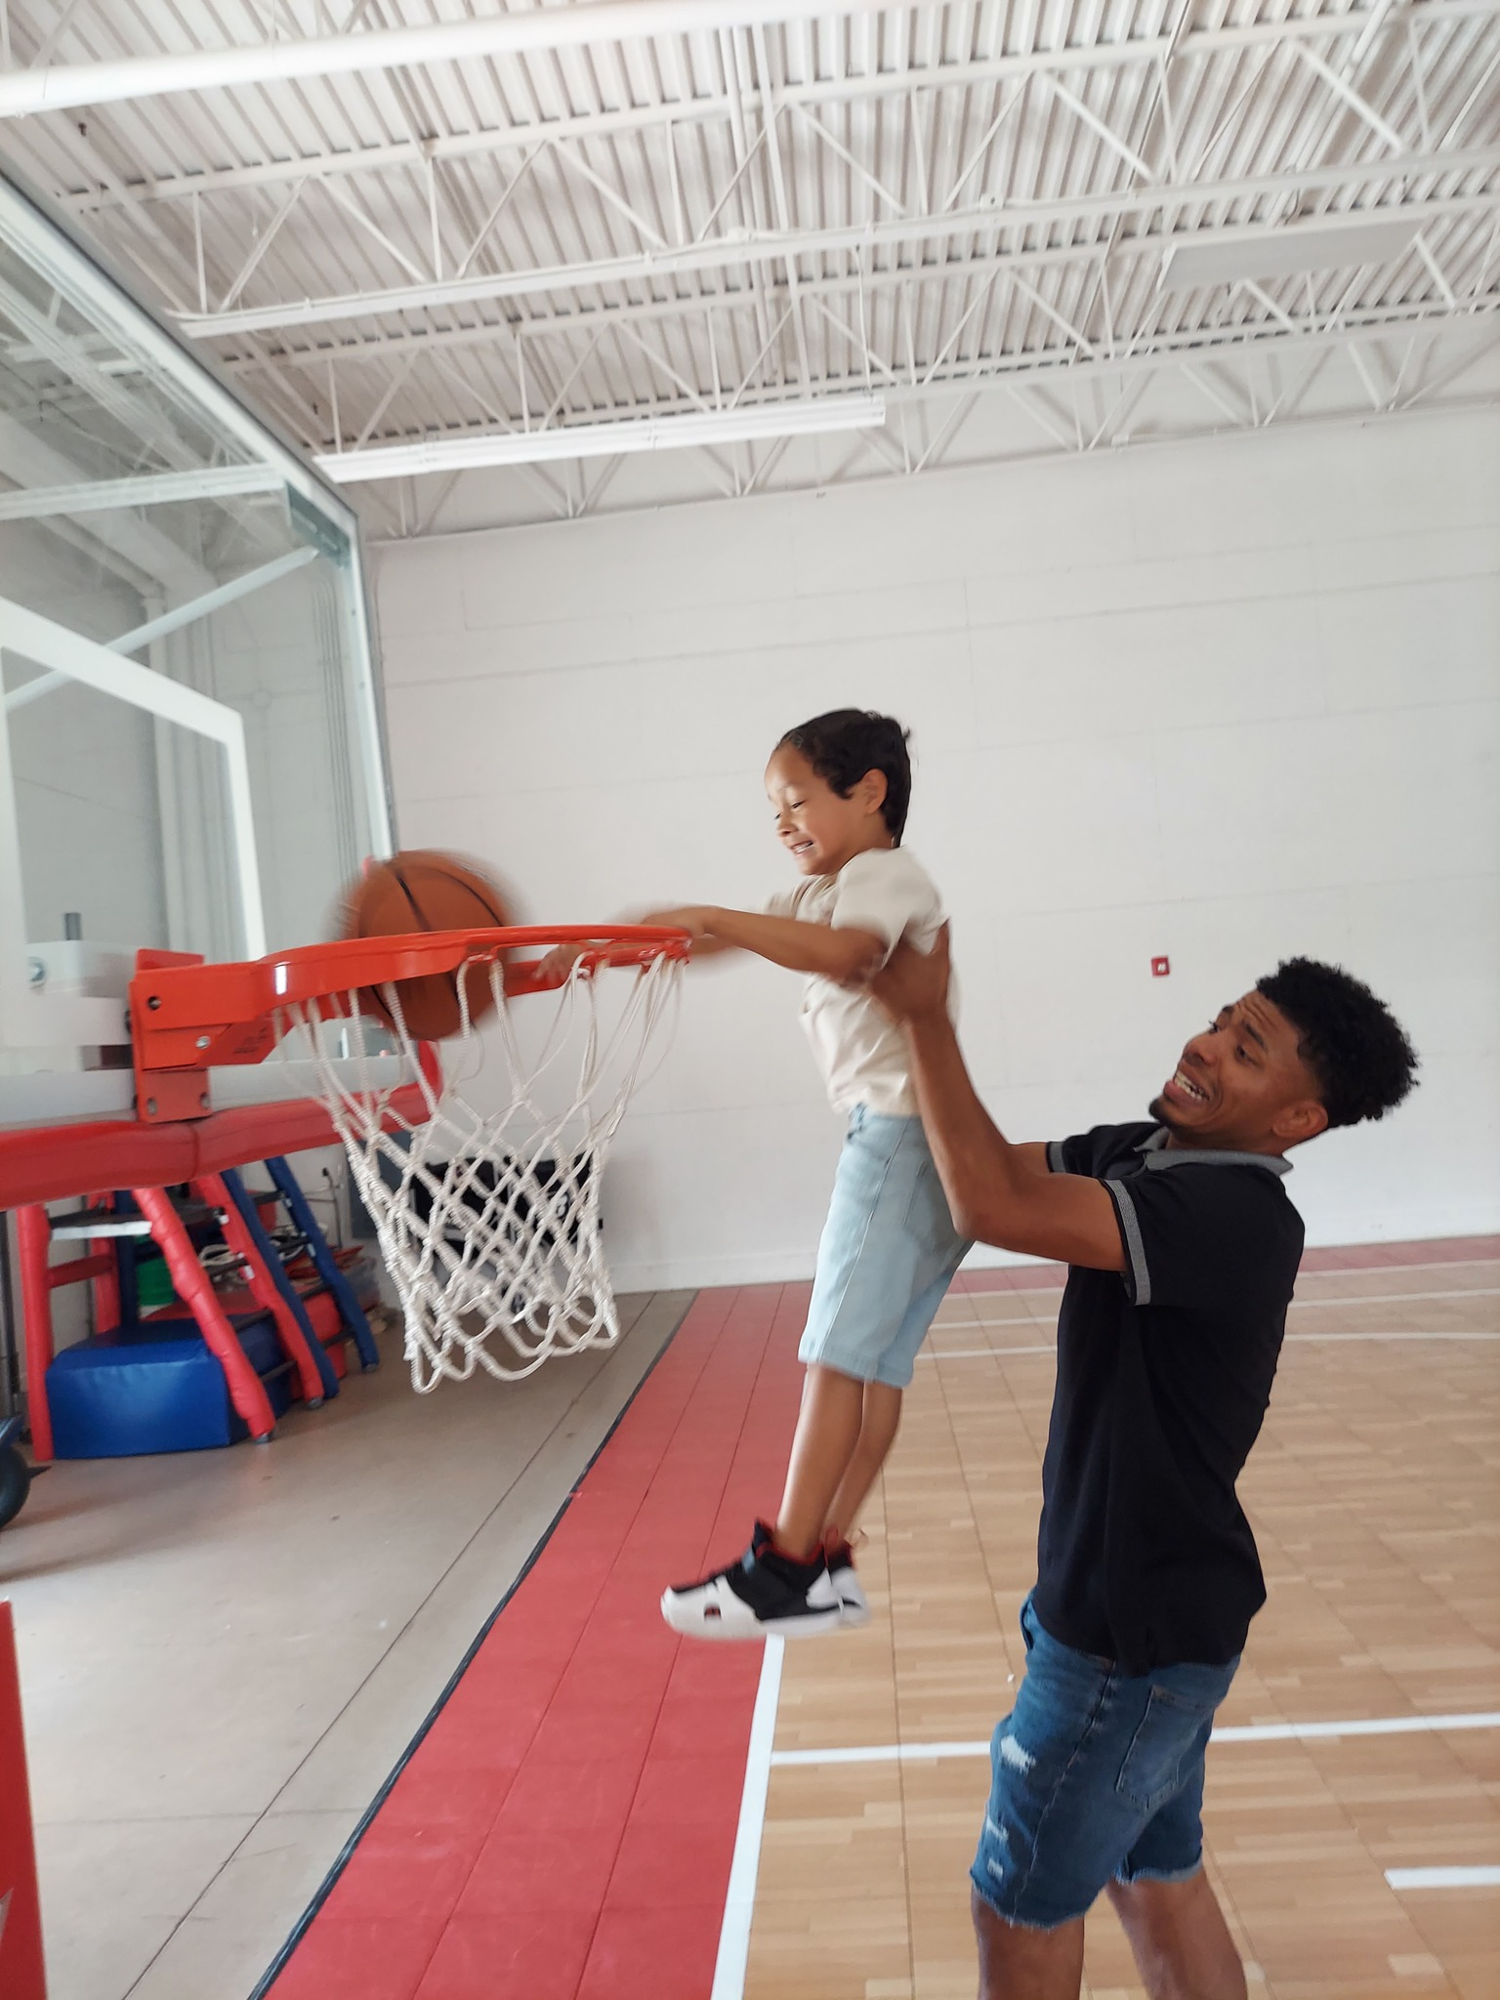
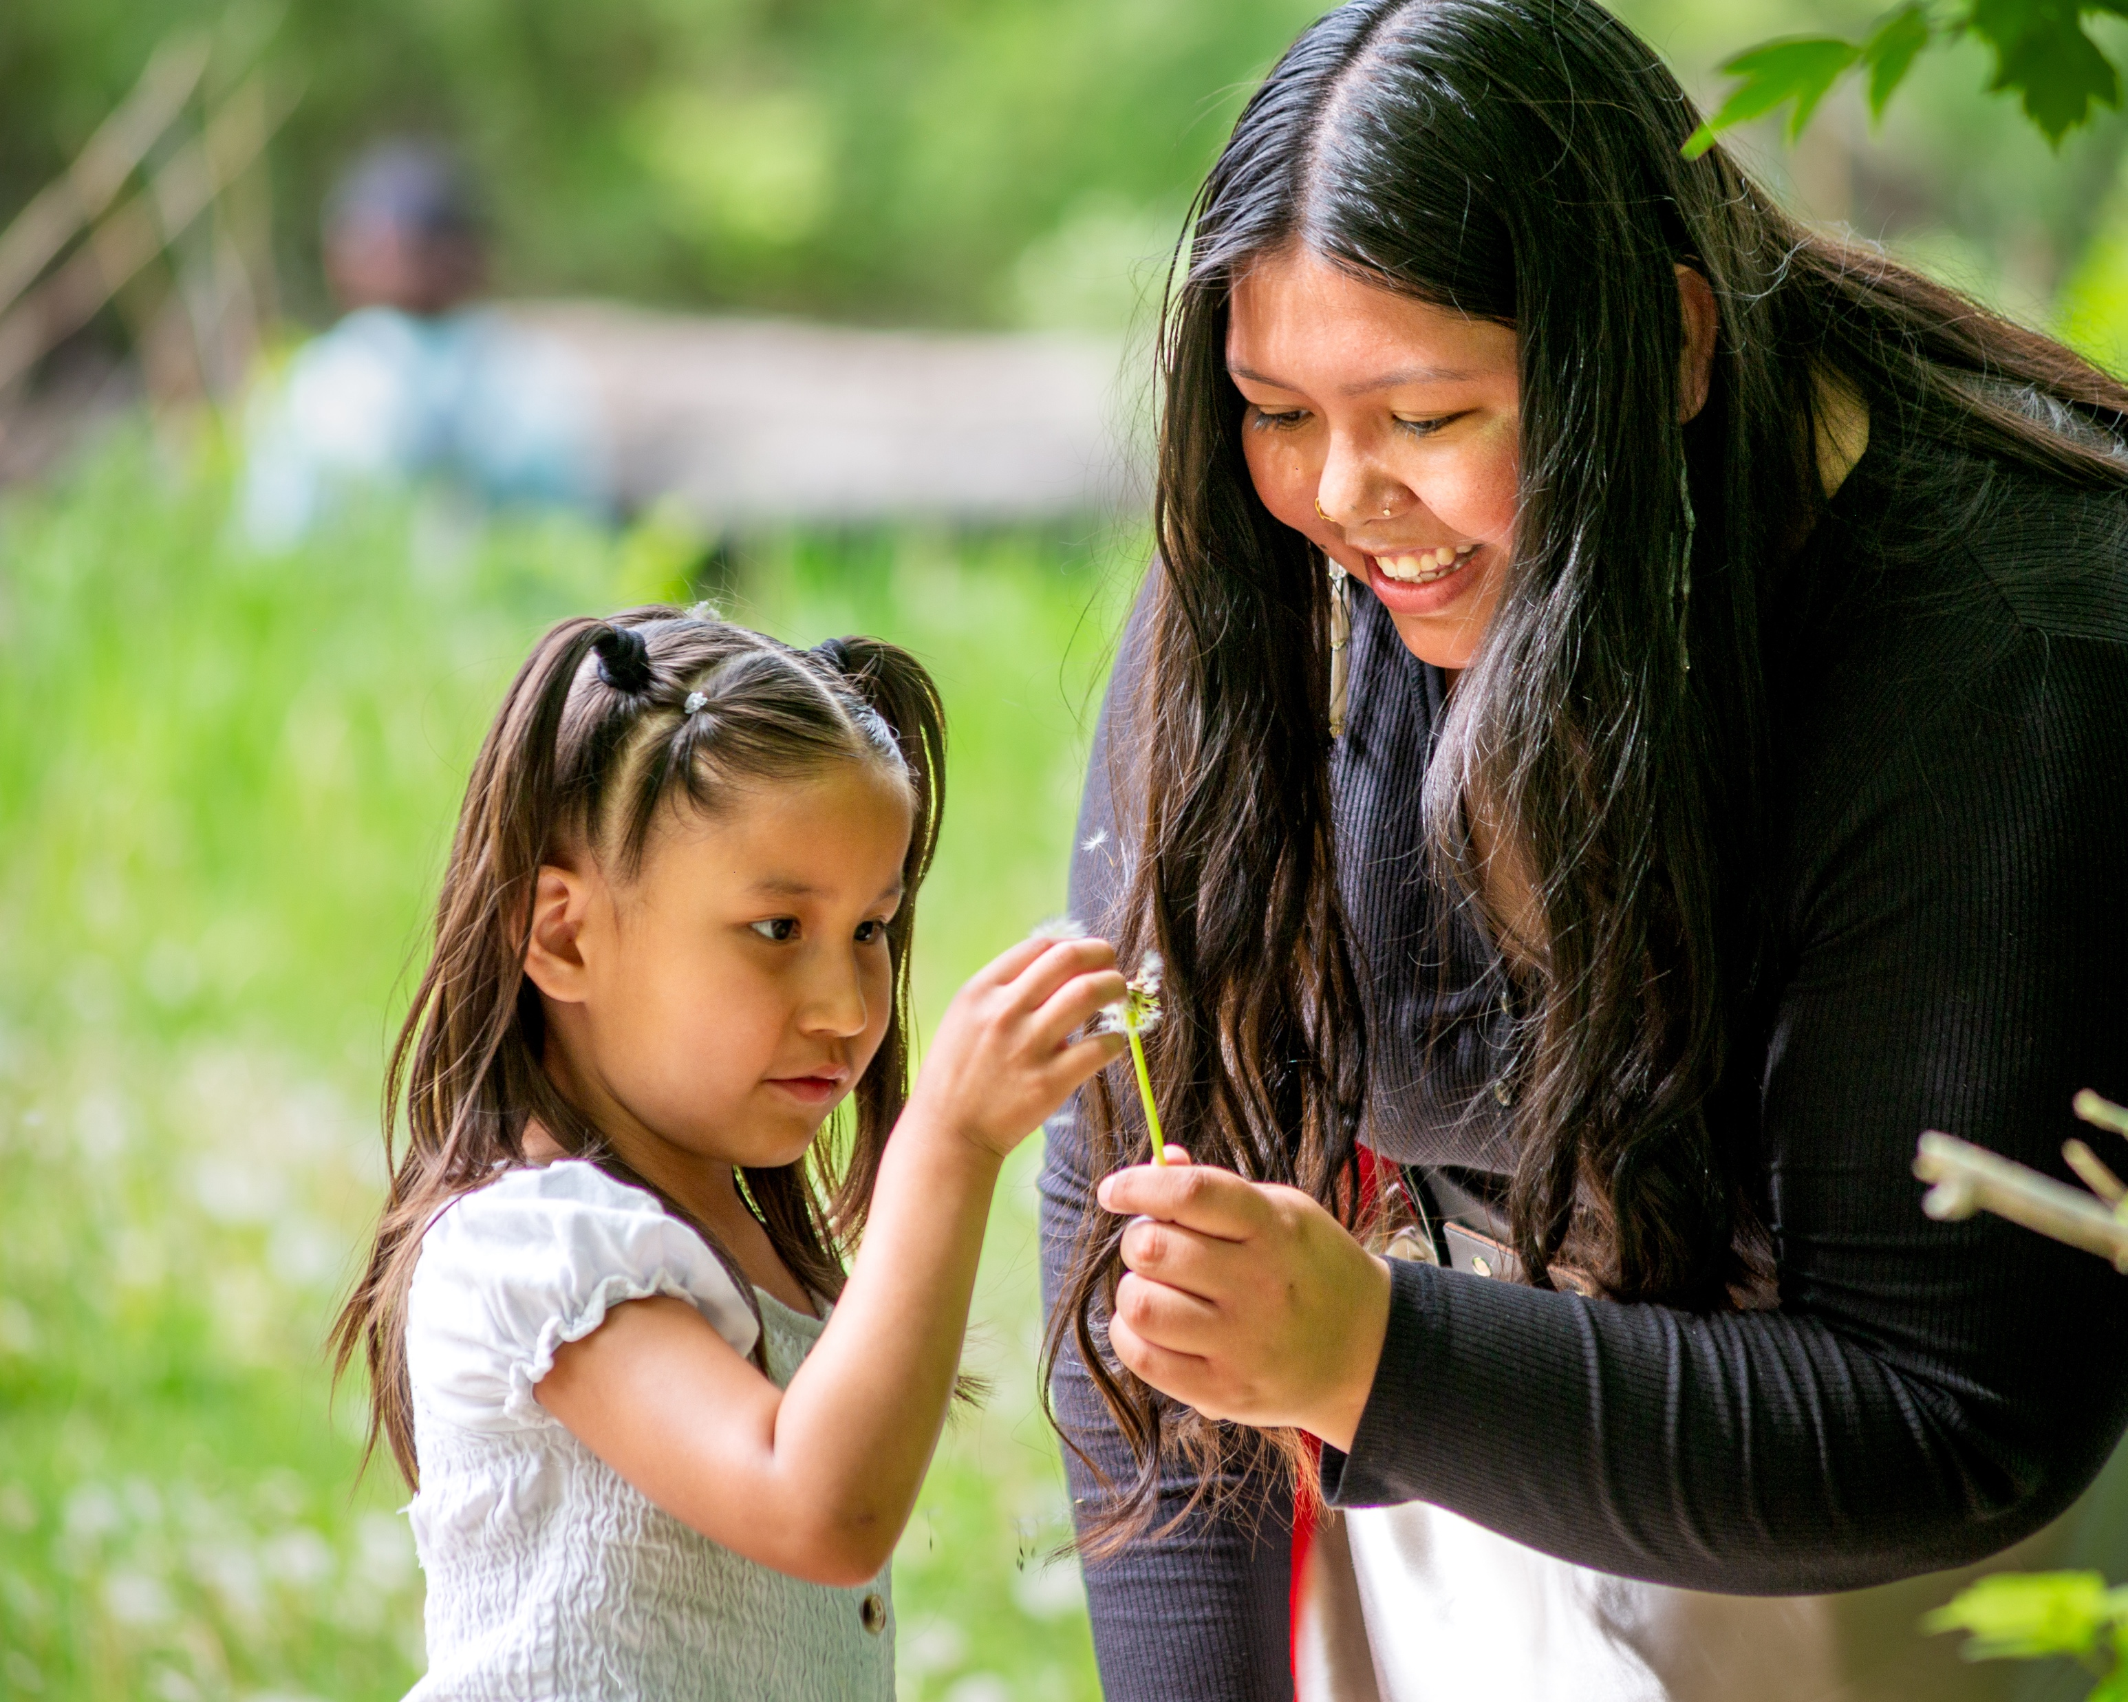
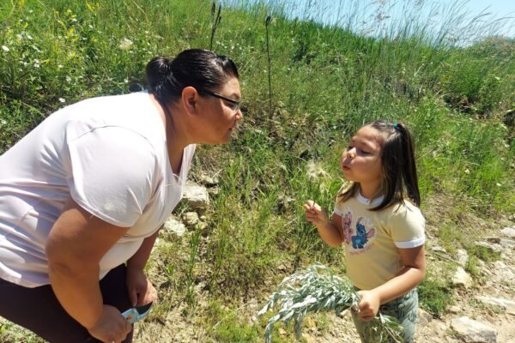
Moccasins on the Ground

Slide 20
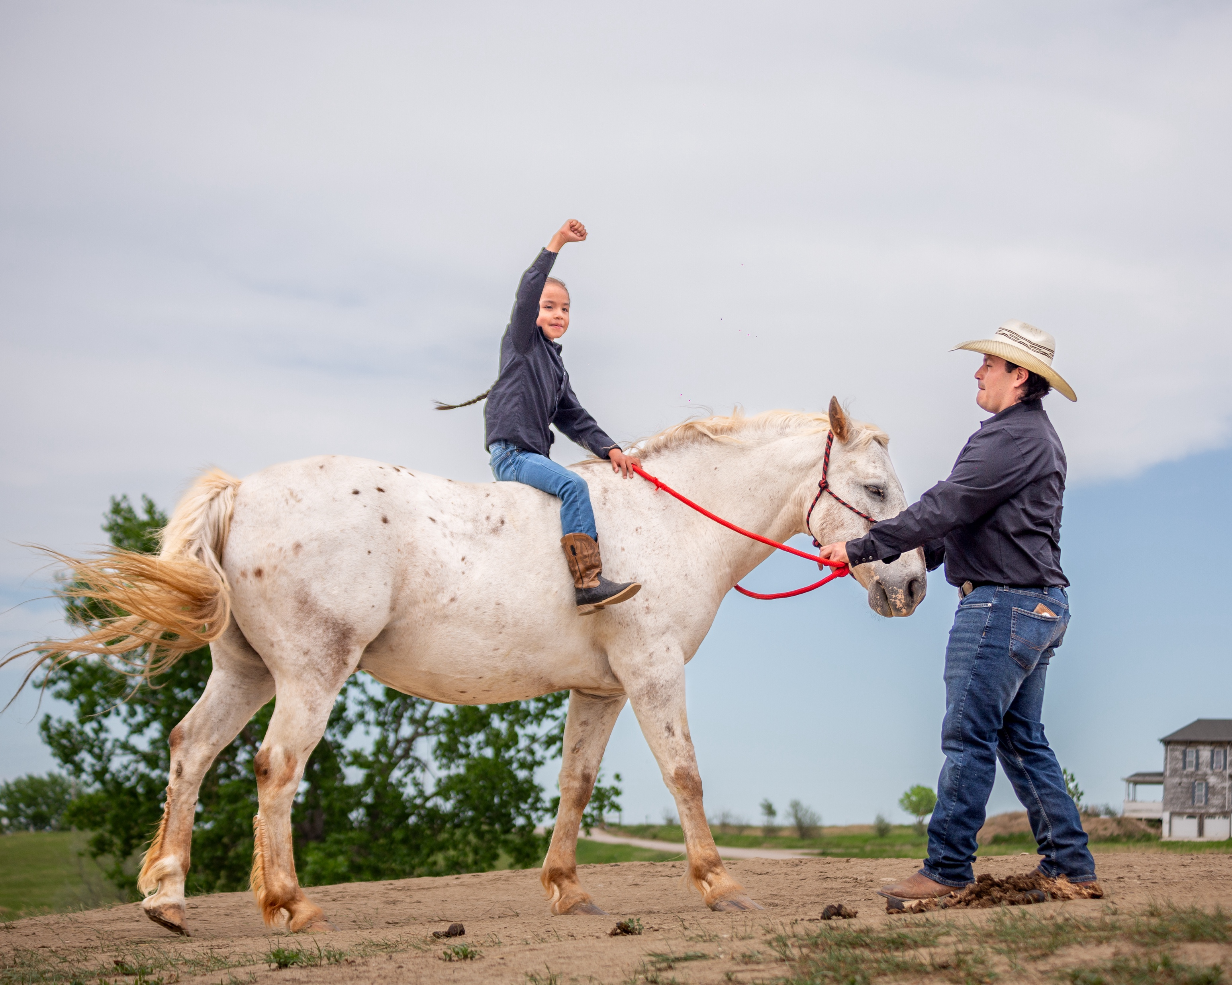
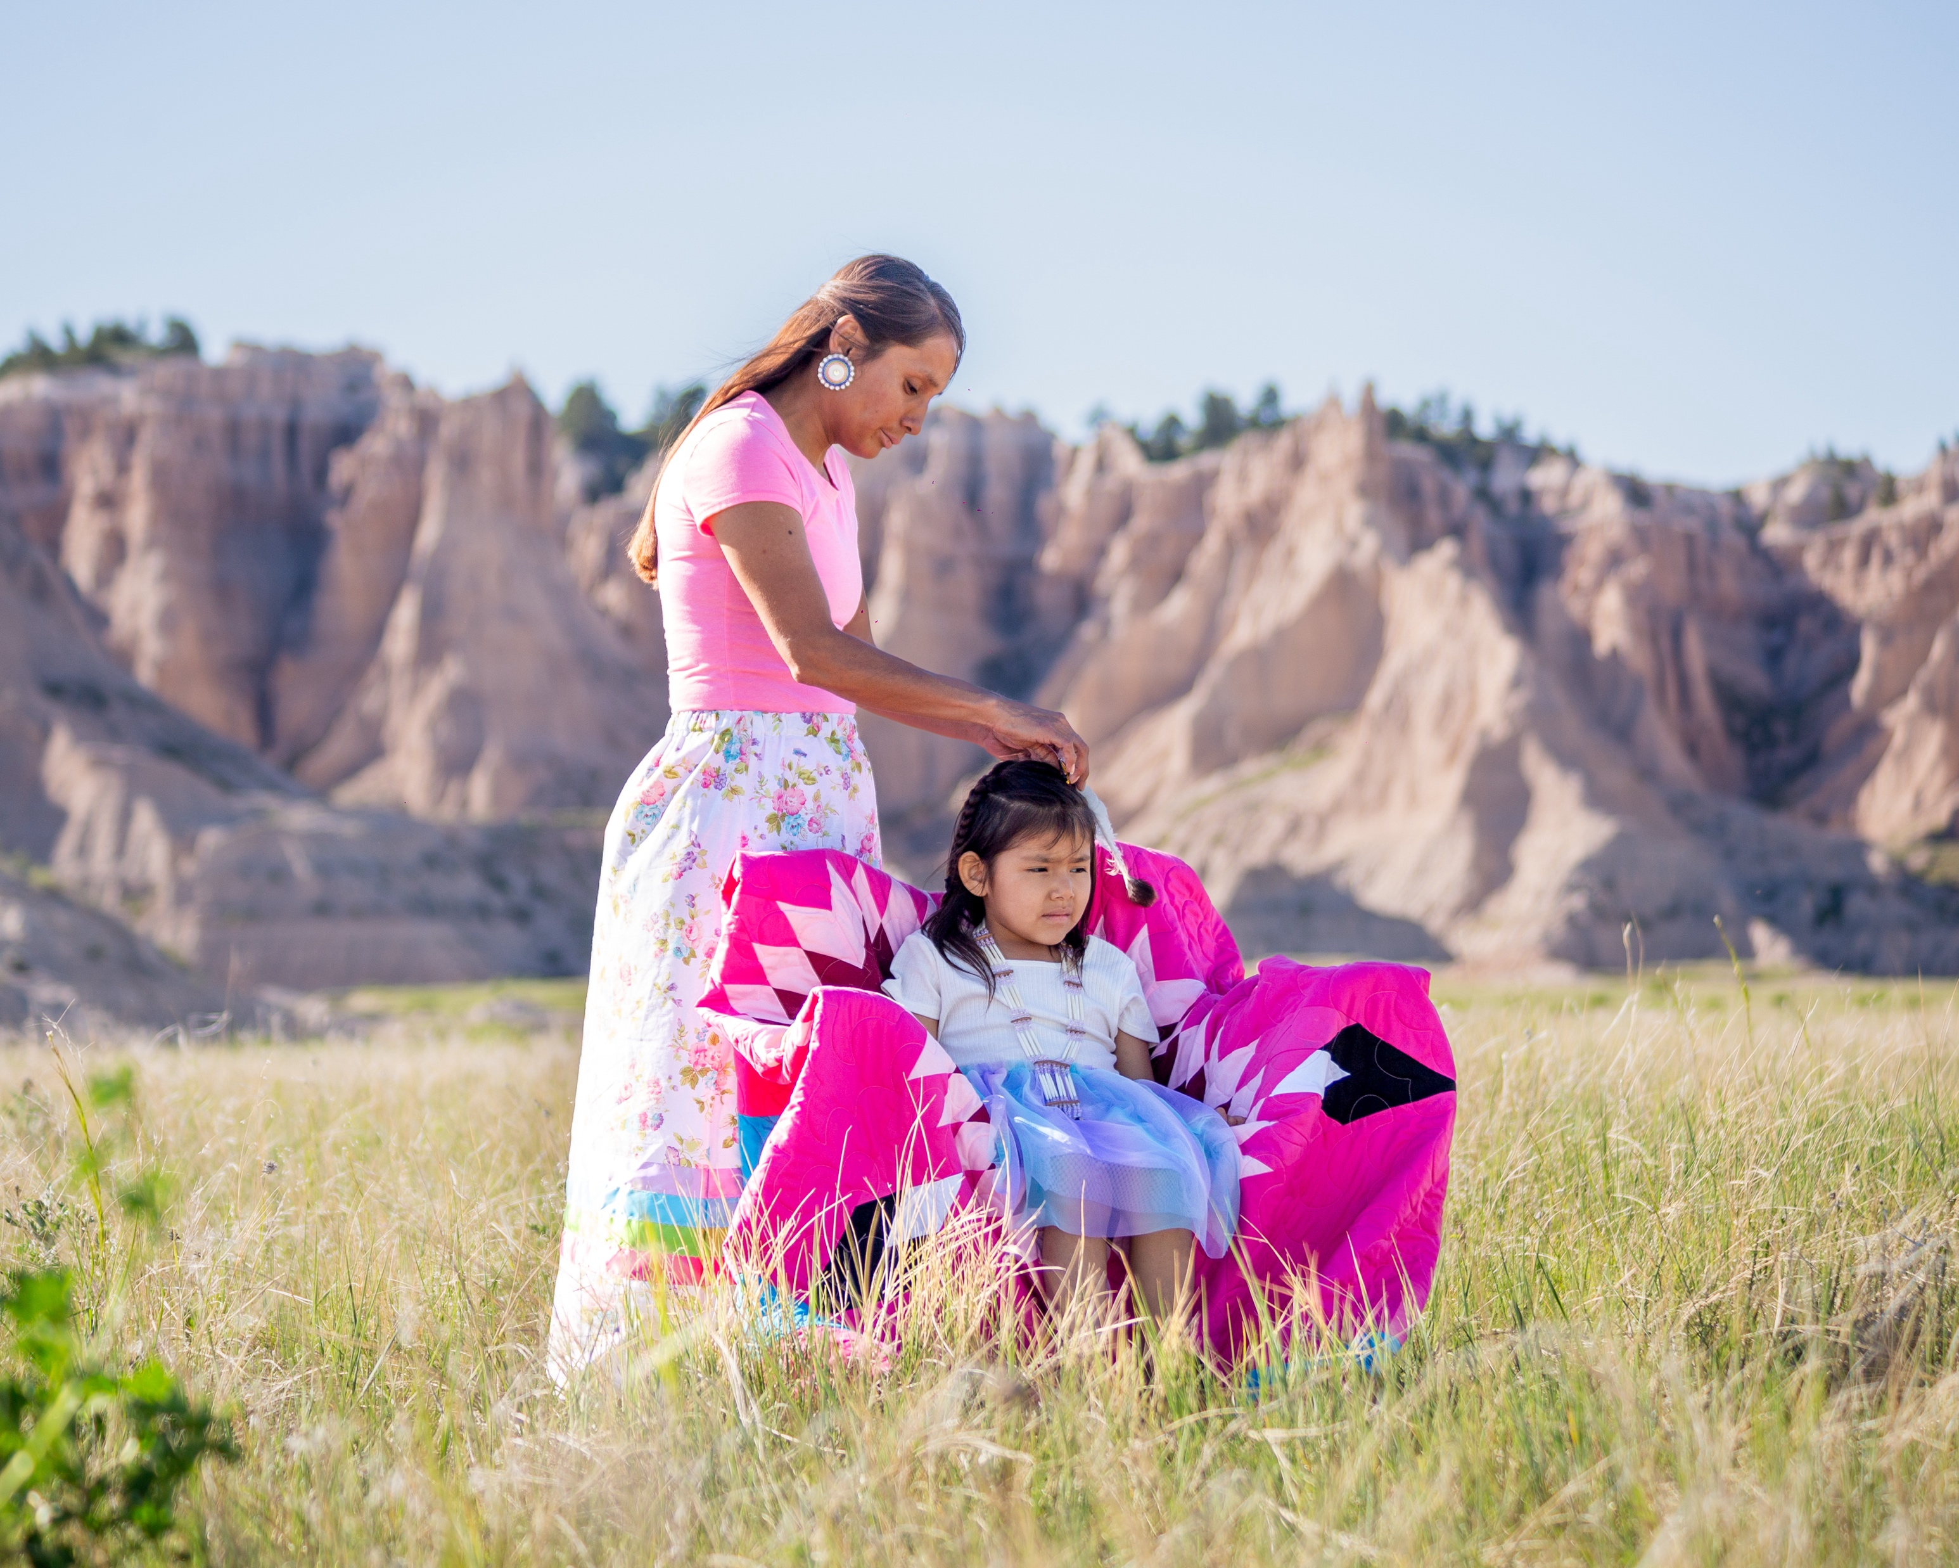
Cultural Interventions

Slide 21
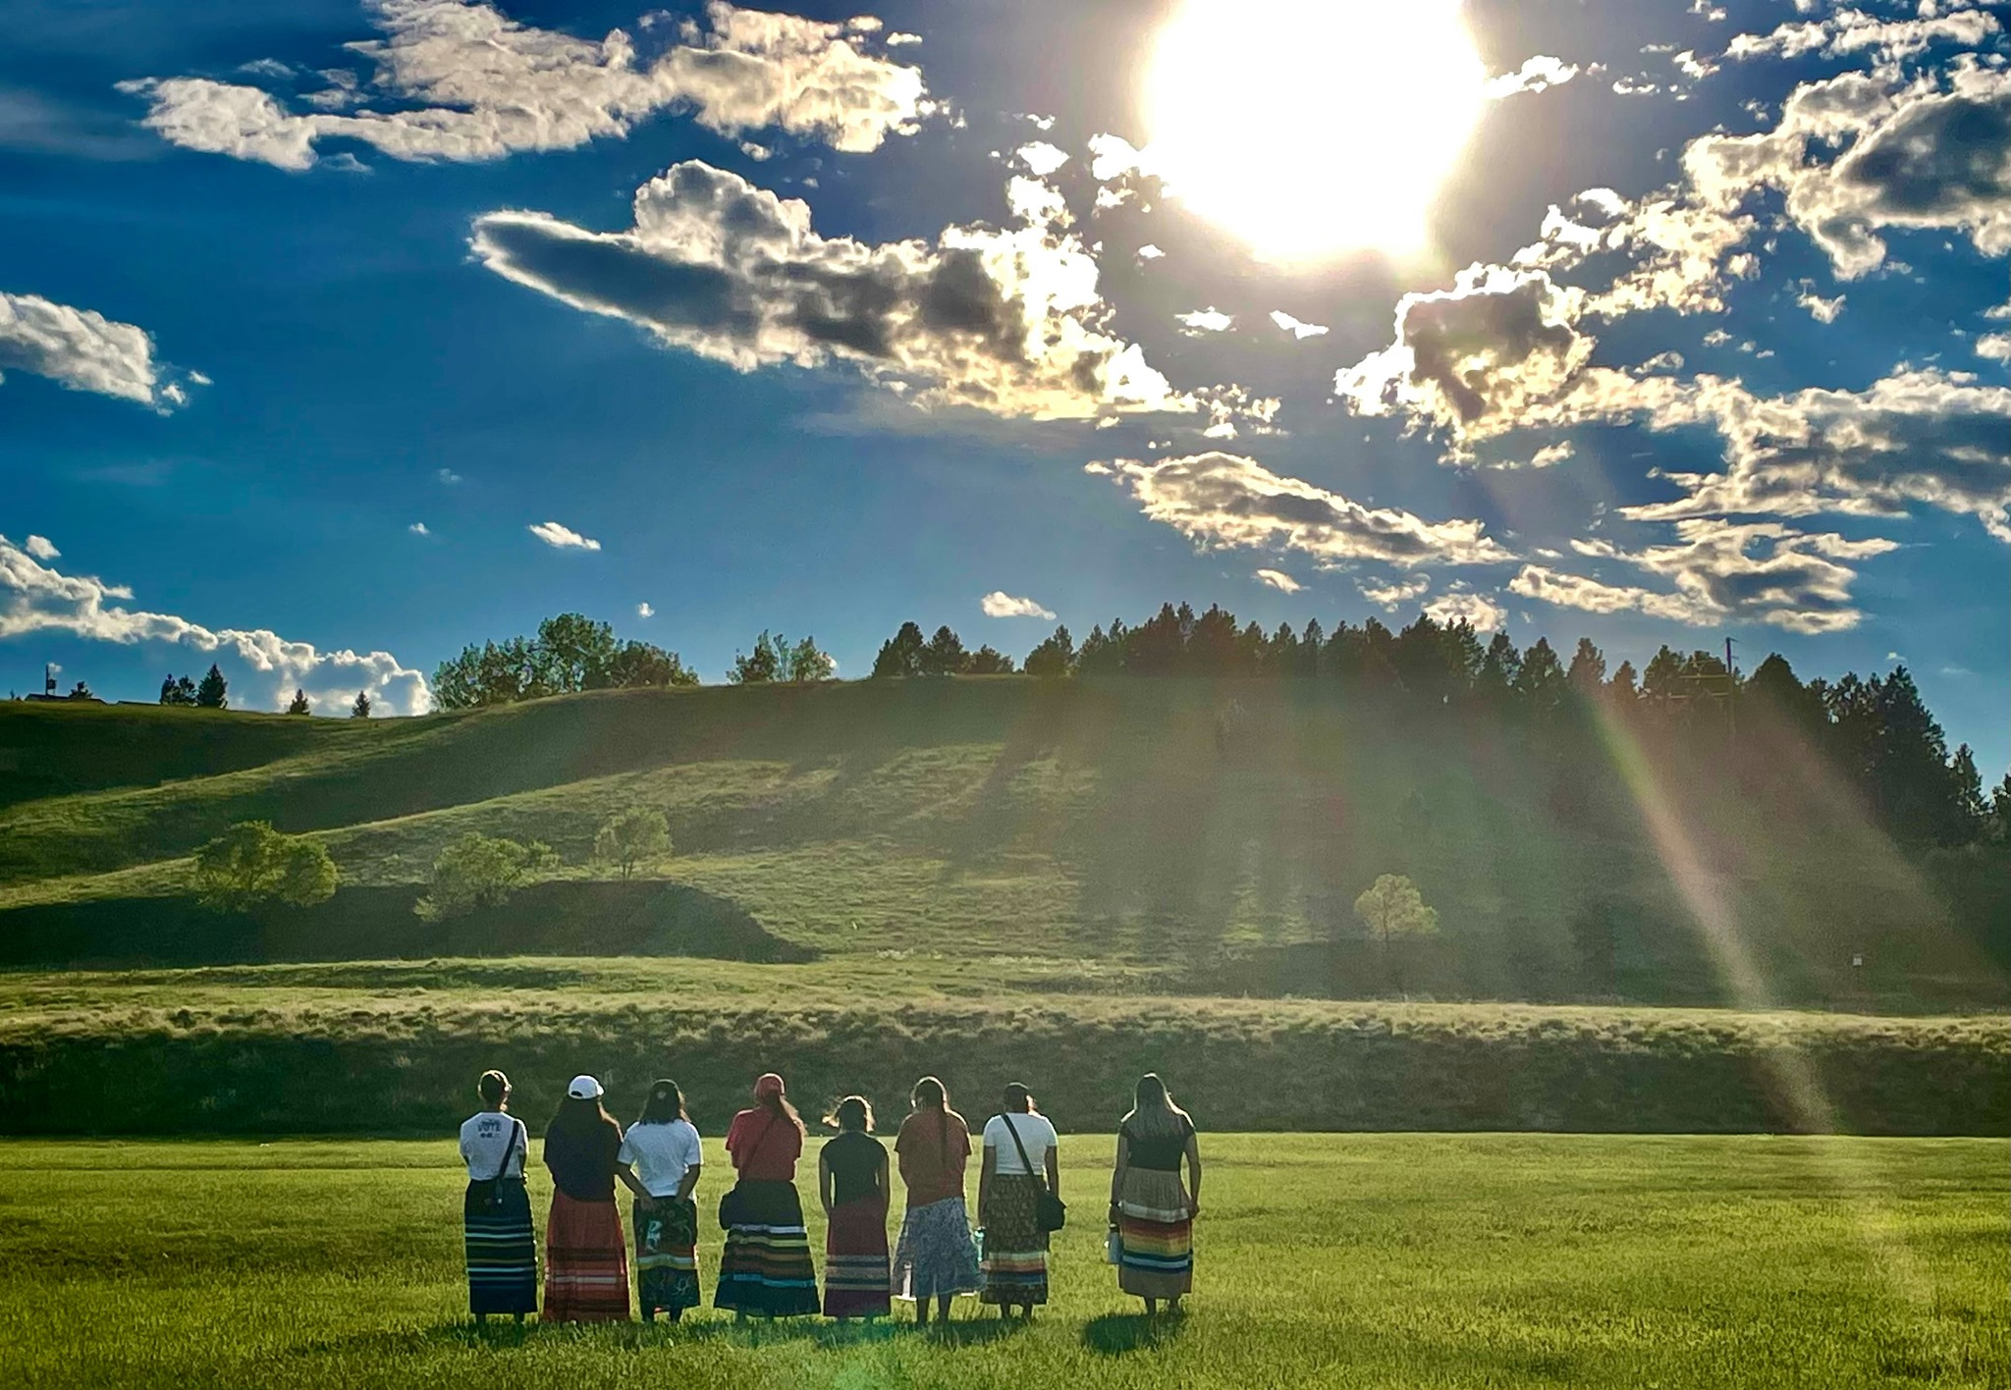
Mending the Sacred Hoop
83% of youth graduate high school
93% avoid the justice system
98% avoid early parenting
92% enroll in post-secondary, serve our country, or enter the workforce
The Harvard Business School Association of Oregon showed that for every $1 invested in Friends of the Children, the community benefits over $7 in saved social costs. Helping one child saves the community $900,000.

Slide 22
Questions?

Slide 23
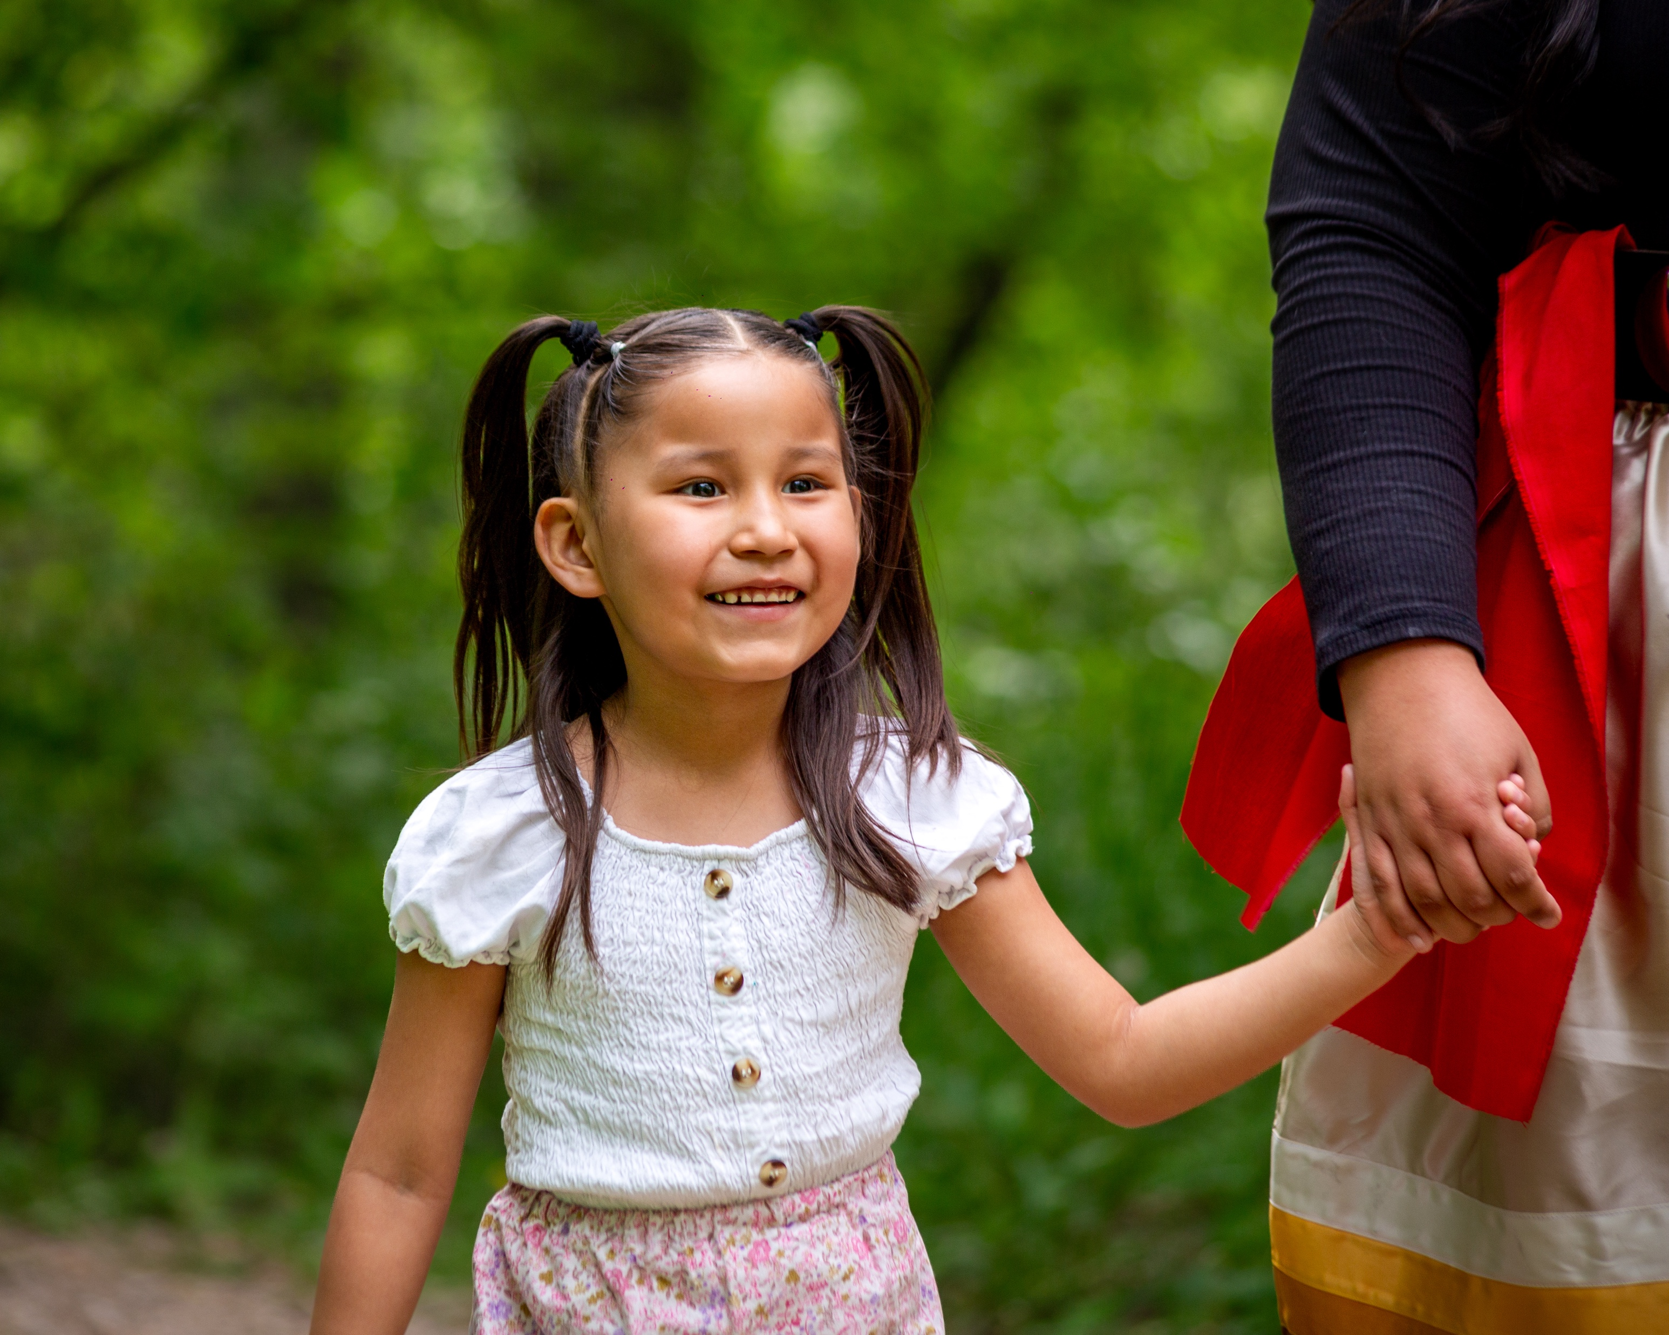





PILAMAYAYE!
THANK YOU!
www.friendsofthechildren.org
@friendsnational

