Slide 1

Nebraska-Focused Family and Community Engagement Resources
Jessie Coffey - Director, Whole Child Program, NDE Office of Coordinated Student Support
Brian Welch - NE Statewide Family Engagement Center

Slide 2
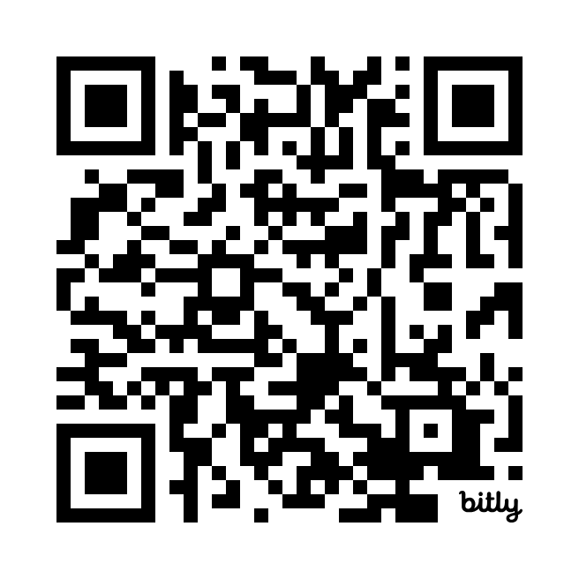
NE School, Family, and Community Engagement Framework
bit.ly/NEEngagement
Notes:
https://bit.ly/NEEngagement

Slide 3


Aligned with:
Positive Partnerships, Relationships, and Success Tenet
AQuESTT provides a structure that is built on the understanding that school, family, and
community engagement:
recognizes that families and the community play a role in advocating for educational opportunity and quality;
is a shared responsibility of families, schools, and communities where knowledge is exchanged;
focuses on culturally respectful partnerships that support student learning, at home, at school, and in the community;
builds, sustains, and grows relationships that empower all students, families, and communities;
is continuous across a child’s life spanning from birth to young adulthood;
occurs in multiple settings where children and youth learn before, during, and after the regular school day as well as summer.

Slide 4
New Supporting Resources
7 Microlearning Videos
An intro video + 1 for each section of the Framework
3-5 min each
Family version of the Engagement Framework
4 sections
  Navigating the School System
  Communicating with Schools
  Advocating for Your Student
  Becoming More Involved
Can be split into single page fliers
Notes:
https://www.education.ne.gov/family/nebraska-school-family-and-community-engagement-framework/

Slide 5

Video: Why Family and Community Engagement?

Slide 6

Video: Active Family Engagement

Slide 7

Video: Safe and Welcoming Schools

Slide 8
Video: Student Attendance

Slide 9
Video: Community Partnerships and Support Services

Slide 10
Video: Business and Industry Partnerships

Slide 11
Video: Before-School, Afterschool, and Summer Programs

Slide 12
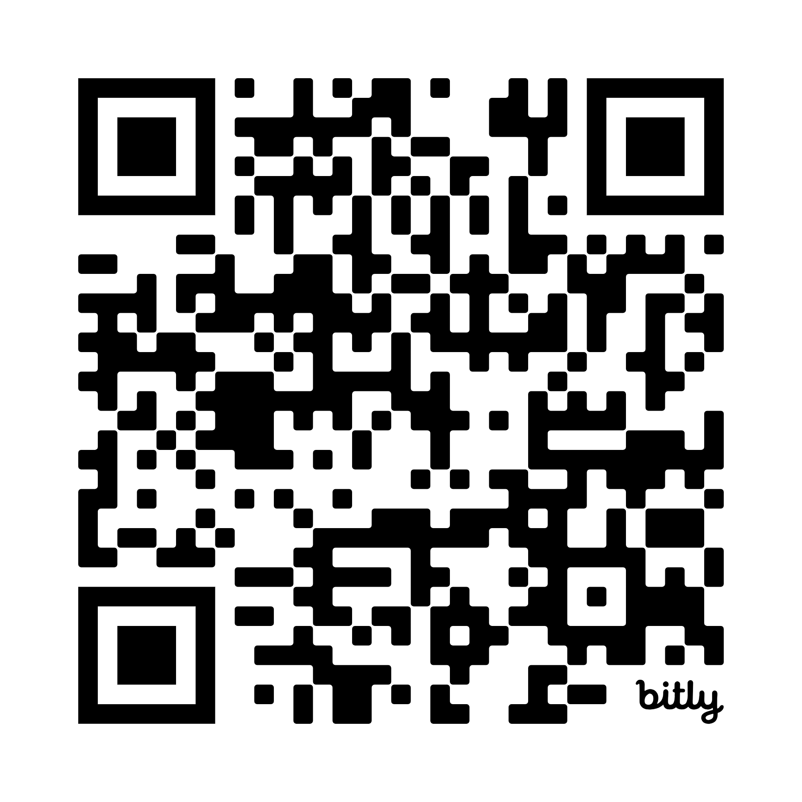
Family Version
of the
Framework
bit.ly/NEFamFramework
Notes:
https://bit.ly/NEFamFramework

Slide 13
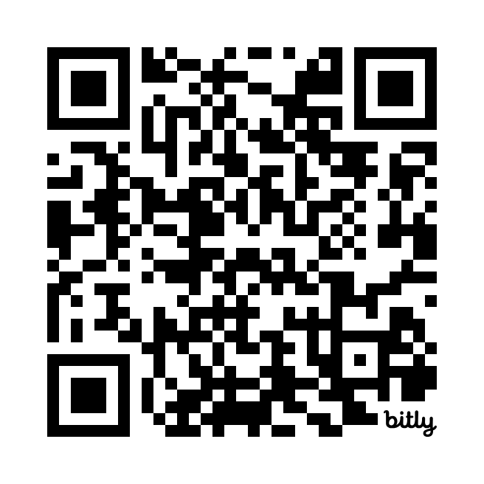
Complete Video Playlist
NDE Office of CSSS YouTube
bit.ly/NE-FEvideos
Notes:
https://bit.ly/NE-FEvideos

Slide 14
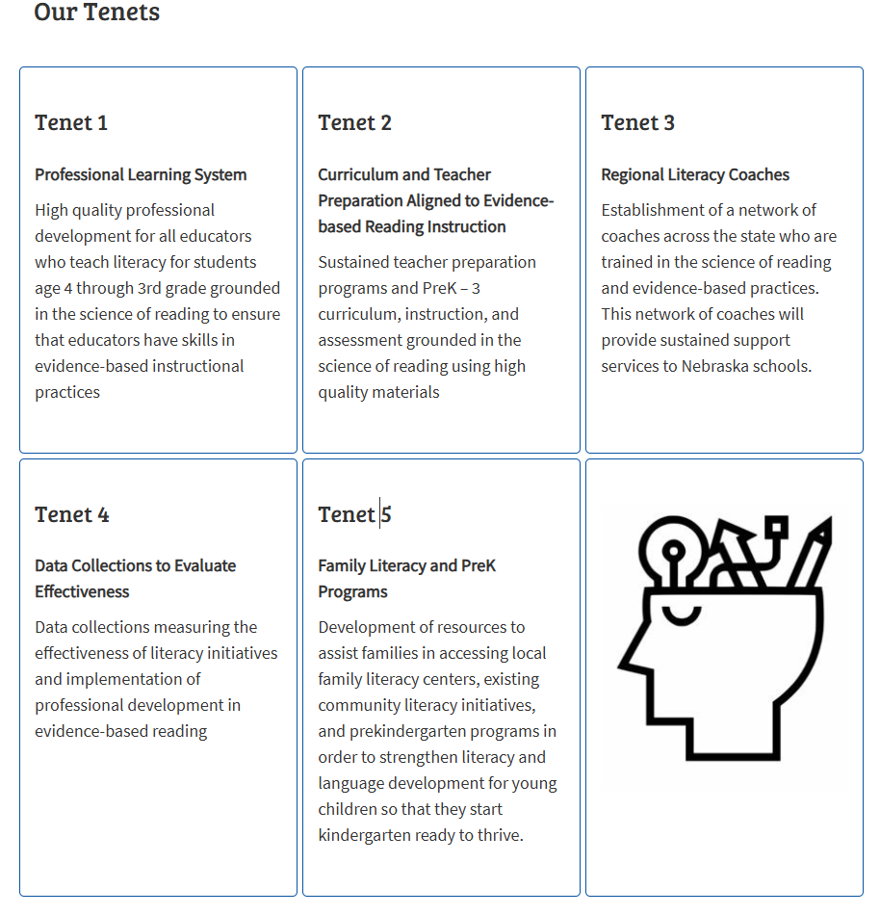
Nebraska Literacy Project
Nebraska Revised Statute 79-2607 requires the Nebraska Department of Education (NDE) to establish a professional learning system related to evidence-based reading instruction.
Our Goals:
Increase third grade proficiency on NSCAS ELA from to 75% by 2030.
Increase the % of Nebraska K-3 students who meet the Nebraska Reading Improvement Act approved assessment thresholds.
Ensure 100% of Nebraska educator preparation programs are implementing evidence-based instruction for teachers grounded in the science of reading.
Join the Nebraska Literacy Project Mailing List
Notes:
https://www.education.ne.gov/nebraskareads/nebraska-literacy-project/

Slide 15

Notes:
First time users should complete the library
patron account set-up form found at
bit.ly/nellpatron
1.
Browse our online catalog at
bit.ly/nellcatalogue [Tip: Type family
community engagement into the search
field to view all available resources.]

Slide 16

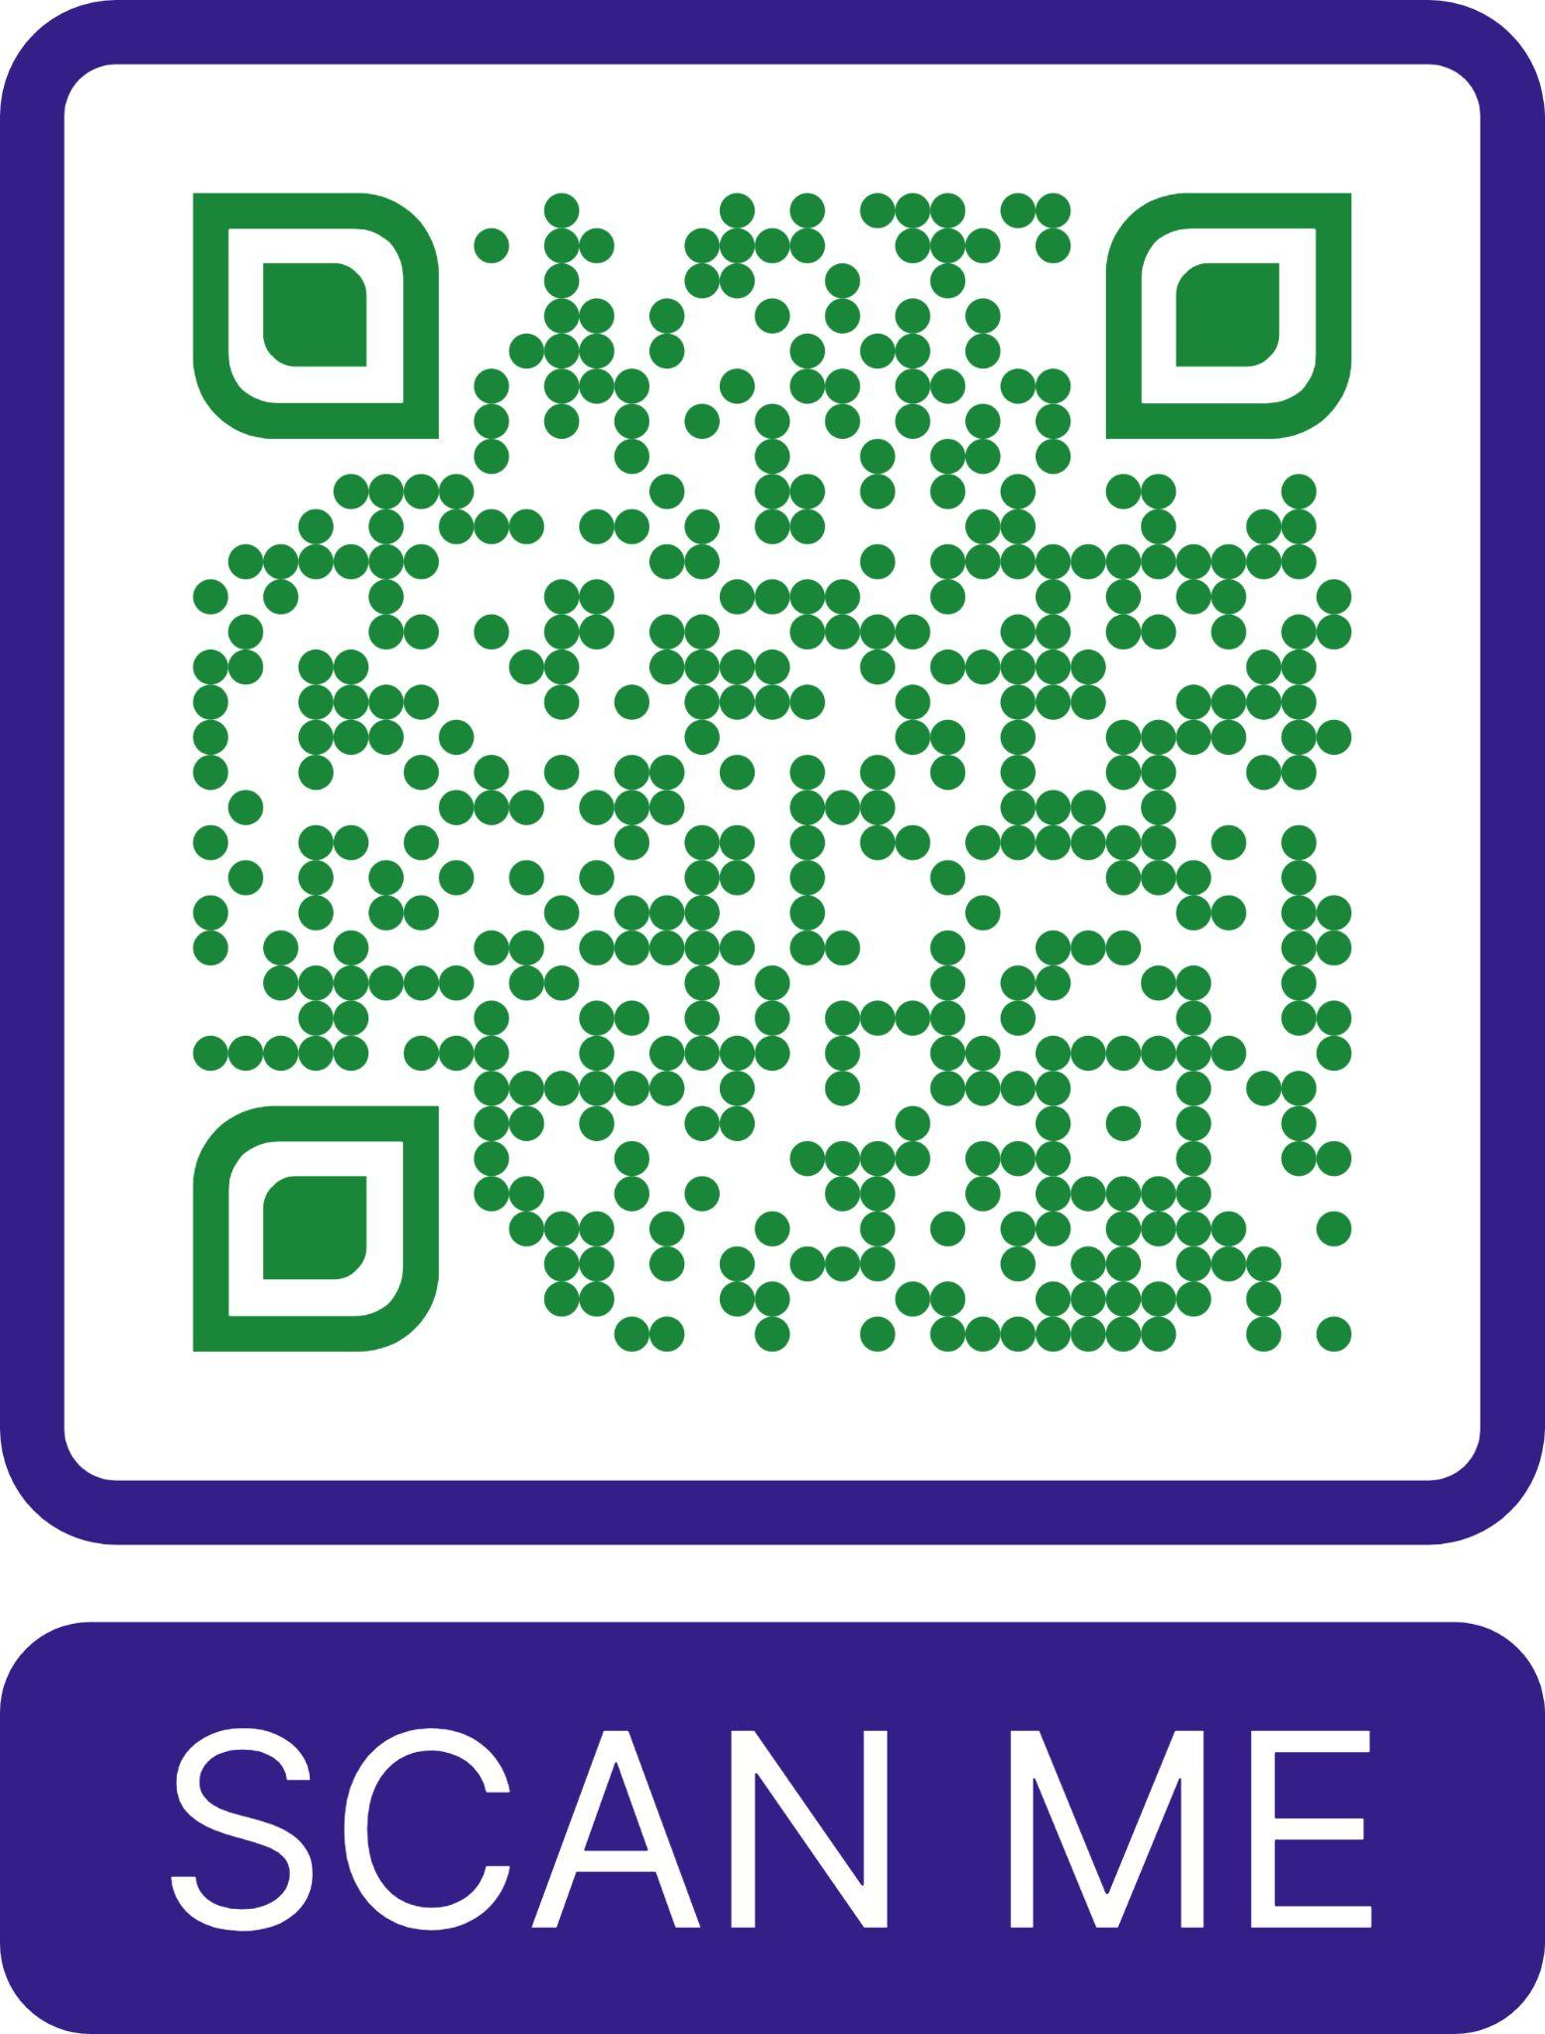
Book in the Bag:
Family Engagement
Order here:

Slide 17
Leadership & Engagement Opportunities Database
Opportunities for
  Young People
  Parents/Caregivers
  Service Providers/School Staff
Searchable
Easy to submit new opportunities
Hosted by the Bring up Nebraska Network
Database Website
Notes:
https://bringupnebraska.org/what-you-can-do/leadership-and-engagement-opportunities/

Slide 18
findhelp.org
Find free or reduced-cost resources like food, housing, financial assistance, health care, and more.
Categories
Food
Housing
Goods
Transit
Health
Money
Care
Education
Work
Legal

Slide 19
Questions?
bit.ly/NEFamFramework

