Slide 1

Home Visitors are Partners in Resilience
Community-based * Voluntary * FREE
Support for Pregnant or Parenting families of children birth to age 5 who may struggle with significant life stressors such as poverty, exposure to violence or substance abuse, teen parenting, or military families with one or both parents in service.
Jennifer Auman, Program Manager
BrieAnna Everett, Program Specialist www.dhhs.ne.gov/homevisiting

Slide 2
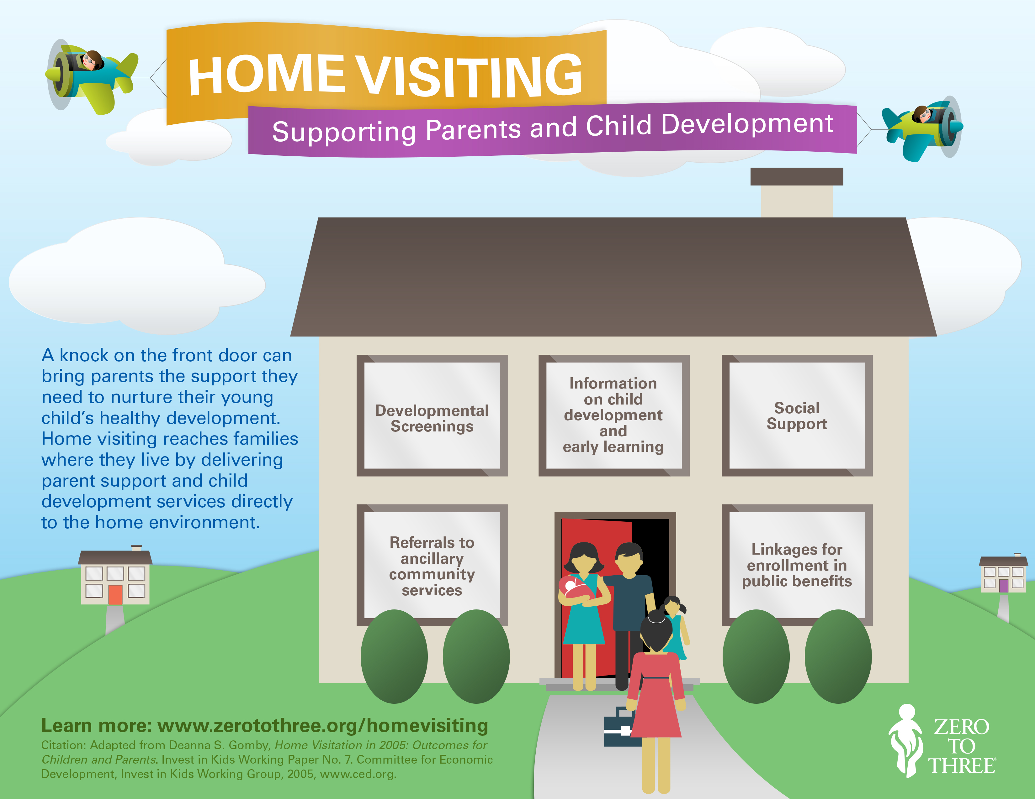

Slide 3

IMPROVING LIFESPAN HEALTH OUTCOMES
for women, children, and families as a whole, through evidence-based home visiting services
In best practice today, evidence-based programs are considered of great value simply because as the name implies, the evidence or the research and data support that the program can actually do what it says it can do.
DHHS Division of Public Health

Slide 4


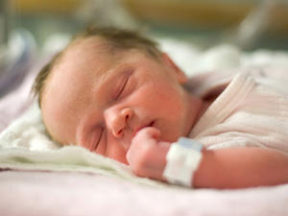
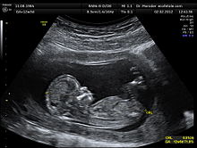
From conception to age 3 years, a child has the GREATEST period of development and growth that he or she will have throughout their WHOLE LIFE!
Bonding, ENVIRONMENT, NUTRITION—
Every experience– BOTH mother and child have shapes the person
that child will become;
physically, cognitively, and emotionally the very beginning.

Slide 5






WHAT PUTS FAMILIES’ FUTURE HEALTH OUTCOMES
“AT RISK?”
Teen Pregnancy
Depression
Poverty or
Homelessness
Mental Illness
Domestic
Violence
Drug or Alcohol Use

Slide 6
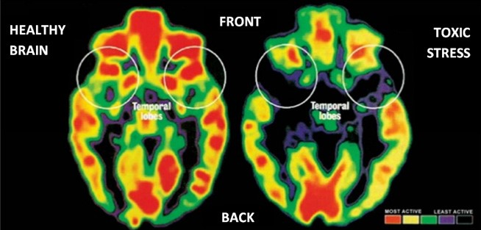

How Toxic Stress Affects Us, and What We Can Do About It
3:52

Slide 7

Perpetuating the cycle—
Children learn what they’ve lived—it is “hard wired” even if they consciously know the behaviors are negative or risky.

Slide 8
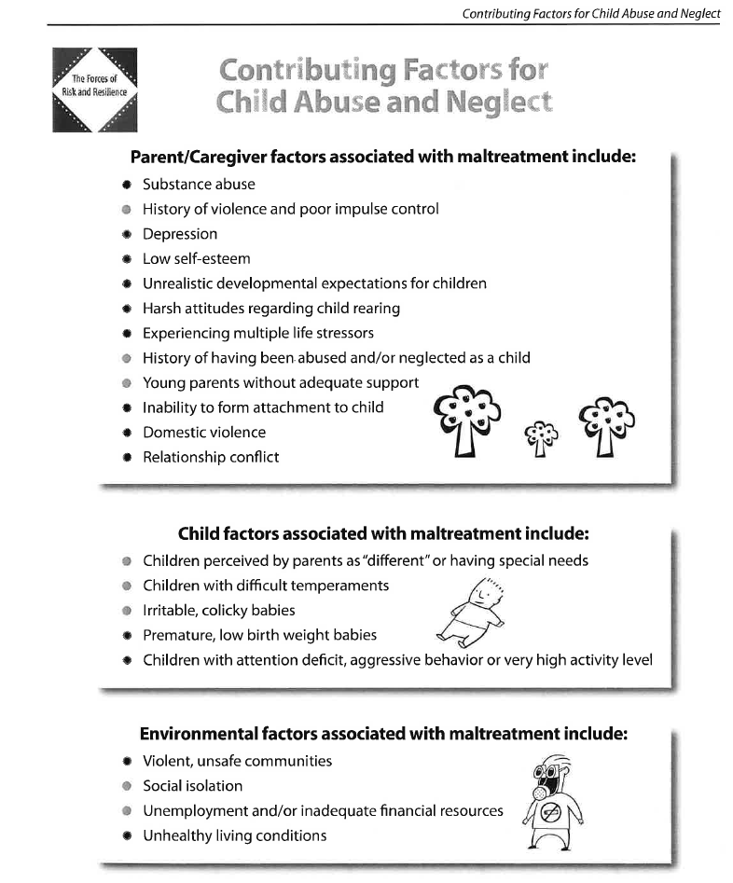



Slide 9



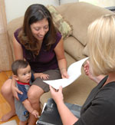
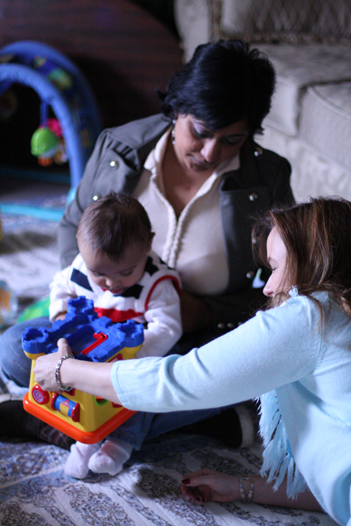
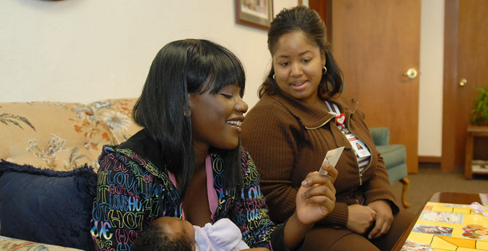
With experienced, educated and caring support,
We can
break the cycles of negative life impact!

Slide 10


Healthy Families America Home Visiting in Nebraska
What it IS:
Family-Centered
Strengths-Based
Relationship-Driven
Culturally Competent
Empowering– show me HOW
What it is NOT:
An Intervention- Do it for them
A sure-fire “Fix” for everyone
“Another handout”
Child Protective Services or a program mandated
by the courts

Slide 11

Reside in a priority community
Low income
Under 21 years old
History of child maltreatment or are involved in child welfare
Exposure to substance use
Tobacco use in the home
Exposure to violence
Have not graduated High School
Children or caregivers with developmental disabilities or delays
Members of the Armed Forces, with multiple deployments
Pregnant or Parenting Families

Slide 12
Evidence-Based Home Visiting
is a PREVENTIVE health measure!
INCREASES:
Protective Factors
Appropriate coping skills
Pre-Conception and Inter-Conception Planning
Quality of Prenatal Care
Successful Breastfeeding
Well-Child Visits & Proper Immunization Schedules
Knowledge of Child Development
Physical, Mental and Emotional Health of the Family
Effectiveness of Referrals and Coordinate Efforts for the Right Referrals
REDUCES:
Child Maltreatment, Abuse, Neglect
Domestic Violence
Parental Use of Drugs, Alcohol or Tobacco
Emergency Room Visits for BOTH Mother and Child
Stress

Slide 13

Family-Centered, Strengths Based
Highly skilled Home Visitors
Enroll families prenatally or within 90 days of birth
Child-Welfare referred families may enroll up to 24 mo of age
Weekly visits for 1 hour
Process of level change based on success
Engage the family until age 3 – 5 years
Community Involvement
Evidence-based Home Visiting Program Model currently utilized in Nebraska with positive outcomes in:
Maternal and child health;
Child development and school readiness;
Reductions in child maltreatment;
Reductions in juvenile delinquency, family violence and crime;
Positive parenting practices;
Family economic self-sufficiency; and
Linkages and referrals
“I am stronger because she helped me.”

Slide 14

The cost of intervention vs PREVENTION
of Child Maltreatment;
We could pay off the National Debt in less than 25 years.

Slide 15
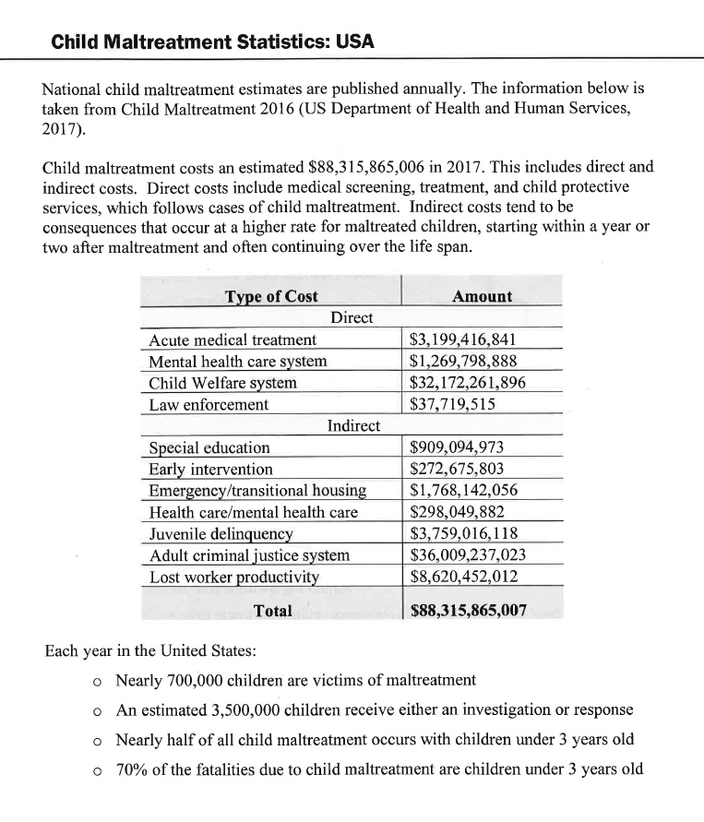
$88 BILLION DOLLARS
PER YEAR
IN THE
UNITED STATES ALONE

Slide 16


Slide 17

How do we do all this?

Slide 18


Slide 19

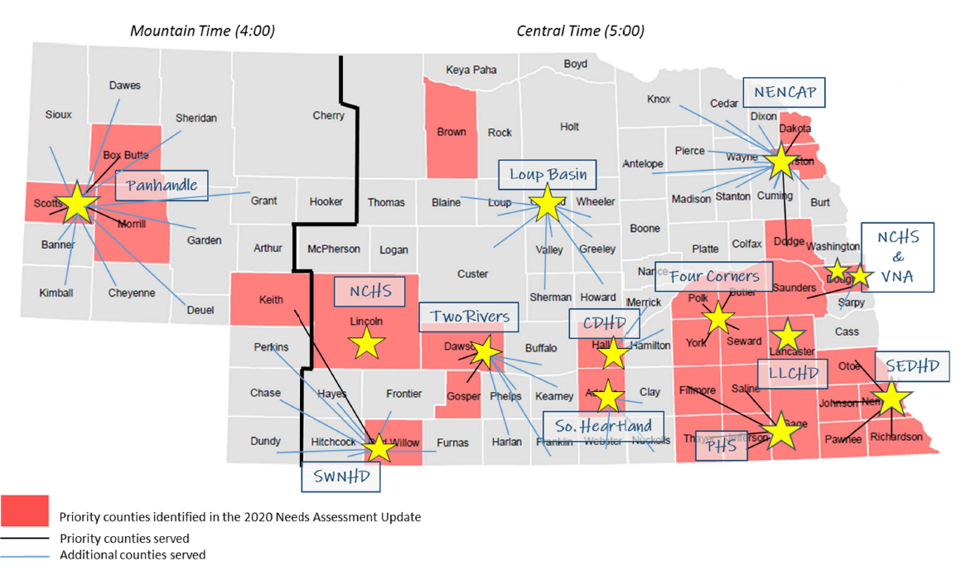
The N-MIECHV Network

Slide 20
Don’t Just Take Our Word For It…
N-MIECHV: Home Visitors are Partners in Family Resilience
3:08

Slide 21
Questions?

Slide 22
Jennifer Auman & BrieAnna Everett
Nebraska Dept. of Health and Human Services
jennifer.auman@nebraska.gov
Brieanna.Everett@nebraska.gov
www.DHHS.ne.gov/homevisiting

