Slide 1


Nebraska Department of Health and Human Services Division of Children and Family Services
Nebraska Abuse and Neglect Hotline
Amanda Nawrocki-
CFS Administrator II
Justin Carter-
CFS Administrator I

Slide 2
Vision: Healthy & Safe Nebraska
Mission: Helping people live better lives everyone, everywhere, every day
HHS and Medical Professionals, Law Enforcement, School Employees, Social Workers, Mental Health Providers, Therapists, Courts …..everyone.
We all have Roles and Responsibilities in protecting children
Awareness of the collaborative process and information sharing to address abuse and neglect
Decision making at the hotline regarding child abuse and neglect

Slide 3

National Child Abuse and Neglect
In 2023, 4.4 million referrals concerning 7.8 million children. More than 50% were not investigated.
The most prevalent types of maltreatment included neglect (72%), physical abuse (12%), sexual abuse (11%), and psychological maltreatment (4%).
American Indian or Alaska Native children and Black or African American children had the highest victimization rates.
While girls had a higher victimization rate than boys, boys had a higher fatality rate.
Children younger than 1 year had the highest victimization rate, and over 25% of victims were 2 years old or younger.

Slide 4
Nebraska- Abuse and Neglect Hotline
Screening and Priority Decision is made using the definitions and thresholds of the Structured Decision Making Intake Tool (SDM) that aligns with DHHS policy, state and federal laws
QA process to ensure accuracy and timeliness of decisions for CPS intervention of the Abuse and Neglect Hotline
Efforts are being made to collaborate with a wider lens to broaden the base to get help for families in the community
Lessen the gaps that result in families being without help

Slide 5
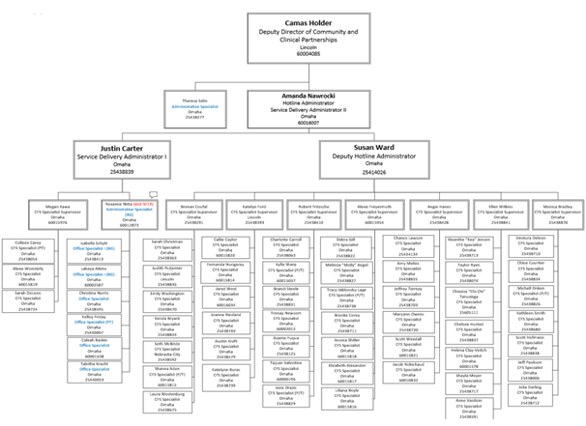
Abuse and Neglect Hotline
1 Deputy Director
3 Administrators
8 CFS Supervisors
50 CFS Specialist
2 Admin Specialist
6 Office Specialist
70 Total Staff

Slide 6
Hotline Call Data
5 Yr Call Volume Trends

Slide 7
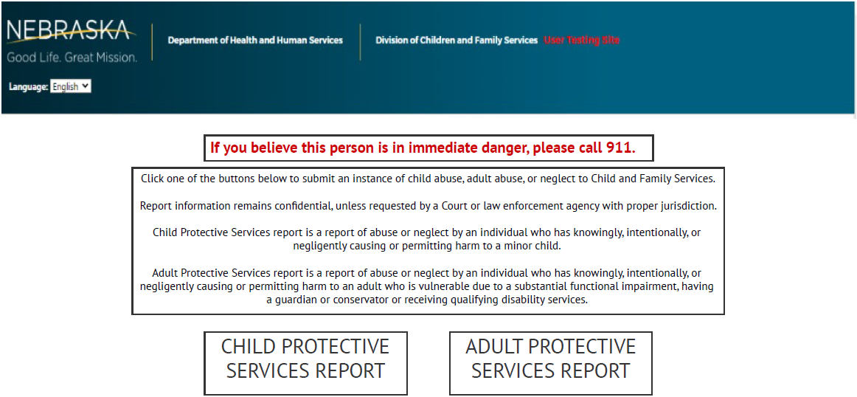
Online Reporting Portal
https://neabusehotline-dhhs.ne.gov

Slide 8
Hotline Online Portal Data
CPS - 4270
APS - 1604

Slide 9
Maltreatment Types
The Hotline staff will interview the Reporter to gather necessary information regarding: the maltreatment, child and adult functioning, protective capacities of the caregivers.
Abuse
Physical abuse
Unreasonable Confinement
Cruel Punishment
Drug exposed infants
Emotional Abuse
Sexual abuse
Sexual exploitation
Sex Trafficking
Neglect
Physical Neglect
Abandonment
Medical Neglect
Emotional Neglect
Educational Neglect
Sexual Acting out
Domestic Violence
Dependency

Slide 10
Hotline Collaborative Efforts
Douglas and Sarpy Investigative MDT
Educational Neglect MDT
NE Dept of Education Attendance Workgroup
Douglas County Threat Assessment Team
Sex Trafficking Prevention Sub Committee

Slide 11

WE CARE | Nebraska Mandatory Reporting
Notes:
Broadening the base of working with others and collaborating with a wider lens to assist families with finding support within their communities.

Slide 12
Who should report child abuse and neglect?
Mandatory Reporter is “anyone” who has reasonable cause to believe that a child has been subjected to abuse or neglect
Reports can be made Anonymously to the Hotline, but it is helpful
if a worker can contact you for additional information.

Slide 13
What to expect before reporting to the Hotline
Per the statute, the State will maintain a hotline 24/7 to accept reports of abuse and neglect. The information needed is as follows:
The child’s name and address, dob or age and address of the child’s residence
The parent’s name and address/Or caretaker involved
The circumstances, nature and extent of the child abuse or neglect or the concerns and conditions of the child(ren) involved
Access of alleged perpetrator to child
Any known parenting concerns, daily functioning, mental health, domestic violence or substance use concerns for the family
Tribal Affiliation

Slide 14

What happens when a call is made to the Hotline
CFS Intake Specialist will gather information from caller – current, history, thresholds
Determine immediate safety concerns (phone call direct to local LE): unsafe children, sex trafficking or to report marks, bruises, injuries from abuse or neglect
The CFS worker will determine if a report meets criteria and how it will be closed: Accepted or Not Accepted
All Reports are sent to local Law Enforcement for their own review as required by state Statute.

Slide 15
Prevention- Families First Prevention Services Act
Hotline identifies youth eligible for FFPSA for prevention services and provides referral information to Reporters
Evidence-Based
Trauma-Informed
Substance Use Prevention & Treatment
Mental Health Services
In-home Parent Skill-Based Program
Child in the home of a family accepted for CPS intervention
Child with a 3(c) filing or
having extraordinary mental health or behaviors the parent is unable to secure assistance to meet the needs
Prenatal infant or child of a pregnant/ parent foster youth
Youth at risk for an adoption or guardianship disruption
Youth previously in foster care and returned to the parent
Youth involved with probation living in the parent home
Notes:
FFPSA-Federal legislation that promotes innovation and flexibility via prevention services reimbursement to support early prevention and evidence-based practices under a broader array of support and funding opportunities that help keep families together.
All Bring Up Nebraska collaboratives have a community response (CR) program of formal and informal supports (e.g., churches, public health, child care, schools) committed to keeping families safely together in their homes and out of public systems
CR relies on family engagement and practices such as navigation, coaching & flexible funding to meet concrete needs
Since 2007, Nebraska has seen a 50% reduction in substantiated maltreatment rates, attributed in part to prevention supports, increased protective factors & authentically involving communities.

Slide 16

Prevention Initiatives
Bring up Nebraska- community collaboratives
Plans of Safe Care- substance exposed infants
Kinship Navigator-non system involved kinship placements
Healthy Families America- home visiting program for expectant parents
Parents as Teachers- home visiting parent education model
Family Centered Treatment- clinician works with family for stable functioning towards family preservation
Bridges to Independence- extension for foster care youth to access services

Slide 17

Mandatory Reporter Training
Training Objectives:
-Identify signs of abuse and neglect
-Understand state reporting requirements
-Differentiate between poverty and neglect
-Identify bias in decision-making

Slide 18

Mandatory Reporter Training
Be on the LOOK OUT!
Nebraska DHHS is developing a self-paced Mandatory Reporter Training focused on when to support, or report, child abuse or neglect. The training will be rolled out before the end of the year.

Slide 19
Nebraska’s Future Warm Line
Focus on revised mandated reporter training to clearly understand when to support vs when to report
Intended for calls that do not need the level of CPS intervention through the hotline
Families can call themselves to ask for assistance at single point of access
Navigation to connect to the right resource in a closed-loop referral system
Enables family stability through preservation or development of family supported placement
Provide support to a family to mitigate the need for child welfare
intervention

Slide 20

Reporting Abuse and Neglect
CPS Hotline 1 800 652-1999
HHS is looking for threats of safety and risk to the child
Call 911 or local LE in the event of an emergency
LE looking for immediate safety and criminal activity
Both agencies are responsible to respond to child abuse
and neglect. 911 should be called for any situation that a child
is in immediate harm or risk of harm due to a crime occurring.

Slide 21
Q and A
Report Abuse and Neglect to the Hotline at:
Phone 1800-652-1999 (24/7)
Fax (402)595-1354
Email DHHS.ChildAdultANHotline@nebraska.gov
Online Reporting: https://neabusehotline-dhhs.ne.gov/
INFO: https://dhhs.ne.gov/Pages/Child-Abuse.aspx

