Slide 1

Children’s Summit 2025 YRTC & TRANSITIONS September 23-24, 2025
Neleigh Boyer / Mary Rose Icenogle/ Bo Botelho/ Dr. Matt Wittry/ Sara Quiroz
Notes:
Add the title of your presentation, your division, name, etc.

Slide 2
HOUSEKEEPING:
FORMAT FOR THE SESSION
INTRODUCTIONS
HANDOUTS
FEEL FREE TO ASK QUESTIONS AS WE GO ALONG

Slide 3
Part I – YRTC Overview & Legal Procedures

Slide 4
YRTCS – WHAT ARE THEY?
General overview
Youth age 14-19
3 facilities
Kearney – Males
Hastings – Females
Lincoln – Males and Females separated
Focus is on treatment and rehabilitation not intended to be a jail

Slide 5
YRTC Programming
Behavioral Groups, as appropriate
Individual therapy, as appropriate
School
On campus jobs, as appropriate
Medication Management, if needed
Some minor medical available
Community engagement opportunities
Age-appropriate recreational activities

Slide 6
Kearney and Hastings
Facilities are campus-like; Kearney is fenced; Housing unit differences
4-stage program at both facilities
Behavioral Group Programming at Kearney
ART – Aggression Replacement Training
MRT – Moral Reconation Therapy
A-CRA – Adolescent Community Response Approach (substance use treatment)
Behavioral Group Programming at Hastings
TARGET – Trauma Response Group DBT – Dialectical Behavior Therapy
VOICES – Female Empowerment Group SU -- Substance Use Group
MRT – Moral Reconation Therapy

Slide 7
Lincoln
Facility Explanation
Population Served
3 stage program referred to as goal sets
Behavioral Group Programming at Lincoln
MRT– Moral Reconation Therapy
DBT group – Dialectical Behavioral Therapy
Substance Use Group

Slide 8
YRTC LEGAL
DHHS Attorneys
Eastern and Northern Service Area
Amber Ayres, amber.ayres@nebraska.gov
Southeast Service Area
Jay Judds, jay.judds@nebraska.gov
C.J. Roberts, christopher.roberts@nebraska.gov
Zackary Carlson, zack.carlson@nebraska.gov
Bridget Besse, bridget.besse@nebraska.gov
Central and Western Service Area
Mary Rose Icenogle, mary.rose.icenogle@nebraska.gov
Notes:
\

Slide 9
HOW IS A YOUTH COMMITTED TO YRTC?
NRS § 43-286
County Attorney files motion to commit
The Office of Juvenile Services shall be served with a copy of such motion and shall be a party to the case
Notice to OJS can be sent to dhhs.yrtclegal@nebraska.gov
The burden is on the state by a preponderance of the evidence to show that:
(A) All levels of probation supervision have been exhausted;
(B) All options for community-based services have been exhausted; and
(C) Placement at a youth rehabilitation and treatment center is a matter of immediate and urgent necessity for the protection of the juvenile or the person or property of another or if it appears that
such juvenile is likely to flee the jurisdiction of the court.

Slide 10
YRTC’S ROLE AT COMMITMENT HEARING
Motion to obtain records
YRTC does not typically take a position on YRTC commitment
Exceptions:
Juvenile may not be amenable to YRTC programming
Location
Commitment to YRTC v. specific facility
Transportation/Detention pre-placement
Overview programming, depending on jurisdiction
For family and youth’s benefit too

Slide 11
WHAT HAPPENS AFTER COMMITMENT?
NRS § 43-407.
The treatment plan shall be developed within fourteen days after admission and provided to the committing court and interested parties.
Treatment plan is essentially a letter, not a formal case plan like in CPS cases; Looks more like therapeutic evaluation
Programs and treatment services address:
(a) Behavioral impairments, severe emotional disturbances, sex offender behaviors, and other mental
health or psychiatric disorders;
(b) Drug and alcohol addiction;
(c) Health and medical needs;
(d) Education, special education, and related services;
(e) May be done through individual, group or family counseling services, as determined by the treatment plan

Slide 12
HOW DOES THE COURT GET UPDATES?
43-408 requires OJS to provide the court and legal parties monthly updates
DHHS submits monthly progress letters
43-424 requires OJS to provide the court with information on any assault, escape or attempt to escape
DHHS submits a letter to court
DHHS may also utilize a Notice of Abscondment if a youth’s whereabouts are unknown
DHHS files a formal notice

Slide 13
CAN YRTC CHANGE PLACEMENT?
N.R.S. § 43-407 prevents the Office of Juvenile Services from changing placement without advance notice, and a hearing may be required
When might this happen?
Different YRTC is determined more appropriate
Different non-YRTC treatment needed
How does it happen?
Notice of placement change for inpatient treatment – 7 days notice
Immediate COP v. Commitment Review -- Governed by § 43-408
Hearings within 24 hours (excluding non-business days) v. Hearing no later than 30 days later

Slide 14
DURATION OF COMMITMENT?
Determined by youth, average stay is 9 months
60-day Notice & Re-entry Hearing (NRS § 43-286)
Treatment team decision
Anticipated completion date
30 day Notice & IRP to be completed (NRS § 43-286)
§ 43-245 IRP requirements:
Juvenile's placement upon return to the community,
Education transition plan,
Treatment plan with any necessary appointments being set prior to the juvenile leaving the center, and
Any other supports
§ 43-286 IRP roles probation v. DHHS
Extension or recission of 60-day notice

Slide 15
REENTRY HEARING—WHAT TO EXPECT
When will hearing occur?
Who will be present?
Will the youth go home from court?
What happens after the hearing?

Slide 16
SUCCESSFUL REENTRY FOR ALL YOUTH
Part II – High Risk Pilot

Slide 17
A Model for the Collaborative Transition Program for youth at the YRTC

Slide 18
Recognized Need
How to successfully transition youth from the highly structured environment of the YRTCs to the community:
Reduce or eliminate cliff effect:
Abrupt loss of YRTC OJS resources and treatment providers for youth
YRTC has no post discharge contact with youth or feed back as to implementation or efficacy of post discharge recommendations
Probation unable to maintain continuity of care, forces youth and probation to start over ( cold hand-off )
Lack of integration between community (probation) and facility (YRTC) made discharge planning more of a recommendation rather than actual planning
All of the above is especially exasperated for high-risk youth
Idea:
YRTC will lean out from the facility and probation will lean into the facility to create a structured extended community furlough by blending facility and community base resources in hopes of stabilizing youth (warm hand off) in the community prior to discharge from YRTC.

Slide 19
Success Statement
Youth committed to the YRTC will engage in an individualized and structured evidence-based transition process which includes intensive collaboration with the youth, family, and professional supports. Areas of focus will include early identification and implementation of community-based treatments, furlough planning/practices, and maintenance of a coordinated network of supports while youth transition to the community after discharge from YRTC. A core component of YRTC programming will include structured furloughs that begin in the community and move to the home environment and consist of community treatment integration. Throughout the process, youth progress will be monitored and communicated via collaborative pre and post furlough meetings, which will include the youth, such that real-time modifications can support continued progress. Post YRTC discharge, ongoing access to and coordination of the developed network of established supports will be ensured. Ultimately, this approach will support a stepwise progressive approach to healthy community re-integration and maintenance of youth and community safety.

Slide 20
Approach
Collaborative effort with involvement from DHHS OJS and CFS, Probation, OPD, Douglas County Sherriff’s Dept, Douglas County Attorney’s Office, Judge Stevens from Douglas County Juvenile Court, and Judge Wightman from Dawson County Court
The model relies upon existing statutory authority and is informed by best practices and the combined experience of OJS and probation serving high risk youth.

Slide 21
Individualized Approach: Screening Top Tier/ High Need (5 or more factors)
Violent Offense (including weapons) (define)
Probation Officer significant community safety/risk of recidivism
YLS/CMI – 4 or more elevated domains
Gang association
Significant behavioral concerns within the facility
Intensive Mental Health and/or Substance Use Support Required and/or risk of treatment non-adherence
Dually Adjudicated
Responsivity Concerns (homelessness and/or trafficking)

Slide 22
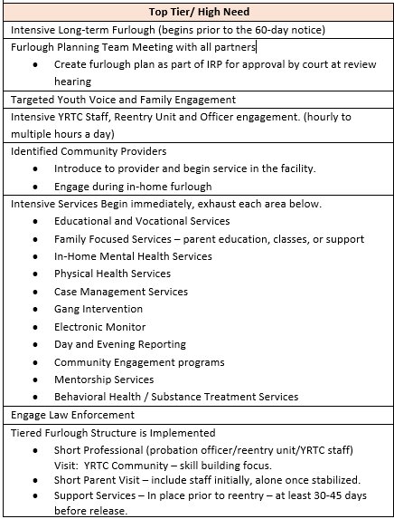
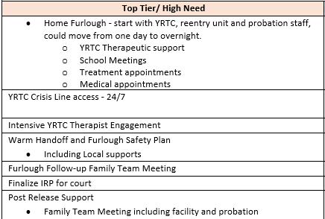
Individualized Approach: Intensity

Slide 23
Roles and Responsibilities
Detailed for all components of the program
Clarifies roles for YRTC, Probation and CFS Staff
Defines “Youth Support Team”

Slide 24
Achievements and Setbacks
Response will be individualized
Achievement measured as safe departure and return to the facility
Youth behavior will be incentivized by the team
Setback measured as a significant disruption or unaccounted time
Youth behavior will impact goal set achievement

Slide 25
Court Process
Notice of Entry into the Program
Confidential letter with details
Motion to Change Placement to YRTC-L
Notice of Furlough
Furlough details will be attached as a separate affidavit to ensure confidential
Motion for EM; Pick-up and Detention; Compliance with furlough agreement: Restricted locations or parties; search; curfew
Monthly progress letters
Discharge plan will be detailed in the IRP

Slide 26
Guiding Principles
Develop and utilize a framework of relational supports
Early development of a comprehensive IRP
Collaboration is key
Responsivity and Nimbleness

Slide 27
Foundations of the Model
Identification of particularly High-Risk Individuals
Youth Support Team identified
Ongoing Evaluation / Collaboration informs early development of IRP
Intensive YRTC Programming + Progressive Furloughs
Initiation of outpatient services while at YRTC = warm hand-off
Utilization of therapeutic rapport/relationships = involvement post YRTC

Slide 31
Pilot Transition Services
Partnership with KVC and Apex to create skill building services and placement options for very high-risk youth
Co-creation of intensive services aimed at highly criminogenic behavior and responses within a team approach
Pilot of a new method of out-of-home placement when a stepdown is needed or youth is dually adjudicated
Services initiated at 60-day notice within the facility and graduate to community
Provider actively involved in transition activities to initiate relationship building
Targeted skill building

Slide 32
Post-YRTC Discharge
Intensive probation supervision
Continuity of services from pilot alongside integration of IRP identified interventions/services
Data shows most YRTC recommitments stem from events within the first 60 days following discharge
Allows for seamless transition and less disruption of established provider relationships
Continuation of team approach
Warm hand-off
YRTC team and Probation Reentry team involvement

Slide 33

Performance Measures and Data Elements
Data Elements
Target Population
Demographics
Furlough Specific (Short-term)
Performance Measures (Long-term)
Impact on community safety and successful transition

Slide 34
Collaboration Team
Any Question?
Dr. Matt Wittry, Mark LaBouchardiere, Kari Rumbaugh, Sara Quiroz, Mary Visek, Heather Briggs, Luke Estes, Sara Thomas, Sarah Brownell, Lana Verbrigghe
"If everyone is moving forward together, then success takes care of itself“
Henry Ford

Slide 35
CONTACT INFORMATION
Bo Botelho – Chief Legal Officer, DHHS
Bo.Botelho@nebraska.gov
Neleigh Boyer – Agency Legal Counsel, DHHS
Neleigh.boyer@nebraska.gov
Mary Rose Icenogle – YRTC Attorney, DHHS
Mary.Rose.Icenogle@nebraska.gov
Dr. Matt Wittry – Medical Services Director, DHHS
Matt.wittry@nebraska.gov
Sara Quiroz, Assistant Deputy Administrator, Juvenile Division, Probation
Sara.Quiroz@nejudicial.gov

